Slide 17
Neuron
Cell bodies
Nerve cells vary in size and shape
Cell bodies form the grey matter of the nervous system and are found at the periphery of the brain and in the center of the spinal cord.
Group of cell bodies are called nuclei in the Central nervous system and ganglia I’m the peripheral nervous system.

Slide 18
Axons and dendrites
Axons and dendrites are extensions of cell bodies form white matter of the white matter of the nervous system.
Axons are found deep in the brain and in group called tracts, at the PNS.
They are referred to as nerves or nerve fibers outside the brain and spinal cord.

Slide 19
Axons
Each nerve cell has only one axon which begins at a Tapered area of the cell body the axon hillock they carry impulses away from the cell body and are usually longer than the dendrites sometimes as long as as 100 cm.
Structure of an axon
The membrane of the axon is called the axolemma and it encloses the Cytoplasmic extension of the cell body.
Mylinated neurons
Large axons And those of peripheral nerves are surrounded by a myelin sheath . this consists of series of Schwann cells arranged along the length of the axon each one is wrap around the Axon that it is covered by a number of concentric layers of schawann cell plasma membrane. Between the layers of plasma membrane is a small amount of fatty substance called myelin.

Slide 20
The outermost layer of schwann cell plasma membrane is the neuro- lema
There are tiny areas of exposed Axolemma between adjacent Schwann cells ,called nodes of ranvier.
Unmylienated neurons
Post ganglionic fibres and some small fibres in the central nervous system are Unmylienated. The speed of transmission of nerve impulses is significantly slower in unmyelinated fibres.

Slide 21
Dendrites
These are the many short processes that receive and carry incoming impulses towards cell bodies. They have the same structure as Axon but Are usually shorter and branching. In motor neurones dendrites form part of synapses and in sensory neurones they form the sensory receptors that respond to specific stimuli.

Slide 22
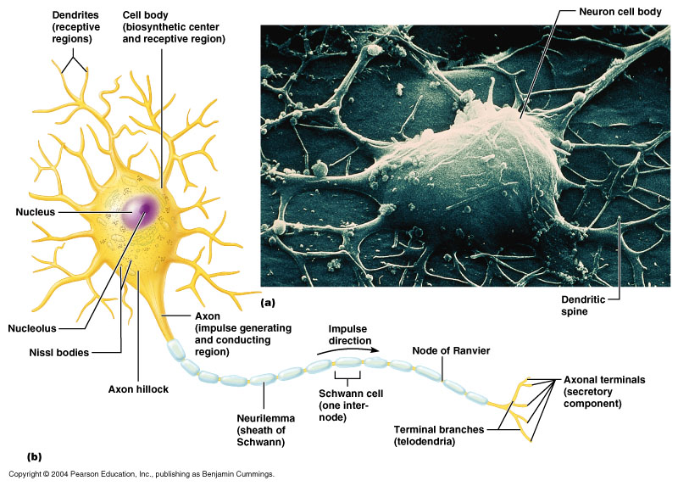
Marieb 11.4

Slide 23
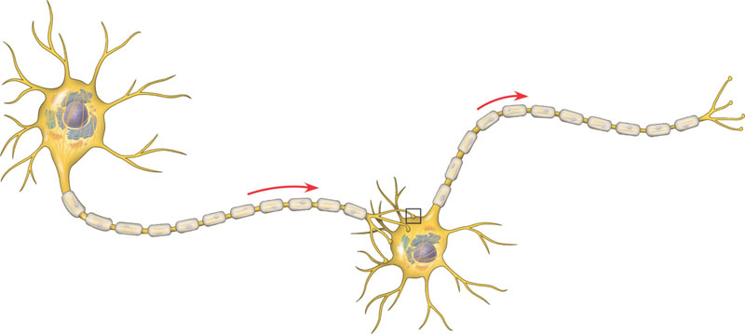
Dendrites
Cell body
Nucleus
Synapse
Signal direction
Axon
Axon hillock
Presynaptic cell
Postsynaptic cell
Myelin sheath
Axon terminals
Campbell 48.5

Slide 24
Saltatory Conduction

Slide 82
Cerebrum
Largest part of brain
Divided by deep cleft, the longitudinal cerebral fissure, into right and left cerebral hemisphere each containing lateral ventricles.
Deeply, are connected by the mass of White Matter called corpus collasum.
Falx celebrity of dura matter separate two cerebral hemisphere and prnetrates to the depth of corpus collasum.

Slide 83
Superficial part – nerve cell bodies ( grey matter), cerebral cortex
Deeper layers –nerve fibers ( axons, white matter)
Cerebral tracts and basal ganglia
Lobes of cerbrum are connected by masses of nerve fibers or tracts.
The efferent and afferent part Linking brain and spinal cord Are as follows: -
Association tracts
Commisurial tracts
Projection tracts

Slide 84
Basal ganglia
Group of cell bodies lie deep in brain
They act as relay station with connection to many parts of the brain including motor areas of the cerebral cortex and thalamus
Its function includes initiation and fine control of complex movement and learned activities, such as posture and walking..
Movement is Uncorddinated when control is inadequate. Or absent.

Slide 85
Functions of cerebral cortex
Higher order function-mental activities involved in memory, sense of responsibility, thinking, reasoning, moral decision making and learning.
Sensory perception, including the perception of pain, temperature, touch, sight hearing, taste and smell
Initiation and control of skeletal muscle contraction and therefore voluntary movement..

