Slide 1
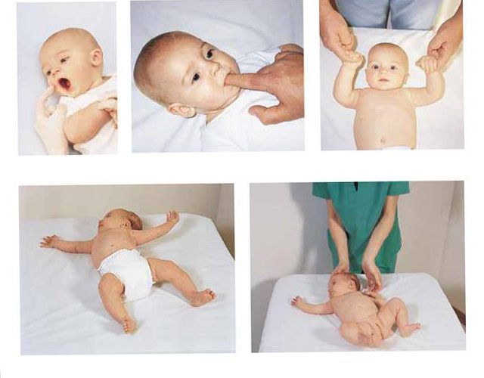
NEWBORN REFLEXES OR PRIMITIVE REFLEXES

Slide 2
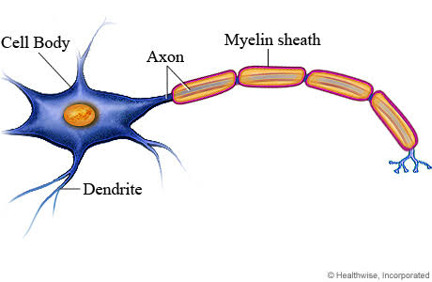

Slide 3
PRIMITIVE REFLEXES
Primitive reflexes are reflex actions originating in the central nervous system that are exhibited by normal infants, but not neurologically intact adults.

Slide 4
Assessment of Reflexes in the Newborn
1. LOCALIZED
Blinking or corneal reflex
Pupillary reflex
Dolls eye reflex
2. NOSE
Sneezing reflex
Glabellar reflex
3. MOUTH & THROAT
Sucking reflex
Swallowing reflex
Gag reflex
Rooting reflex
Extrusion reflex
Yawn reflex
Cough reflex
Perez reflex

Slide 5
4. EXTREMITIES
Grasp reflex (palmar & plantar grasp)
Babinski reflex
5. MASS
Moro reflex
Tonic neck reflex
Galant or trunk incurvation reflex
Dancing or stepping reflex
Crawling reflex
Parachute reflex
Landau reflex

Slide 6
1. BLINKING OR CORNEAL REFLEX
Infants blinks at sudden appearance of a bright light or at approach of an object toward cornea
Protection of the eyes by rapid eyelid closure
Persists throughout life

Slide 7
2.PUPILLARY REFLEX
Pupil constricts when a bright light shines toward it.
Persists throughout life

Slide 8
3.Dolls eye reflex
when a baby is lying on her back, if head is turned from side to side, her eyes remain fixed towards that side.
Disappears between 2-4 months of age

Slide 9
4.Sneezing reflex
Sneezing is a spontaneous response of nasal passages to irritation or obstruction
Persists throughout life

Slide 10
5.Glabellar reflex
Tapping briskly on glabella (bridge of nose) causes eyes to close tightly (blink) in response to first several steps
Persists throughout life

Slide 11
6.Sucking reflex
Touching the lips with the nipple of the breast or bottle or other object

Slide 12
7.Swallowing reflex
Food reaching the posterior of the mouth is swallowed
Persists throughout life

Slide 13
8. Gag reflex
The gag reflex, also known as the pharyngeal reflex or laryngeal spasm.
The reflex helps prevent choking.
Does not disappear

Slide 14
9.ROOTING REFLEX
Touching or stroking the cheek near the corner of the mouth
Head turns in direction of stimulation so that the neonate can find food.
Disappears around 3 to 4 months

Slide 15
10. EXTRUSION REFLEX (learning to swallow)
Substance placed on anterior position of tongue.
Disappears about 4 months

Slide 16
11.YAWN REFLEX
Yawning is a spontaneous response to decreased oxygen.
Occurs before and after sleep
Persists throughout life

Slide 17
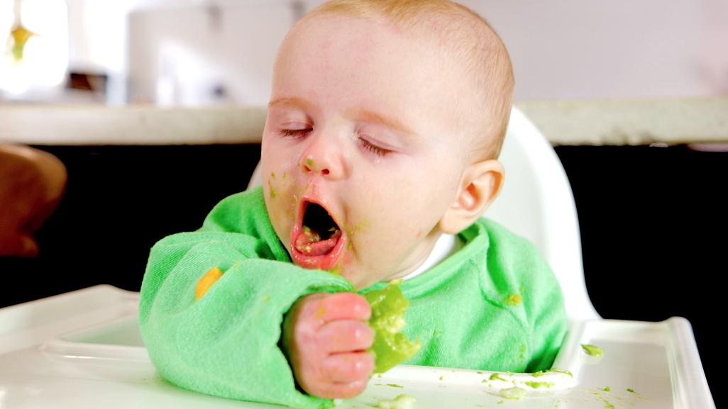
12.COUGH REFLEX
Foreign substances entering the lower airways .
Does not disappear

Slide 18
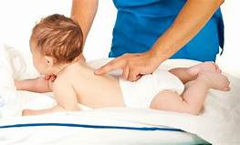
13. PEREZ REFLEX
While infant is prone on a firm surface thumb is pressed along spine from sacrum to neck.
Infants responds by crying, flexing extremities and elevating head.
Disappears by age 4-6 months.

Slide 19
14. GRASP REFLEX
PALMAR GRASP
Objects placed in newborn’s palm
Grasping of object by closing fingers around it.
No palmar grasp indicates spasticity
Disappears around 6 months
PLANTAR GRASP
Touching the sole of the foot at the base of the toes
Toes grasp around very small object
Disappears about 8-9 months

Slide 20
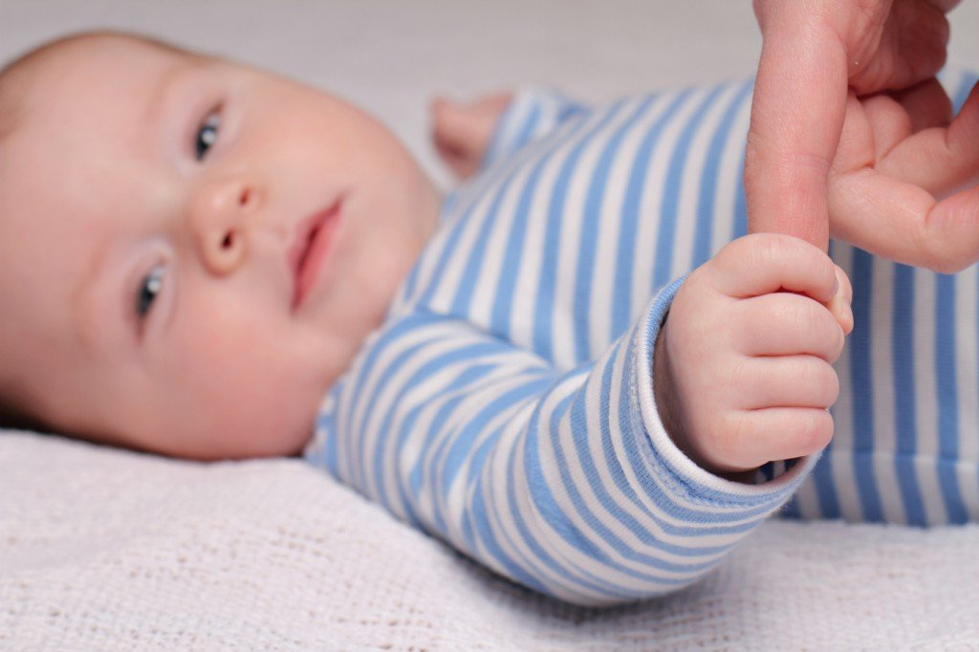
PALMAR GRASP
PLANTAR GRASP

Slide 21
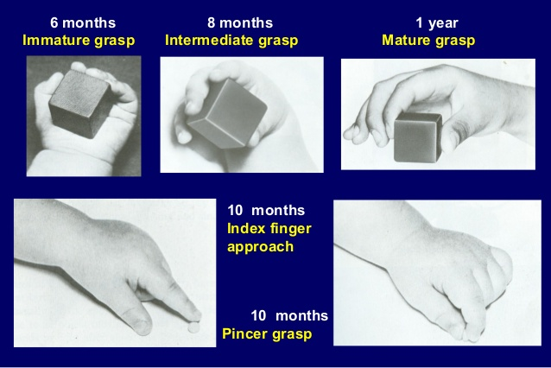

Slide 22
15.BABINSKI REFLEX
Stroking the lateral aspect of the sole of the foot with a sharp object (finger nail) from the downward to upward.
Disappears at 3 months of age.

Slide 23
BABINSKI REFLEX

Slide 24
16. MORO REFLEX (Startle Reflex)
Startling the newborn with a loud voice or apparent loss of support due to a change in equilibrium
Symmetric abduction and extension of the arms and legs with fanning of the fingers
The thumb and index finger on each hand form a “c” shape
Disappears by 3-4 months

Slide 25
17.ASYMMETRIC TONIC NECK REFLEX
Turning the head quickly to one side while the infant is supine.
Arm and leg on the side the head is turned toward extend
Disappears by 6-7 months of age

Slide 26
18.GALANT OR TRUNK INCURVATION REFLEX
It is elicited by holding the newborn in ventral suspension (face down) and stroking along the one side of the spine.
The normal reaction is for the newborn to laterally flex toward the stimulated side.
Disappears between 1 – 3 months

Slide 27
19.DANCING OR STEPPING REFLEX
Hold neonate in a vertical position with the feet touching a flat, firm surface
Disappears approximately 2 months of age

Slide 28
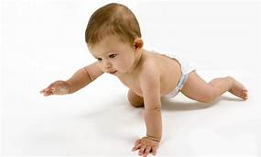
20. CRAWLING REFLEX
This reflex can be stimulated by placing the neonate prone position on a flat surface.
The neonate will attempt to crawl forward using the arms and legs
Disappears around 3–4 months of age

Slide 29
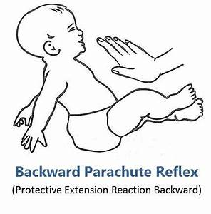
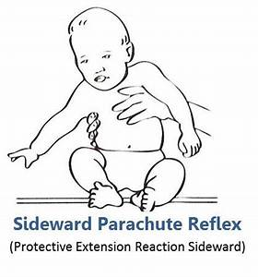

Slide 30
22. LANDAU REFLEX
It refers to position of the infant when held horizontally in the air in the prone position.
Head, legs and spine extended
It emerges 3 months after birth and lasts until up to 12 months to 24 months of age.
Absence of reflex occurs in mental abnormalities

