Slide 1
Vital Signs

Slide 2
Vital Signs
Body temperature, pulse, respirations, and Blood Pressure
Monitor functions of the body
Should be a thoughtful, scientific assessment

Slide 3
When to Assess Vital Signs
On admission
Change in client’s health status
Client reports symptoms such as chest pain, feeling hot, or faint
Pre and post surgery/invasive procedure
Pre and post medication administration that could affect CV system
Pre and post nursing intervention that could affect vital signs

Slide 4
Body Temperature
Reflects the balance between the heat produced and the heat lost from the body
Measured by heat units called degrees

Slide 5
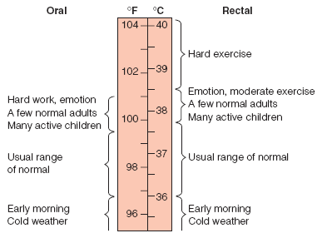
Factors Affecting Body Temperature
Age
Diurnal variations (circadian rhythms)
Exercise
Hormones
Stress
Environment

Slide 6
Alterations in Body Temperature
Pyrexia, Hyperthermia, Fever
body temperature above the usual range
Febrile
a client who has a fever
Afebrile
a client who does not have fever
Hypothermia
core body temperature below the lower limit of normal

Slide 7
Pulse
Is a wave of blood created by contraction of the left ventricle of the heart
Represents the amount of blood that enters the arteries with each ventricular contraction
Peripheral pulse- a pulse located away from the heart Ex. Foot or wrist
Apical pulse- is the central pulse that is located at the apex of the heart

Slide 8
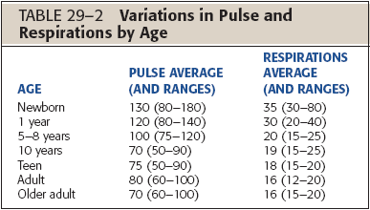
Factors Affecting Pulse
Age
Gender
Exercise
Fever
Medications
Hypovolemia
Stress
Position changes
Pathology

Slide 9
Factors Affecting Respirations
Exercise
Stress
Environmental temperature
Medications

Slide 10
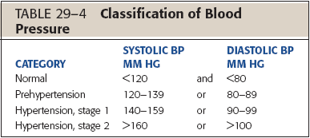
Factors Affecting Blood Pressure
Age
Exercise
Stress
Race
Gender
Medications
Obesity
Diurnal variations
Disease process

Slide 11
Temperature: Lifespan Considerations
Infants
Children Elders
Unstable
Newborns must be kept warm to prevent hypothermia
Tympanic or temporal artery sites preferred
Tends to be lower than that of middle-aged adults

Slide 12
Pulse: Lifespan Considerations
Infants
Children
Elders
Newborns may have heart murmurs that are not pathological
The apex of the heart is normally located in the fourth intercostal space in young children; fifth intercostal space in children 7 years old and older
Often have decreased peripheral circulation

Slide 13
Respirations: Lifespan Considerations
Infants
Children Elders
Some newborns display “periodic breathing”
Diaphragmatic breathers
Anatomic and physiologic changes cause respiratory system to be less efficient

Slide 14
Blood Pressure: Lifespan Considerations
Infants
Children Elders
Arm and thigh pressures are equivalent under 1 year of age
Thigh pressure is 10 mm Hg higher than arm
Client’s medication may affect how pressure is taken

Slide 15
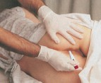
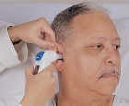
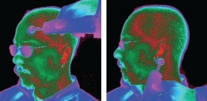
Sites for Measuring Body Temperature
Oral
Rectal
Axillary
Tympanic membrane
Skin/Temporal artery

Slide 16
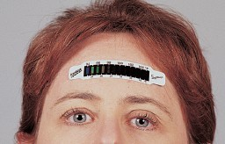
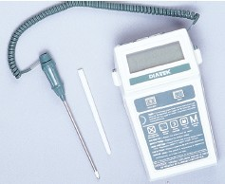
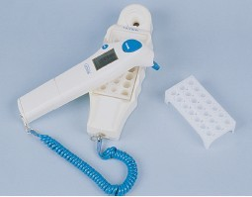
Types of Thermometers
Electronic
Chemical disposable
Infrared (tympanic)
Scanning infrared (temporal artery)
Temperature-sensitive tape
Glass mercury

Slide 17
Nursing Care for Fever
Monitor vital signs
Assess skin color and temperature
Monitor laboratory results for signs of dehydration or infection
Remove excess blankets when the client feels warm
Provide adequate nutrition and fluid
Measure intake and output
Reduce physical activity
Administer antipyretic as ordered
Provide oral hygiene
Provide a tepid sponge bath
Provide dry clothing and bed linens

Slide 18
Nursing Care for Hypothermia
Provide warm environment
Provide dry clothing
Apply warm blankets
Keep limbs close to body
Cover the client’s scalp
Supply warm oral or intravenous fluids
Apply warming pads

Slide 19
Pulse Sites
Readily accessible
When radial pulse is not accessible
During cardiac arrest/shock in adults Determine circulation to the brain Infants and children up to 3 years of age
Discrepancies with radial pulse Monitor some medications
Radial
Temporal
Carotid
Apical

Slide 20
Pulse Sites
Brachial
Femoral
Popliteal Posterior tibial Dorsalis pedis
Blood pressure
Cardiac arrest in infants
Cardiac arrest/shock
Circulation to a leg; Circulation to lower leg Circulation to the foot
Circulation to the foot

Slide 21
Characteristics of the Pulse
Rate
tachycardia- over 100 BPM bradycardia- less than 60 BPM
Rhythm
dysrhytmia or arrhythmia- irregular pulse
Volume
force of blood with each beat absent to bounding
Arterial wall elasticity
Bilateral equality

Slide 22
Pulse Rate and Rhythm
Rate
Beats per minute
Tachycardia
Bradycardia
Rhythm
Equality of beats and intervals between beats
Dysrhythmias
Arrhythmia

Slide 23
Characteristics of the Pulse
Volume
Strength or amplitude
Absent to bounding
Arterial wall elasticity
Expansibility or deformity
Presence or absence of bilateral equality
Compare corresponding artery

Slide 24
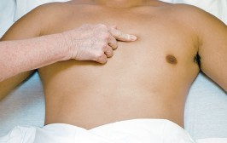
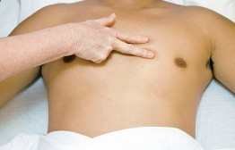
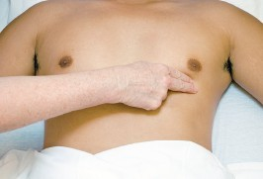
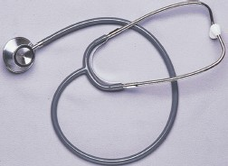
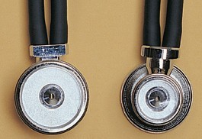
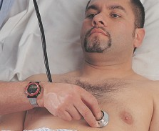
Measuring Apical Pulse

Slide 25
Apical-Radial Pulse
Locate apical and radial sites
Two nurse method:
Decide on starting time
Nurse counting radial says “start”
Both count for 60 seconds
Nurse counting radial says “stop”
Radial can never be greater than apical

Slide 26
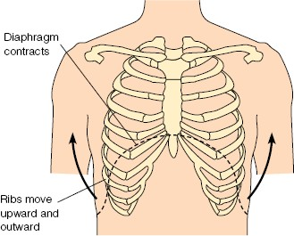
Inhalation
Diaphragm contracts (flattens)
Ribs move upward and outward
Sternum moves outward
Enlarging the size of the thorax

Slide 27
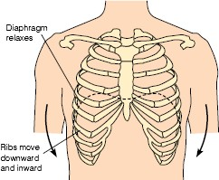
Exhalation
Diaphragm relaxes
Ribs move downward and inward
Sternum moves inward
Decreasing the size of the thorax

Slide 28
Respiratory Control Mechanisms
Respiratory centers
Medulla oblongata
Pons

Slide 29
Components of Respiratory Assessment
Rate
Depth
Rhythm
Quality
Effectiveness

Slide 30
Respiratory Rate and Depth
Rate
Breaths per minute
Apnea – absence of breathing
Bradypnea- abnormally slow respirations
Tachypnea- abnormally fast respirations
Depth
Normal
Deep
Shallow

Slide 31
Components of Respiratory Assessment
Rhythm
Regular
Irregular
Quality
Effort
Sounds
Effectiveness
Uptake and transport of O₂
Transport and elimination of CO₂

Slide 32
Alteratered Breathing Patterns
Rate
Tachypnea – quick, shallow breaths
Bradypnea- abnormally shallow breathing
Apnea- absence or cessation of breathing
Volume
-Hyperventilation- overexpansion of the lungs characterized by rapid and deep breaths
-Hypoventilation- underexpansion of the lungs characterized by shallow respirations

Slide 33
Alteratered Breathing Patterns
Rhythm
Cheyne- Stroke breathing- rhythmic waxing and waning of respirations, from very deep to very shallow breathing and temporary apnea
Ease or Effort
Dyspnea- difficult and labored breathing during which the individual has a persistent, unsatisfied need for air and feels distressed
Orthopnea- ability to breathe only in upright sitting or standing positions

Slide 34
Alteratered Breath Sounds
Stridor – a shrill, harsh sound heard during inspiration with laryngeal obstruction
Wheeze- continuous, high pitched musical squeak or whistling sound occuring on expiration

Slide 35
Systolic and Diastolic Blood Pressure
Systolic
Contraction of the ventricles
Diastolic
Ventricles are at rest
Lower pressure present at all times
Pulse Pressure = difference between systolic and diastolic pressures
Measured in mm Hg
Recorded as a fraction, e.g. 120/80
Systolic = 120 and Diastolic = 80

Slide 36
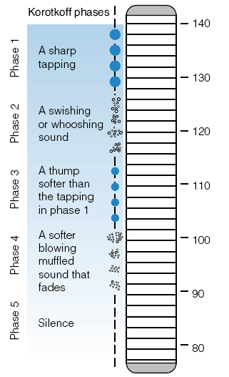
Korotkoff’s Sounds

Slide 37
Korotkoff’s Sounds
Phase 1
First faint, clear tapping or thumping sounds
Systolic pressure
Phase 2
Muffled, whooshing, or swishing sound

Slide 38
Korotkoff’s Sounds
Phase 3
Blood flows freely
Crisper and more intense sound
Thumping quality but softer than in phase 1
Phase 4
Muffled and have a soft, blowing sound
Phase 5
Pressure level when the last sound is heard
Period of silence
Diastolic pressure

Slide 39
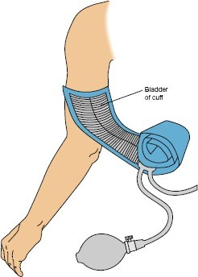
Measuring Blood Pressure
Direct (Invasive Monitoring)
Indirect
Auscultatory
Palpatory
Sites
Upper arm (brachial artery)
Thigh (popliteal artery)

Slide 40
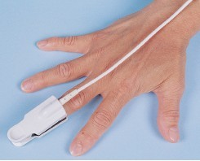
Pulse Oximetry

Slide 41
Pulse Oximetry
Noninvasive
Estimates arterial blood oxygen saturation (SpO₂)
Normal SpO₂ 85-100%; < 70% life threatening
Detects hypoxemia before clinical signs and symptoms
Sensor, photodetector, pulse oximeter unit

Slide 42
Pulse Oximetry
Factors that affect accuracy include:
Hemoglobin level
Circulation
Activity
Carbon monoxide poisoning

