Slide 1
COMPLEMENTARY FEEDING

Slide 2
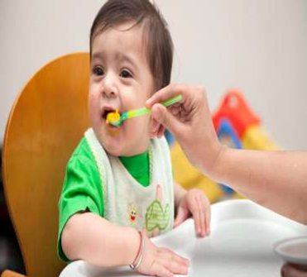
INTRODUCTION
Breast feeding alone is adequate to maintain growth and development up to 6 months. And complementary feeding should be given to maintain their growth and development according to age.

Slide 3
DEFINITION-
Complementary feeding or weaning is the process of giving an infant other foods and liquids along with breast milk after the age of 6 months as breast milk alone is no longer sufficient to meet the nutritional requirements of growing baby.

Slide 4
PRINCIPLES OF INTRODUCING SUPPLEMENTARY FOOD Start with soup , vegetable soup or juice of fresh fruits & vegetables which are available & are inexpensive. This may include oranges , apple, tomato’s etc. Sweeten the juice by adding sugar , if necessary. Start with small quantity & when the child tolerates, the quantity should be increased gradually. Offer one new food at a time at an interval of 1 week

Slide 5
5) When starting with egg , it should be soft boiled , first give only the yolk; when the child tolerates , white of an egg can also be given. 6) When starting vegetables , they should be cooked either by boiling and feed the baby. 7) When starting with foods such as banana , guava , apple, chiku etc. this should be ripped. 8) When starting with cereals and pulses they should be well cooked, khichdi, khir ,soft boiled rice , soft dal. Baby foods available in the market are expensive , so fresh food prepared at home should be preferred.

Slide 6
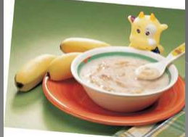
9) This solids should be given before the breast feed. 10) Increase all the solids until the child takes good 4 to 5 meals a day, which are usually cooked for the family. 11) The mother must find time and spend time to feed the baby.
12)She must wash hands ,use clean utensils while preparing the feed, while serving& feeding the child.

Slide 7
Why start at six month
-Infant’s intestinal tract develops immunologically with defence mechanisms to protect the infant from foreign proteins.
· The infant’s ability to digest and absorb proteins, fats, and carbohydrates, other than those in breast milk increases rapidly.
· The infant’s kidneys develop the ability to excrete the waste products.  The infant develops the neuromuscular mechanisms needed for recognizing and accepting variation the taste and color of foods.

Slide 8
What are the sign that baby is ready for complementary food
Hold his/her head straight when sitting down.
· Opens his/her mouth when others eat
· Is interested in foods when others eat.
· Receives frequent breast feed but appear hungry soon after.
· Is not gaining weight adequately.

Slide 9
Preparation for weaning food
Wash hands.
· Keep food in clean utensils.
· Cook food thoroughly.
· Keep food at safe temperatures.
· Use safe water.
· Give freshly prepared food.
· Keep the cooked food covered.

Slide 11
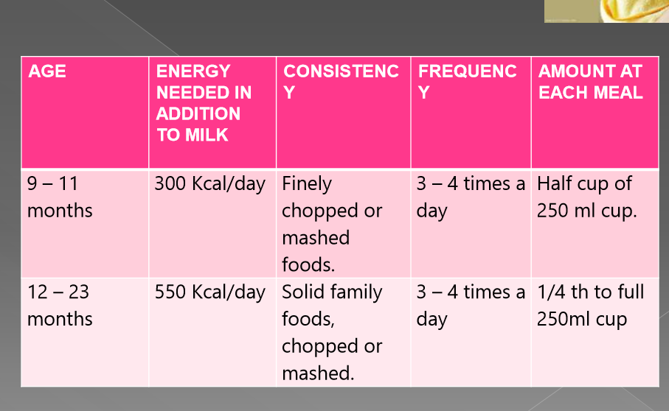

Slide 15
THANK
YOU

