Slide 1
BREAST FEEDING
PREPARED BY:
JIGISHA CHAUDHRI
CHILD HEALTH NURSING

Slide 2
DEFINITION
Breastfeeding is the feeding of an infant or young child with breast milk directly from female human breasts not from a baby bottle or other container.

Slide 3
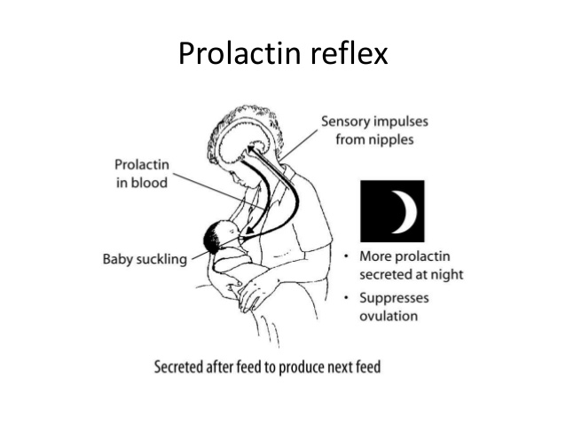
MILK EJECTION REFLEX
The Prolactin Reflex:
1. Nerve impulses from sucking
go to brain.
2. The pituitary gland releases
prolactin hormone into the blood.
3. This causes the alveolar cells
to secrete milk and swells the
alveoli.

Slide 4
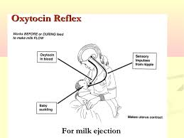
CONTI….
Milk Ejection Reflex:
1. Nerve impulses from sucking go
to the brain.
2. The pituitary gland releases
oxytocin into the bloodstream.
3.. This causes muscles around the
alveoli in the breast to squeeze milk
to the nipple

Slide 5
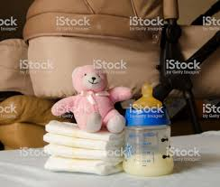
COMPOSITION OF BREAST MILK
COLOSTRUM:
It is secreted during first three days
After delivery.
It is thick, yellow.
It contains fat soluble vitamins.

Slide 6
CONTI….
TRANSITIONAL MILK:
It secrete during first 2 weeks of postnatal periods.
It has increased fat and sugar content and decreased protein.
MATURE MILK:
It secrete from 10-12 days after delivery. It is watery but contains all nutrients for optimal growth of the baby.

Slide 7
CONTI….
PRETERM MILK:
The breast milk secreted by a mother who has delivered a preterm baby.
This milk contains more proteins, iron, immunoglobulins and calorie appropriate for the requirements of the preterm neonates.
FOREMILK: It is secreted at the starting of the regular breastfeeding, it is more watery to satisfy the thirst of the baby.

Slide 8
CONTI….
HIND MILK:
It is secreted at the end of regular breastfeeding and contains more fat & energy.

Slide 9
BENEFITS OF BREASTFEEDING TO MOTHER
This promotes mother and child bonding
It prevent uterine bleeding in the mother after delivery.
This is a natural form of Family Planning.
This reduces the risks of breast and ovarian cancer.
This saves time and expenses .

Slide 10
BENEFITS BREASTFEEDING FOR BABY
This provides the best possible nutrition to the child.
It reduces the incidence of all the infections.
It is essential for the optimal physical, emotional and mental development of the child.
Breast milk is easily digestable.
It contain IgA, IgM.

Slide 11
10 STEPS TO SUCCESSFUL BREASTFEEDING
1. Have a written breastfeeding policy that is routinely communicated to all health care staff.
2. Train all health care staff in skills necessary to implement this policy.
3. Inform all pregnant women about the benefits of breastfeeding.
4. Help mothers initiate breastfeeding within half an hour of birth.
5. Show mothers how to breastfeed the baby.

Slide 12
CONTI….
6.Give newborn infants no food or drink other than breast milk, unless medically indicated.
7.Practise rooming-in - that is, allow mothers and infants to remain together - 24 hours a day.
8.Encourage breastfeeding on demand.
9.Give no artificial pacifiers.
10.Foster the establishment of breastfeeding on discharge from the hospital or clinic.

Slide 13
PROPER LACTATION
Baby open the mouth wider.
The chin touching the breast.
The breast looked full and round.
Can hear the sound suck and swallow

Slide 14
INDICATORS OF ADEQUACY OF BREASTFEEDING
Audible swallowing sound during the feed.
Breast is full before feed and softer afterward.
Wet nappies 6 or more in 24 hours.
Average weight gain is 18-30 gm per day.
Sleep well & does not cry frequently.

Slide 15
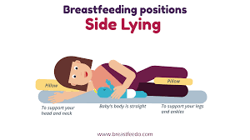
SIDE LYING POSITION

Slide 16
CRADLE POSITIONING

Slide 17
CONTRAINDICATIONS
Active /untreated TB
Mother takes radioactive compound(cancer for chemo)
Mother take illegal drug
HIV infection

Slide 18
PROBLEMS OF BREASTFEEDING
INVERTED NIPPLE:
Treatment should be started after the birth of the baby.
A plastic syringe is used.

Slide 19
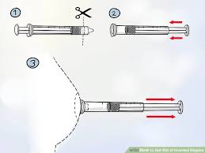

Slide 20
THANK YOU

