Slide 1
UNIT – 9
MACHINERY, EQUIPMENTS
AND
LINEN

Slide 2
LINENS
In simple words, linen is a fabric made from fibres of flax plant. It includes clothes, sheet, etc. In hospital setting, linens are used for many purposes: covering the bed, client, articles.

Slide 3
Following is the list of linen used in hospital setting:
Bed sheets: bottom and top, draw sheets, pack sheet
Blankets
Curtains
Cloth covers: pillows, mattress, hot water bottles, ice collar, ice cap, air cushion, inhaler cover, and sand bag cover.
Towels: bath, hand, dressing, , treatment, doctor’s towel

Slide 4
Wrappers for the tray, dressing set, gloves, syringes.
Client’s clothes: mask, cap, gown, shirt, pyjama.
Binders, Bandages
Restraints – Elbow, Jackets.
Dusters, Mittens
Others: Diet napkins, tray covers

Slide 9
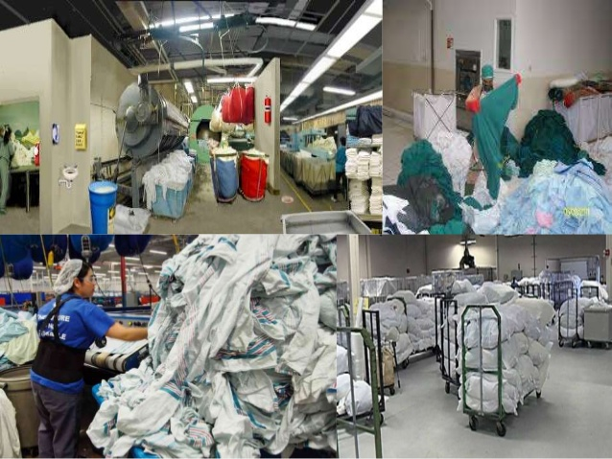

Slide 10
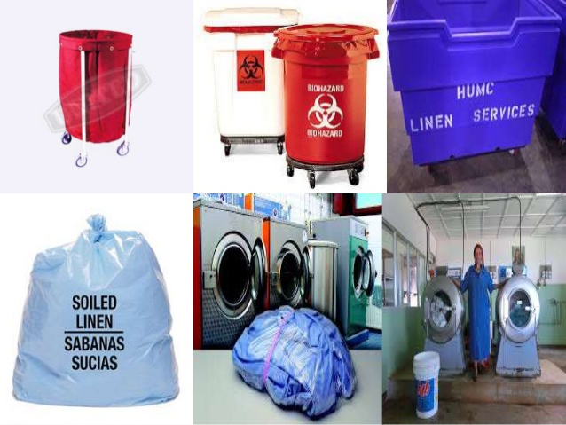

Slide 11
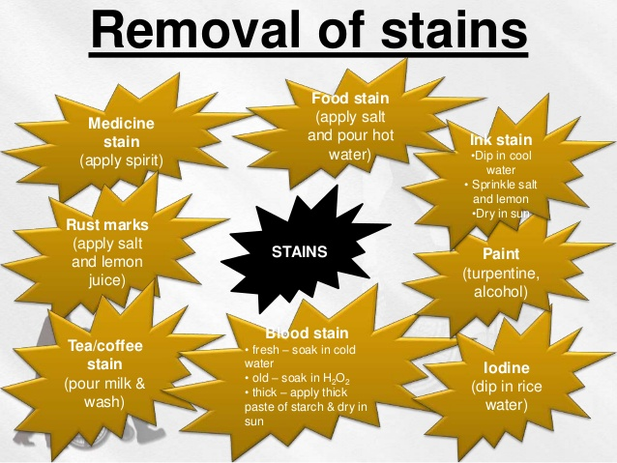

Slide 25
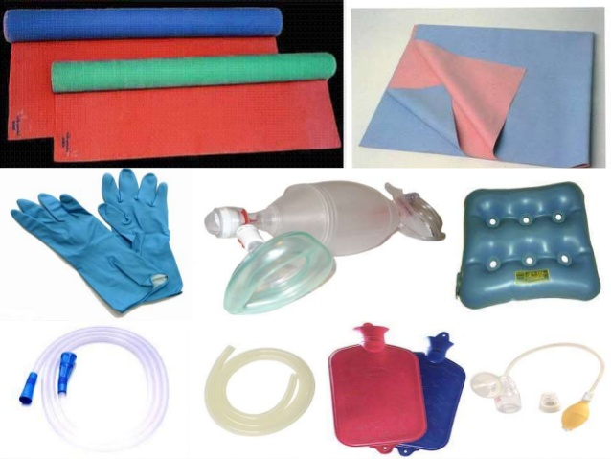

Slide 44
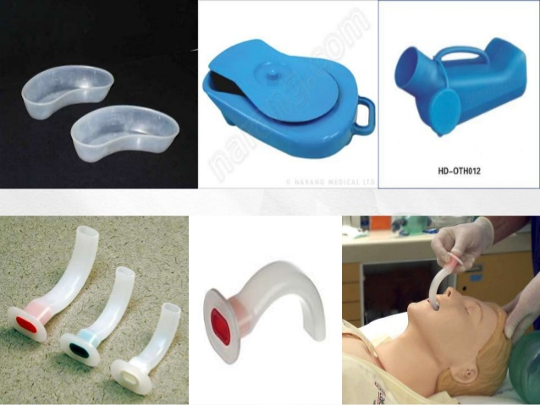

Slide 49
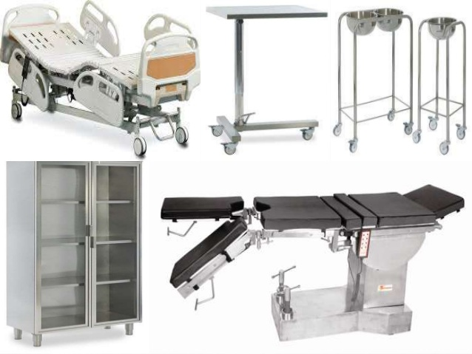

Slide 50
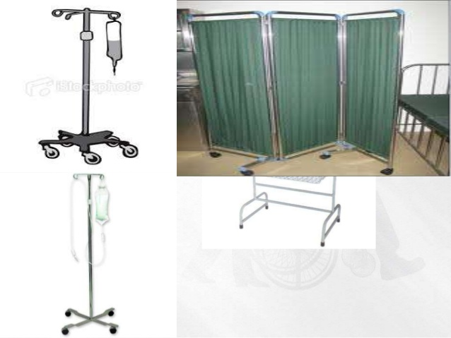

Slide 53
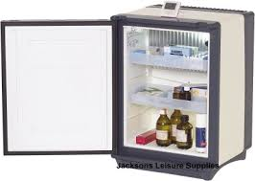
Care and Monitoring of Refrigerators
and Freezers
Cleaning of refrigerator in hospital is done same way as done in home setting/instructions in given by company.

Slide 54
Following points need more attention:-
1) Empty and clean it twice a month. If get soiled, must be cleaned immediately.
2) Discard unsent blood samples, expired blood products, open medications (if the client is discharged)
3) Do not keep eatables in the refrigerator containing pathological products (Eatables provide conductive environment for growth of microorganisms)
4) Label client’s name, age, gender over the item kept in refrigerator.
5) Ensure working condition of refrigerator.

Slide 58
