Slide 1
BRAIN STEM

Slide 2
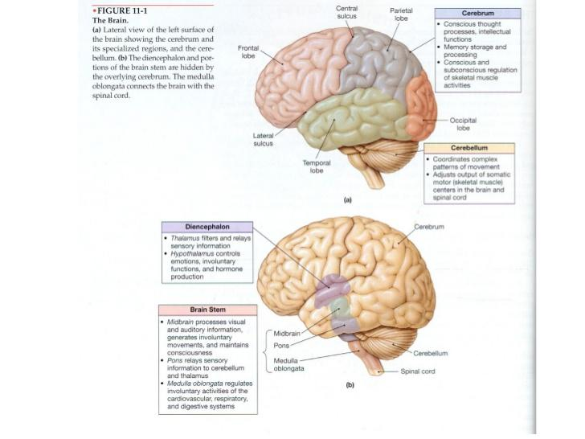

Slide 4
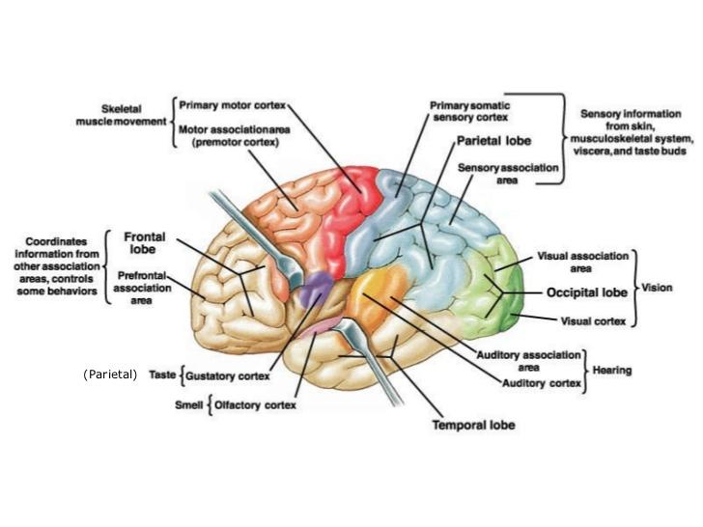

Slide 5
Midbrain
Area of the brain situated around the cerebral aqueduct between the cerebrum above and the pons below.
It consists of nuclie and nerve fiber which connect the cerebrum with lower parts of the brain and spiral cord.
The nuclei act as relay station for the ascending and descending nerve fibers and have important roles in auditory and visual reflexes.

Slide 6
Pons
It is situated in front of the cerebellum, below the midbrain and above the medulla oblangata.
It consists mainly of nerve fibers that form the bridge between the two hemispheres of the cerebellum, and of fibres passing between the higher levels of brain and spinal cord.
There are nuclie within the pond that act as relay station, others form the pneumotaxic and apnoustic centres that operate in conjunction with the respiratory center in the medulla oblangata to control respiration.
Anotomical structure of pons differs from that of the cerebrum in that the cell bodies (grey matter) lie deeply and nerve fibers are on the surface.

Slide 7
Medulla oblangata
The medulla oblangata, or simply the medulla, is the most interior region of the brain stem
It is about 2.5 CM Long and lies just within the cranium above the foramen magnum.
The outer aspect is composed of white matter, which passes between the brain and the spinal cord, and, grey matter, which lies centrally.
Some cells constitute relay stations for sensory nerves passing from spinal cord to cerebrum
The vital centers, consisting of group ofcell bodies (nuclie) associated with autonomic reflex activity, lie in deeper structure.

Slide 8
Cardiovascular center
Respiratory center
Reflex centers of vomiting, coughing, sneezing, and swallowing.

Slide 9
Cerebellum
It is situated behind the pons and immediately below the posterior portion of the cerebrum occupying the posterior portion of cranial fossa.
Its is oviod in shape and has two hemispheres, separated by a narrow median strip called the vermis.
Grey matter forms the cerebellum, and the white matter lies deeply.

Slide 11
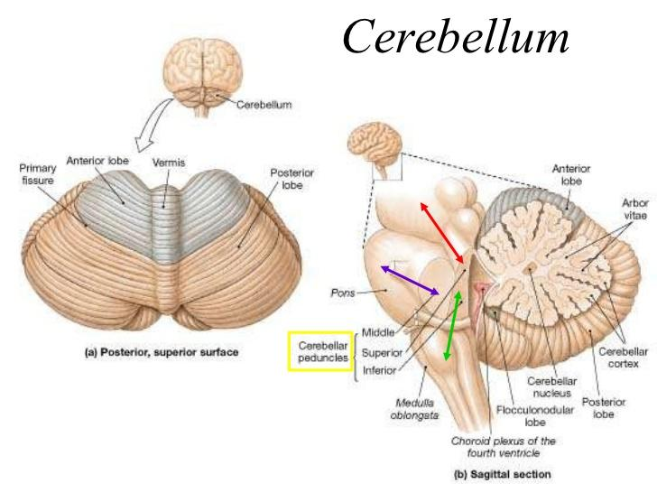

Slide 12
Spinal cord

Slide 13
The spinal cord is the elongated almost cylindrical part of the central nervous system which is suspended in the vertebral Canal surrounded by the meninges and CSF .
The spinal cord is continuous about with medula oblongata and extends from the upper border of the Atlas to the lower border of first lumbar vertebra.
It is approximately 45 cm long in adult males and is about thickness of little finger
Some activities of the spinal cord are independent of the brain and controlled at the level of spinal cord by spinal reflexes.
The spinal cord is incompletely divided into two equal parts anteriorly by a short, shallow median fissure and posteriorly by a deep narrow septum the posterior medium septum.

Slide 14
The cross section of the spinal cord shows that it is composed of Grey matter in the centre surrounded by white matter supported by neurologia.
Grey matter
The arrangement of Grey matter in the spinal cord resembles the shape of letter h having two posterior to interior and two little columns .
The nerve cell bodies may belong To: -
Sensory neurones which receive impulses from the Periphery of the body2
lower motor neurones impulses to the skeletal muscles
Connector neurones linking sensory and motor neurones.

Slide 15
Posterior columns of grey matter
These are composed of cell bodies that are stimulated by sensory impulses from the Periphery of the body the nerve fibres of these cells contribute to the white matter of the chord and translate the sensory impulses upwards to the brain.
Anterior columns of Grey matter
These are composed of cell bodies of the lower motor neurones that are stimulated by the upper motor neurone Or the connecter neurones linking the anterior and posterior columns to form reflex arc.
The Posterior root( spinal )ganglia form by the cell bodies of the sensory nerves

