Slide 1
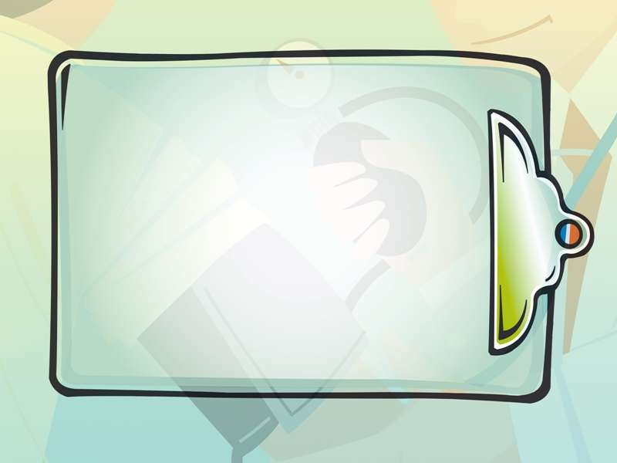





Slide 2
What is it?
–the process of placing a soft plastic or rubber nasogastric (NG) tube through a patient's nostril, past the pharynx and down the esophagus into a patient's stomach.

Slide 3
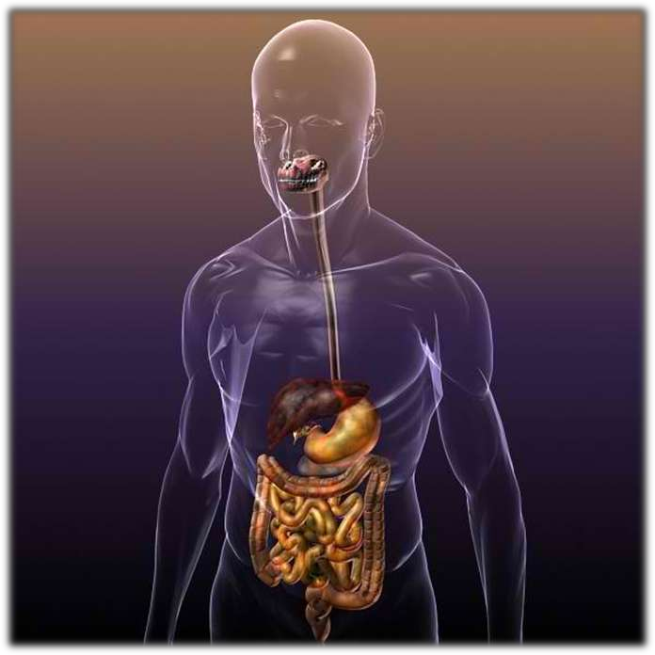

Slide 4
Indication
-Unable to chew , ingest and swallow
To weak to swallow food
Surgery of mouth , throat and esophagus
Paralysis of face
Fracture of jaw’
Head and neck injury
Coma
Refuse food

Slide 5
contraindication
Gastric surgery
Ulcers
Oesophagus surgery
Polyps in nose

Slide 6



Slide 7
Preparatio n

Slide 8
Equipment:
Nasogastric tube
Water-soluble lubricant
Glass of water with straw
(or ice chips)
Towel
Tissues
Emesis basin
Bulb or 50 ml catheter-tip
syringe

Slide 9
Blue litmus strip
Hypoallergenic tape
Safety pin
Stethoscope
Clamp

Slide 10
Explain the purpose of the tube to the patient.
deliver substances
directly into the stomach
remove substances from
testing stomach function or contents
the stomach

Slide 11
Explain the procedure to the patient.
NPO for 6 hours before
the procedure
Have the patient blow
his nose and remove
dentures if they have them

Slide 12
Ask the patient about
whether they have had sinus
problems, nasal problems such as nosebleeds or nasal surgery in the past.
Inspect and select a nostril
to use for intubation.

Slide 13


INSERTION

Slide 14
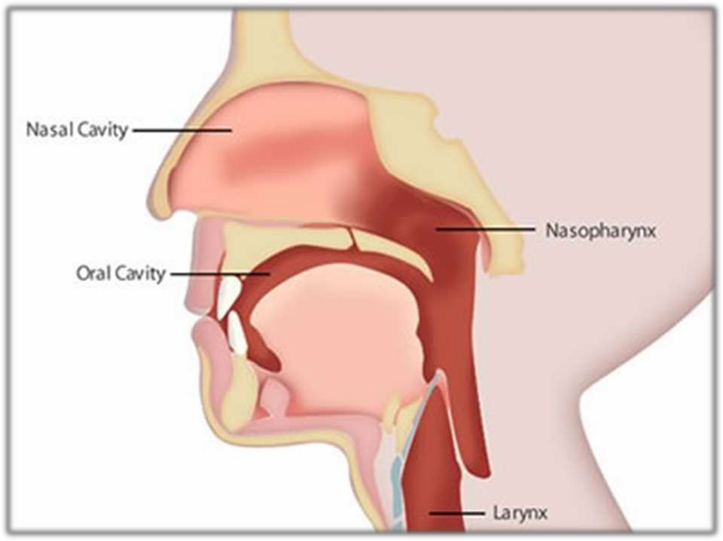

Slide 15
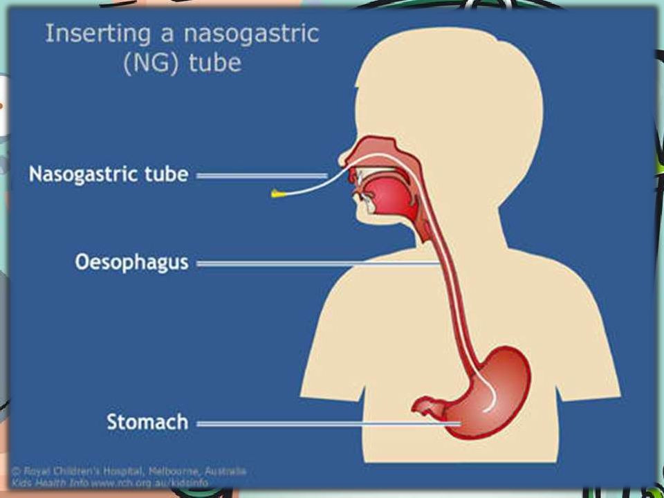

Slide 16
Confirm placement
Let patient talk
Auscultation method (15 cc
Measurement of the tube
Gastric aspiration and pH measurement (1-5 pH)
of air)
length
Chest x-ray

Slide 17
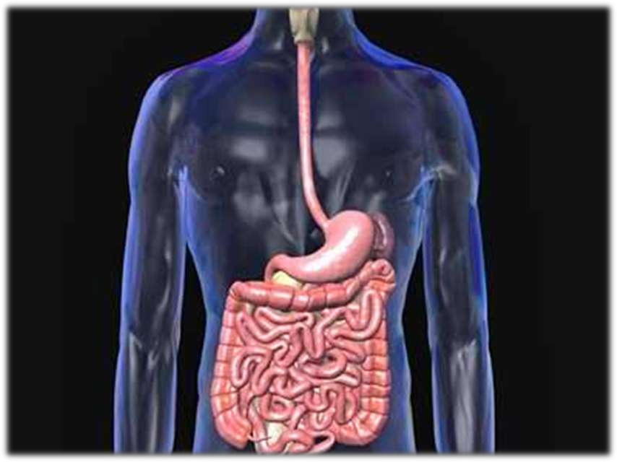

Slide 18
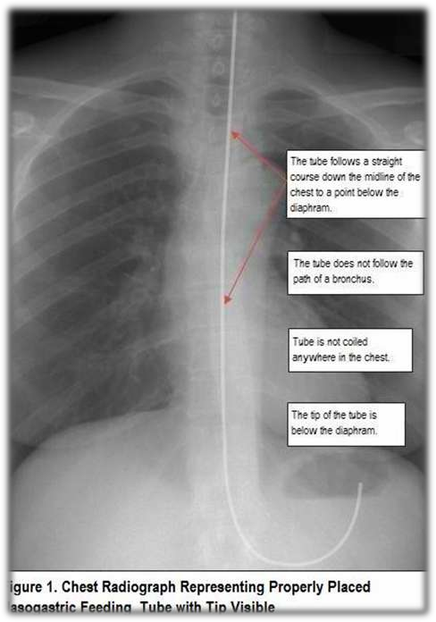

Slide 19
Securing

Slide 20
Feeding
Intermittent
200 – 350 ml for 10 – 15 minutes
6.6 pH value

Slide 21
Removal

Slide 22
Wear clean gloves.
Remove adhesive tape from the
nose and the safety pin from
gown.
Flush tube with 10 ml normal
Withraw tube gently and slowly for 15 to 20 cm until the tip
saline.
reaches the esophagus.
The remainder is withrawn
rapidly from the nostril.
As the tube is withrawn, it is
concealed in a towel.
Provide oral hygiene.

Slide 23
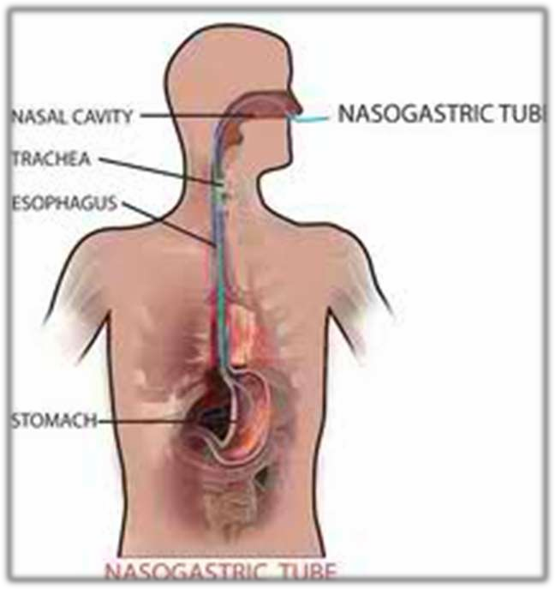

Slide 24







Slide 25


Gastric Aspirate | NORMAL | ABNORMAL | IMPLICATION
pH | 1 – 5 | or greater or greater | incorrect placement of tube
Color | no color yellow- green | coffee-bean color | may indicate bleeding
Consistency | mucoid
Amount | Female 0.2 – 3.8 mEq/hour Male 1 – 5 mEq/hour | elevated | Duodenal cancer Jejunal cancer
 |  | markedly elevated | Zollinger-Ellison syndrome
 |  | depressed | Gastric carcinoma Benign gastric ulcer
 |  | absent | Pernicious anemia

Slide 26



Slide 27
Encourage good mouth care and
cleansing the nares routinely.
Provide mouth care once per
shift, or as needed.
Coat patient’s lips with
Regularly check the tape that
petroleum jelly.
secures the tube.
Change the tape position daily
and examine the tissue around
the nose and under the tape.
Keep the head of the bed elevated
30 degrees at all times.

Slide 28
Place the head of the bed 30-45
degrees during tube feedings and
for 30-60 minutes after intermittent tube feedings if the patient can tolerate this position.
The feeding bag and tubing
should be changed usually every
24 hours to prevent bacterial contamination.
Inspect gastric drainage.

Slide 29
Nasogastric feeding

Slide 30
It is artificial method of giving fluid and nutrients through a tube that has been passed into stomach through nose.

Slide 31
Purpose :-

Slide 32





