Slide 1
Restraints
Safety devices
Mr. Jahid Noyda

Slide 2
Definition :-
These are the protective devices employed to prevent client from harming to himself or others ,
to immobilize body part ,
To restrict activity ,
To promote a feeling of security
In the client who need It.

Slide 3
Objective :-
To avoid client from injury.
To prevent interruption of therapy.
To prevent confused client from removing any
Life supportive equipment.
To reduce the risk of injury to others.

Slide 4
Types of Restraints :-
1. anklets and wristlets restraints.
2. Elbow and Knee restraints.
3. Milt restraints.
4. Body jacket , restraints.
5.Mummy restraints
6.safety belts
7. splints, plaster cast , sand bags , bandages , etc
8. environment control restraints

Slide 5
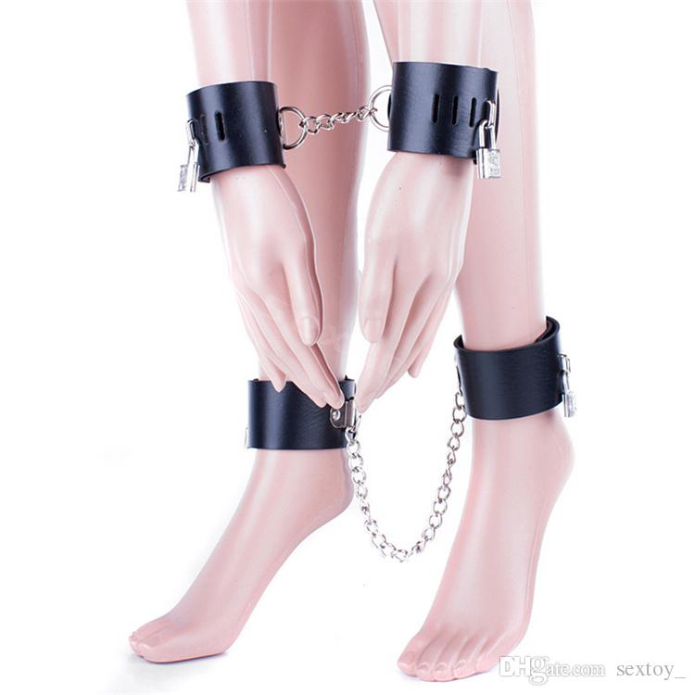
Anklets and Wristlets restraints:-
Those are used to restrict the activity of limbs in client.
To immobilise one or more limbs during procedure
ex :- violent behaviour of pt.

Slide 6
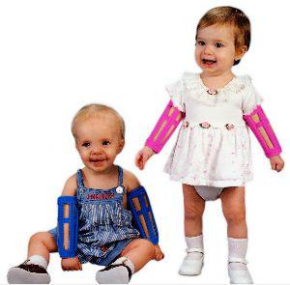
Elbow and knee restraints.
It is applied to prevent flexion of elbow and knee joint.

Slide 7
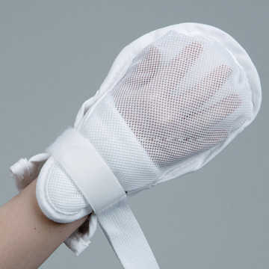
Mitt restraints
It is used for children or confused patient to prevent them using their finger or hands for removing tubes , dressing , and other appliance used in treatment.

Slide 8
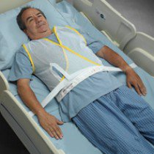
Body jackets
It is used for children and adult
Jacket restraints attached to the client’s bed frame.

Slide 9
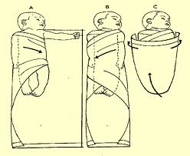
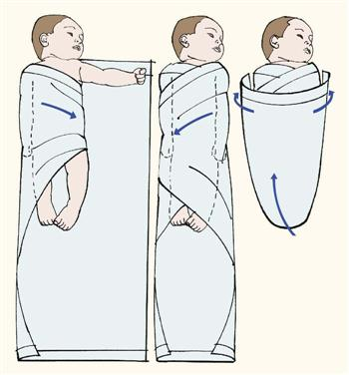
Mummy restraints
Its used to restrict the movement of limb in small child during rx.

Slide 10
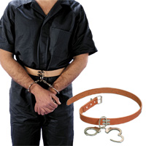
Safety belts
These are frequently used on stretchers and operation tables in orders to prevent client from falling
Belt restraints prevent the client from falling and leaving bed.

Slide 11
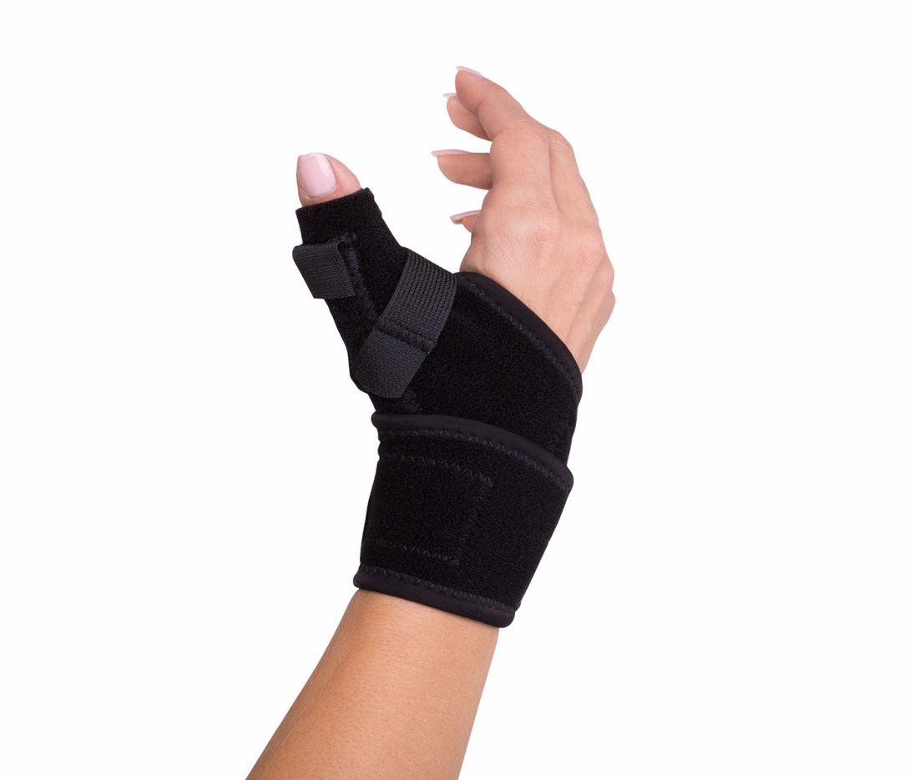
7. splints, plaster cast , sand bags , bandages , etc are used to restrict movement of different part of the body.

Slide 12
Envt control
A. side rails :- those are attached to both side of bed to prevent the client from getting out and falling out.
B. quite rooms :-
hazards free and commonly used for psychiatric pt.

Slide 13
Comfort :-
Comfort devices

Slide 14
Comfort :-
Meaning :-
Comfort is state of freedom from pain , discomfort, tension and anxiety .
Definition :-
Its defined as the contented enjoyment in physical or mental well being , freedom from pain or trouble.

Slide 15
Cause of discomfort
Pain
Restriction of movement due to weakness.
Wrinkled , soiled and wet sheets.
Delayed or inadequate to meet personal need
Lack of exercise
Extremes temperature
Too bright light
Fear due to illness

Slide 16
Insecurity feeling
Lack of sleep
Uncomfortable position
Indigestion

Slide 17
Devices promoting physical comfort
COMFORT DEVICES : comfort devices are invented article which would add to comfort of the patient when used in appropriate manner.

Slide 18
Comfort devices
Pillow
Back rest
Rolls
Foot rest
Sand bags
Air or water mattress
Rings
Bed cradle
Bed block
Air cushion

Slide 19
1. Pillow
Pillow are used to give comfortable position to the patient . those are mostly used to support various body part.
Purpose:-
  To maintain proper alignment
  To support body parts
  Help to reduce pressure on part
  It can be folded , rolled or tucked against the body to maintain position.
  It is used to support head , neck , arms , legs and parts of back.

Slide 20
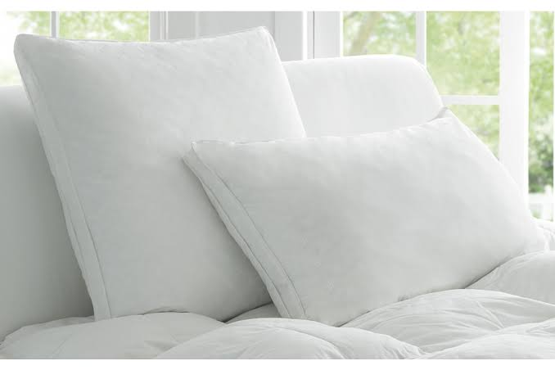

Slide 21
2.Back Rest
It is mechanical device which provide suitable support and rest for back of the patient
Purpose :-
  To support back.
  To facilitate easy breathing.
  To given for asthma and heart patient.

Slide 22
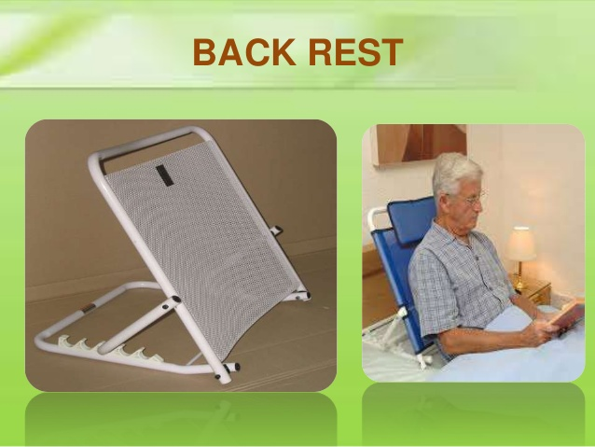

Slide 23
3. Hand rolls And Thigh roll
A. Hand rolls are made of cloth that rolled into the cylinder about 4-5 inches long and 2-3 inches in diameter.
Purpose :-
  To keep the fingers free.
  B. Thigh rolls
  Thigh roll are used to support hips and thighs.
  to provide paralysis fracture of femur and hip surgery .

Slide 24
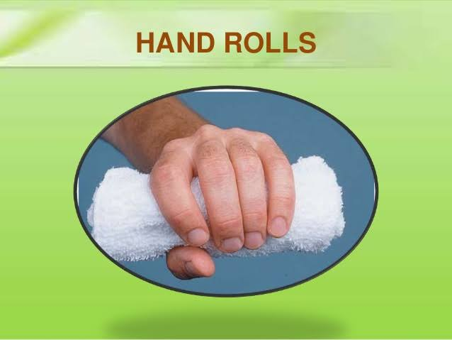
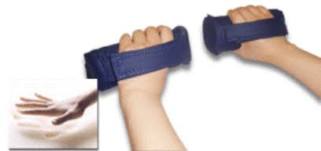

Slide 25
4.Foot rest
These are mechanical devices used to give rest to feet. Sand bags and foot board may be used.
  Purpose
  To maintain normal position of patient
  To promote comfort
  T o prevent foot drop.

Slide 26
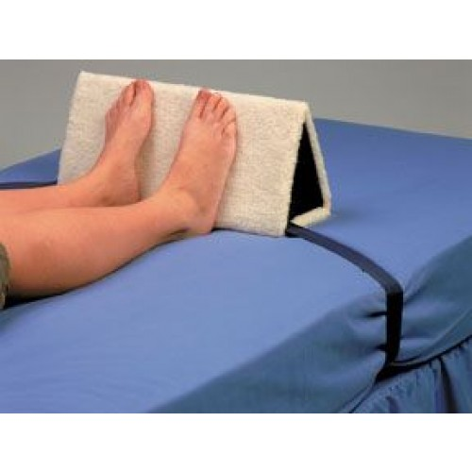

Slide 27
5.Sand bags
These are canvas rubber or plastic bags filled with sand. Those are used to immobilize a part.
Purpose :-
  To relieve discomfort.
  Used to support body parts
  Used to immobilize body part
  Used to support in fractured patient
  To prevent foot drops and wrist drop

Slide 28
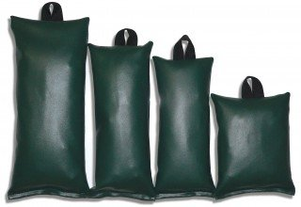

Slide 29
Air and water mattresses
Those are used for very thin and obese patient and those who get pressure sores.
Purpose
  To improve circulation
  To provide comfort
  To prevent pressure sore

Slide 30
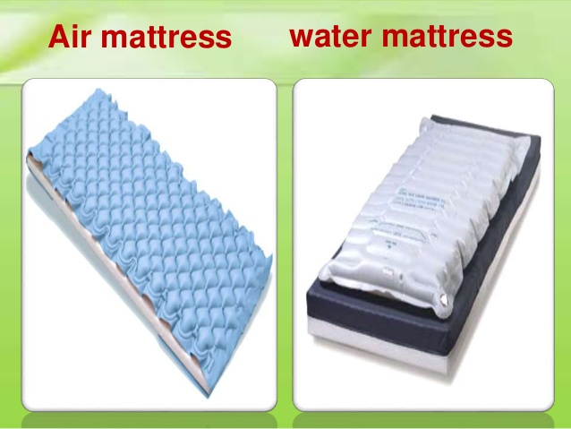

Slide 31
Bed cradle
These are made of wood , metal or electronic.
The bed cradle supports and takes off the weight off top bedding.
Purpose
  to prevent the top cloth if coming in contact with patient especially burn pt.

Slide 32
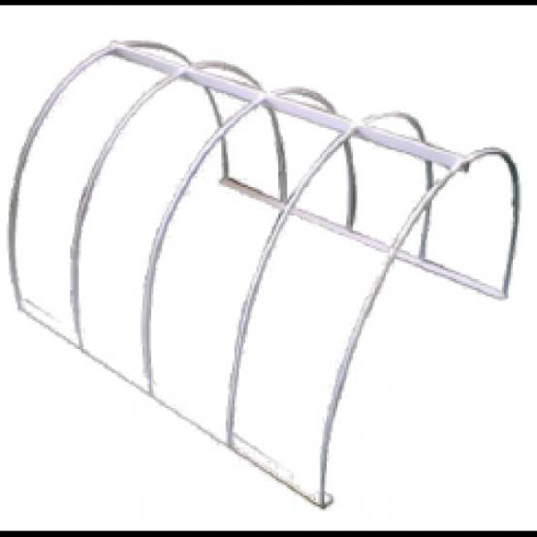

Slide 33
Bed blocks
These are made up of wood. Those are placed under foot of bed .
Purpose :-
  To prevent shock.
  After tonsillectomy.
  After spinal anesthesia
  .

Slide 34
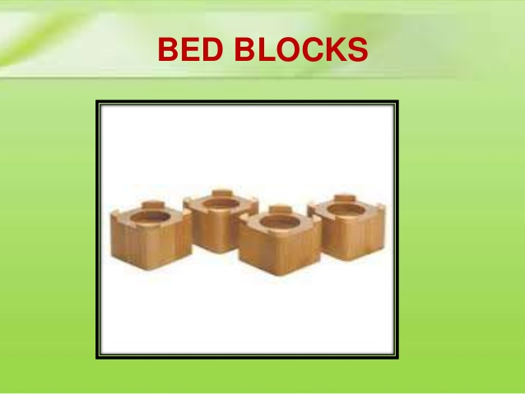

Slide 35
Air cushion
They are round in shape and made up of rubber.
It can be filled with air.
Purpose
  to relieve pressure on certain part of body.
  To promote comfort of client

Slide 36
