Slide 1
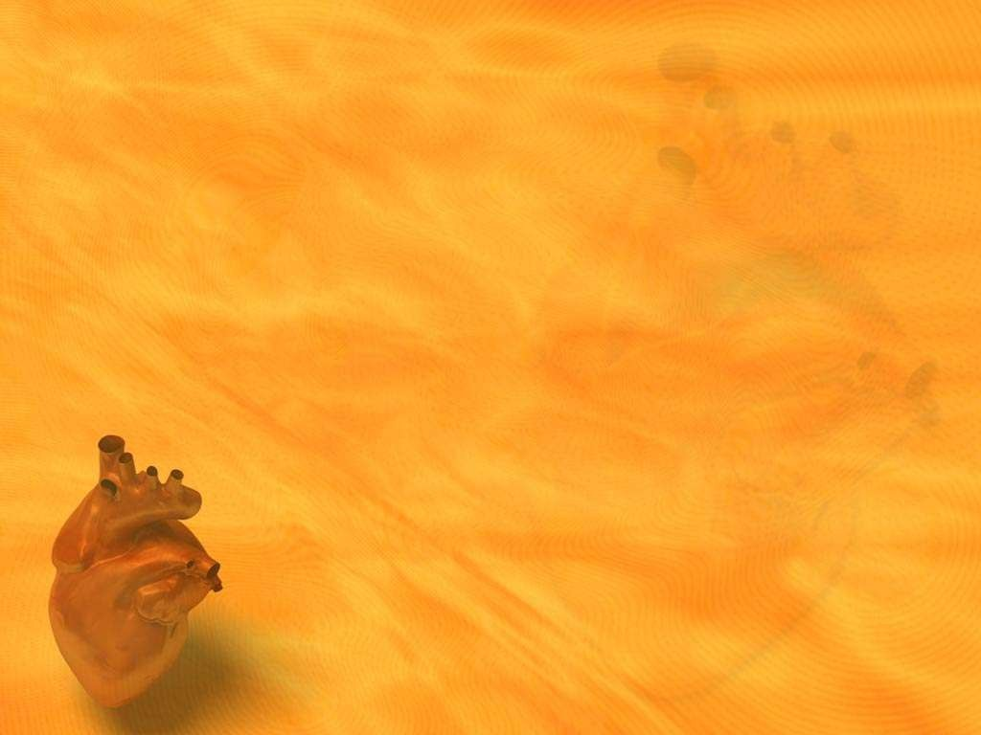
Cardio Pulmonary Resuscitation

Slide 2

Cardiopulmonary resuscitation (CPR) is a lifesaving technique useful in many emergencies, including heart attack or near drowning, in which someone's breathing or heartbeat has stopped.

Slide 3
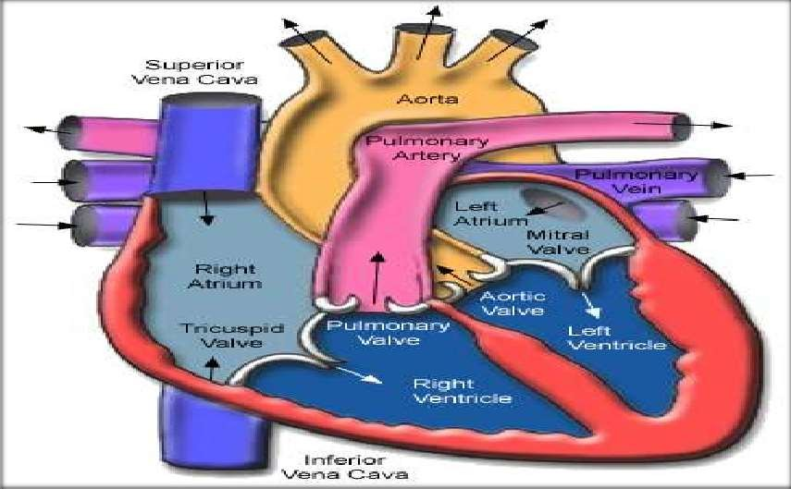

Slide 4





Cardio Pulmonary Resuscitation is a technique of basic life support for oxygenating the brain and heart until appropriate, definitive medical treatment can restore normal heart and ventilatory action.

Slide 5


To maintain Blood circulation by external cardiac massages (C).
To maintain an open and clear airway (A).
To maintain breathing by external ventilation (B).
To save life of the Patient.
To provide basic life support till medical and advanced life support arrives.

Slide 6





Cardiac Arrest
Ventricular fibrillation (VF)
Ventricular tachycardia (VT)
Asystole
Pulse less electrical activity

Slide 7
Respiratory Arresst
This may be result of following:
Drowning
Stroke
Foreign body in throat
Smoke inhalation
Drug overdose
Suffocation
Accident, injury
Coma
Epiglottis paralysis.

Slide 8




To restore effective circulation and ventilation.
To prevent irreversible cerebral damage due to anoxia. When the heart fails to maintain the cerebral circulation for approximately four minutes the brain may suffer irreversible damage.

Slide 9


SEQUENCES OF PROCEDURES PERFORMED TO RESTORE THE CIRCULATION OF OXYGENATED BLOOD AFTER A SUDDEN PULMONARY AND/OR CARDIAC ARREST
CHEST COMPRESSIONS AND PULMONARY VENTILATION PERFORMED BY ANYONE WHO KNOWS HOW TO DO
IT, ANYWHERE, IMMEDIATELY, WITHOUT
ANY OTHER EQUIPMENT

Slide 10



Approach safely
Check response
Shout for help
Open airway
Check breathing
Call 108
30 chest compressions
2 rescue breaths

Slide 11
APPROACH SAFELY!
Approach safely
WATCH OBSERVE
Check response
Shout for help
Open airway
Check breathing
Call 108
30 chest compressions
2 rescue breaths

Slide 12
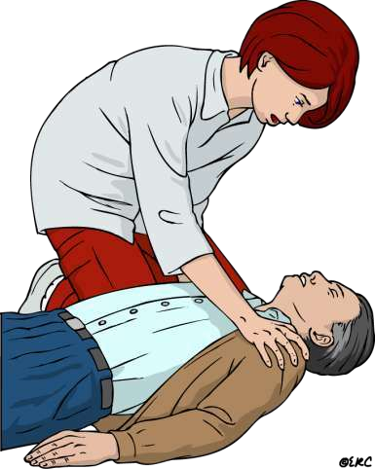
CHECK RESPONSE
Approach safely
Check response
Shout for help
Open airway
Check breathing
Call 112
30 chest compressions
2 rescue breaths

Slide 13
CHECK RESPONSE
Shake shoulders gently Ask “Are you all right?” If he responds
Leave as you find him.
Find out what is wrong.
Reassess regularly.

Slide 14
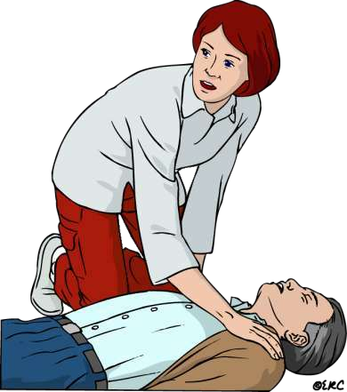
SHOUT FOR HELP
Approach safely
Check response
Shout for help
Open airway
Check breathing
Call 112
30 chest compressions
2 rescue breaths

Slide 15
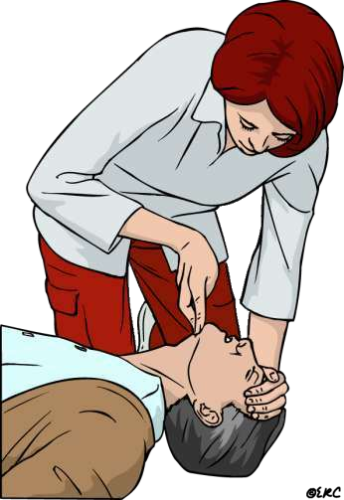
OPEN AIRWAY
Approach safely
Check response
Shout for help
Open airway
Check breathing
Call 112
30 chest compressions
2 rescue breaths

Slide 16
OPEN AIRWAY
Head tilt and chin lift
lay rescuers
non-healthcare rescuers
No need for finger sweep unless solid material can be seen in the airway

Slide 17
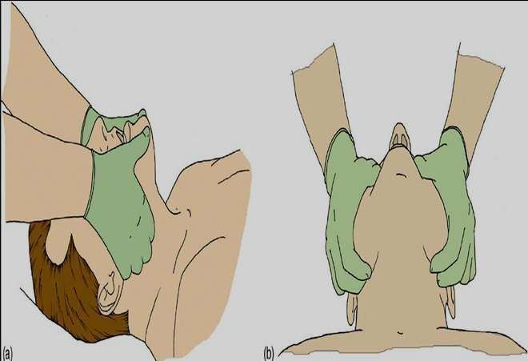
OPEN AIRWAY
Head tilt, chin lift + jaw thrust

Slide 18
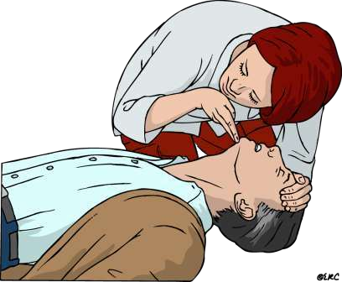
CHECK BREATHING
Approach safely
Check response
Shout for help
Open airway
Check breathing
Call 108
30 chest compressions
2 rescue breaths

Slide 19
CHECK BREATHING
Look, listen and feel for NORMAL breathing
Do not confuse agonal breathing with NORMAL breathing

Slide 20

Occurs shortly after the heart stops in up to 40% of cardiac arrests
Described as barely, heavy, noisy or gasping breathing
Recognise as a sign of cardiac arrest

Slide 21

Approach safely
Check response
Shout for help
Open airway
Check breathing
Call 108
30 chest compressions
2 rescue breaths

Slide 22
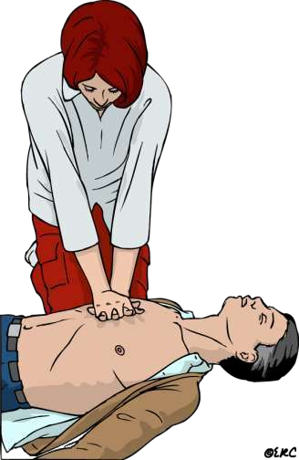
30 CHEST COMPRESSIONS
Approach safely
Check response
Shout for help
Open airway
Check breathing
Call 108
30 chest compressions
2 rescue breaths

Slide 23
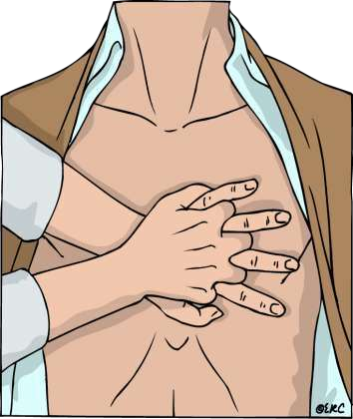
CHEST COMPRESSIONS
Place the heel of one hand in the centre of the chest
Place other hand on top
Interlock fingers
Compress the chest
  Rate 100 min⁻¹
  Depth 4-5 cm (1.5 to 2 inch)
  Equal compression : relaxation
When possible change CPR operator every 2 min

Slide 24
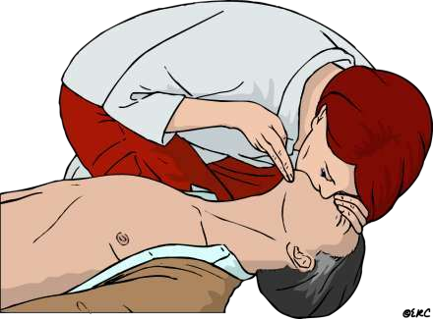
RESCUE BREATHS
Approach safely
Check response
Shout for help
Open airway
Check breathing
Call 112
30 chest compressions
2 rescue breaths

Slide 25

Pinch the nose
Take a normal breath
Place lips over mouth
Blow until the chest rises
Take about 1 second
Allow chest to fall
Repeat

Slide 26

RECOMMENDATIONS:
Tidal volume
500 – 600 ml
Respiratory rate
give each breaths over about 1s with enough
volume to make the victim’s chest rise
Chest-compression-only
continuously at a rate of 100 min

Slide 27
CONTINUE CPR
30
2

Slide 28

Coronary vessel injury
Diaphragm injury
Hemopericardium
Hemothorax
Interference with ventilation

Slide 29
Liver injury
Myocardial injury
Pneumothorax
Rib fractures
Spleen injury
Sternal fracture

Slide 30

Adrenaline
Adrenaline (epinephrine) is the main drug used during resuscitation from cardiac arrest.
Atropine
Atropine as a single dose of 3mg is sufficient to block vagal tone completely and should be used once in cases of asystole. It is also indicated for symptomatic bradycardia in a dose of 0.5mg - 1mg.
Amiodarone
It is an antiarrhythmic drug.

Slide 31

Maintains airway patency with use of airway adjuncts as required (suction, high flow oxygen with O2 or bag valve mask ventilation).
Assist with intubation and securing of ETT
Inserts gastric tube and/or facilitates gastric decompression post intubation as required.
Assists with ongoing management of airway patency and adequate ventilation

Slide 32
Supports less experienced staff by coaching/guidance e.g. drug preparation
If a shockable rhythm is present (VF/VT) ensure manual defibrillator pads are applied and connected.
If CPR is in progress, prepare and independently double check and label 3 doses of adrenaline
Prepare and administer IV fluids
Document medications administered (including time)

