Slide 1
fat
Ms Mitali solanki
lecturer

Slide 2
fat is made up of three fatty acid and glycerol is also known as triglyrol. It is one of three main macronutrient.
There are two essential fatty acid alpha-linolenic acid (omega 3 fatty acid) and linolenic acid (omega 6 fatty acid).
It is the gtreatest source of energy.

Slide 3
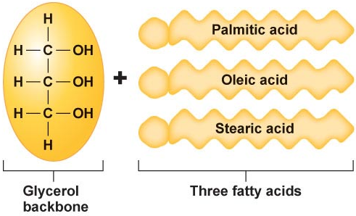
Triglycerides
Portion of Figure 5.7
Three fatty acids connected to a glycerol backbone

Slide 4
Fatty Acids and Rancidity
Rancidity: spoiling of fats through oxidation
  More double bonds therefore more susceptible to oxidation and rancidity
PUFA > MUFA > Saturated fatty acids
Enhancing stability of fatty acids by reducing rancidity
  Adding antioxidants
  Limiting food exposure to oxygen, heat, and light
  Hydrogenation

Slide 5
Classification of fatty acid
saturated fatty acid
Unsaturated fatty acid
Polyunsaturated fatty acid

Slide 6
Fatty Acids Vary in Saturation
Saturated
  All the carbons on the fatty acid are bound to hydrogen
  Solid at room temperature
  Higher melting point

Slide 7
Fatty Acids Vary in Saturation
Unsaturated
  Some carbons on fatty acid form a double bond with each other instead of binding to hydrogen
  Monounsaturated fatty acids (MUFA)
    Has one double bond
  Polyunsaturated fatty acid (PUFA)
    Has two or more double bonds
  Liquid at room temperature
  Lower melting point

Slide 8
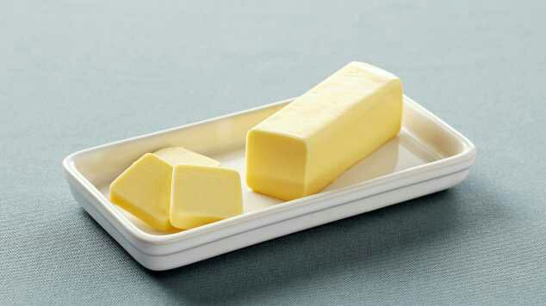
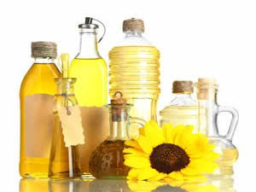
Types of fat:
i) Visible fat

Slide 9
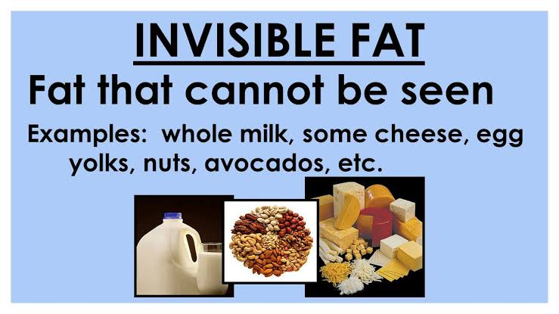
Invisible fat

Slide 10
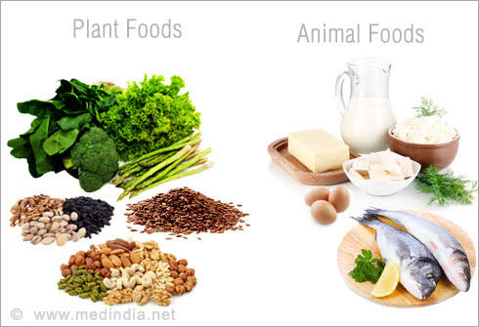
Sources of fat

Slide 11
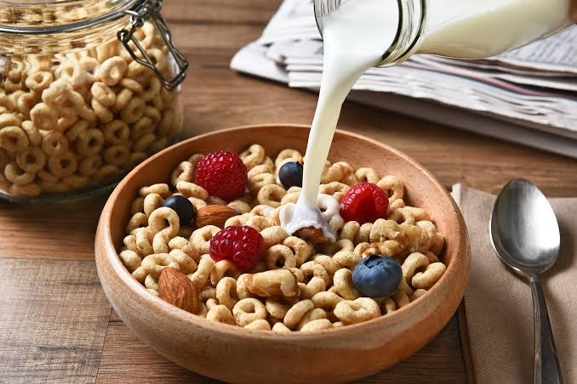
3.Other sources

Slide 12
Digestion of food:

Slide 13
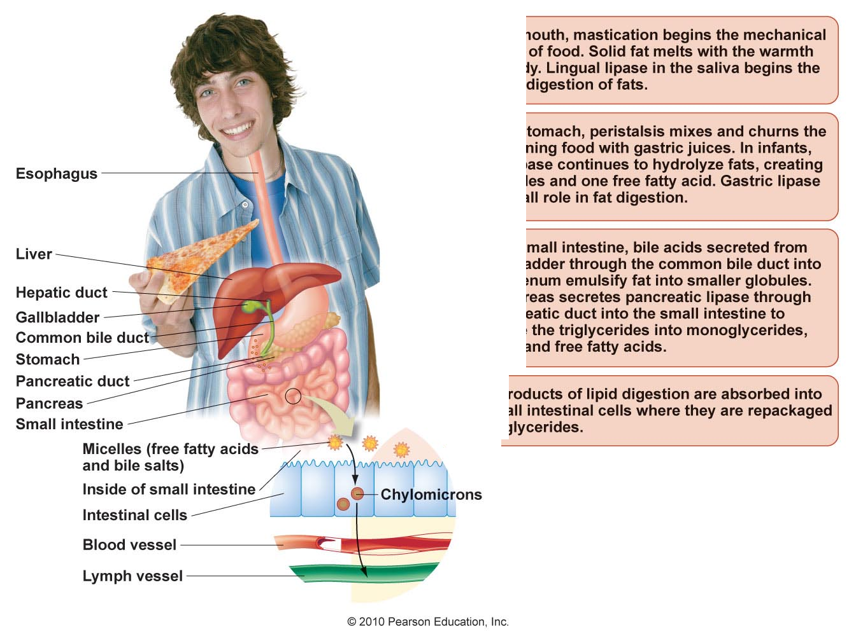
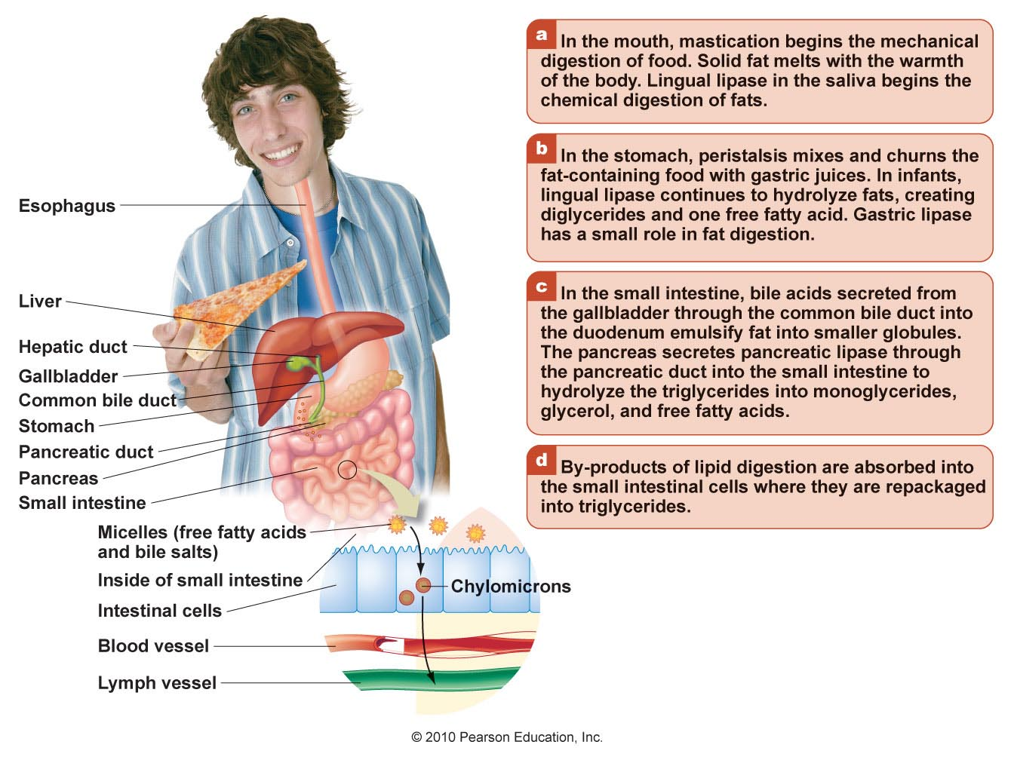
Figure 5.13

Slide 14
Figure 5.13

Slide 15
Figure 5.13

Slide 16
Figure 5.13

Slide 17
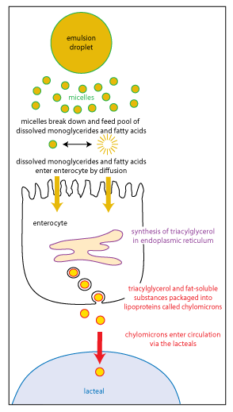

Slide 18
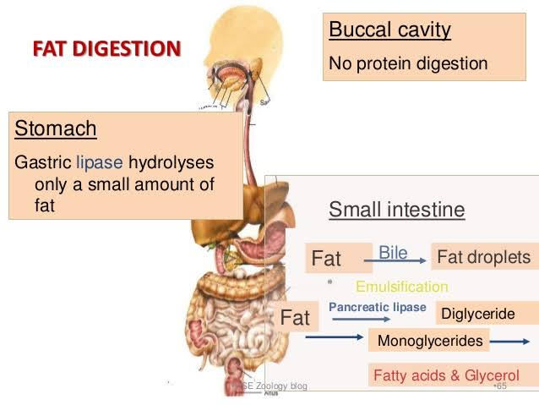

Slide 19
Lipoproteins Transport Fat Through the Lymph and Blood
Very low-density lipoproteins (VLDLs)
  Become LDLs
LDLs: “bad” cholesterol
HDLs: “good” cholesterol
HDL and LDL levels can be used to determine the health of arteries

Slide 20
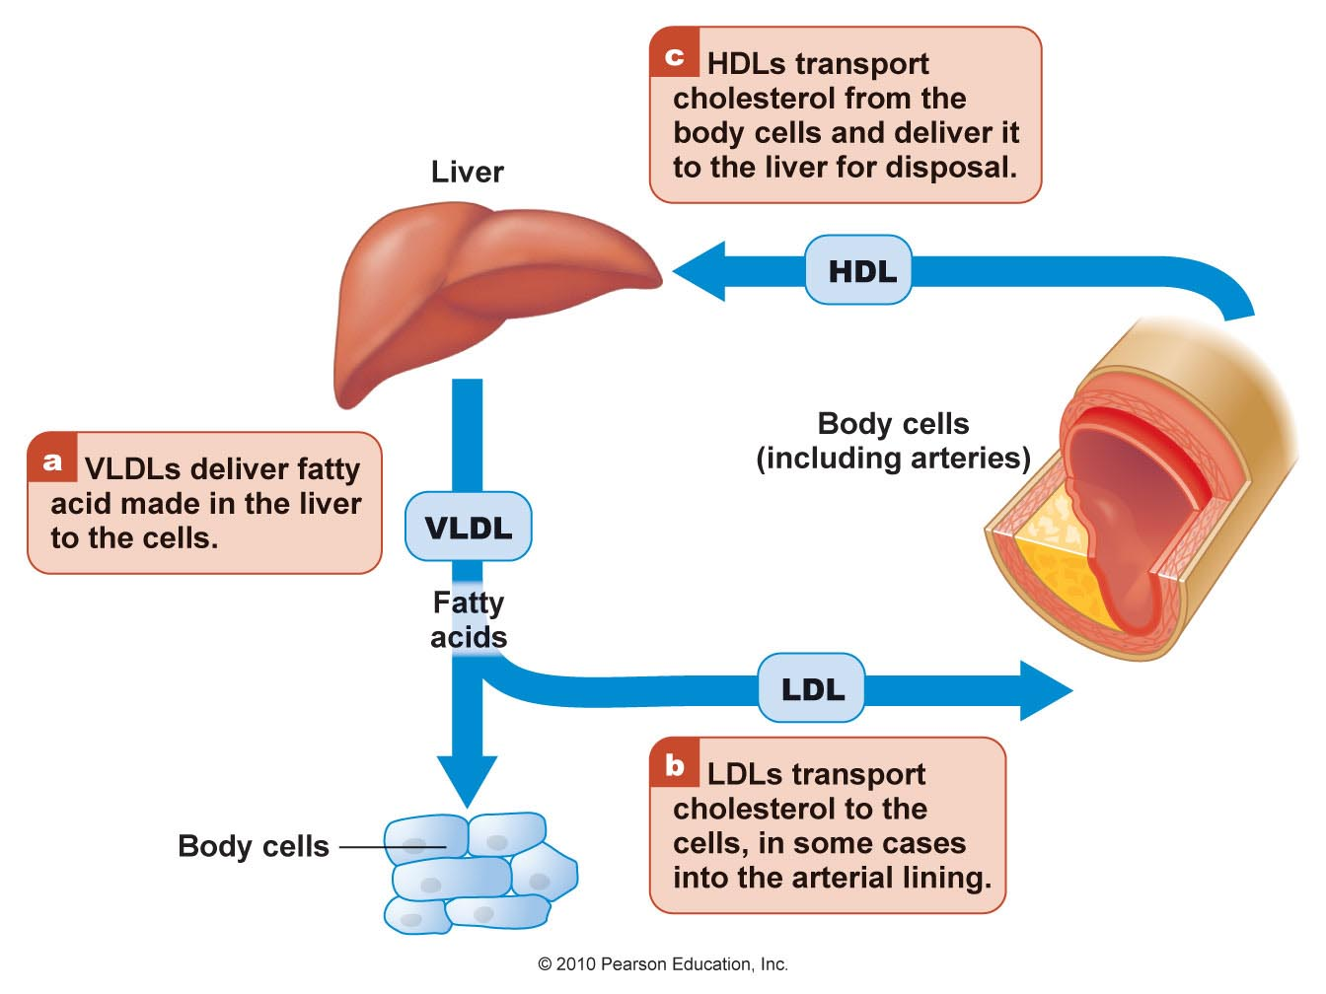
The Roles of VLDL, LDL, and HDL Lipoproteins
Figure 5.18

Slide 21
Quick Review
Most fats are digested in the small intestine with the help of bile acids and pancreatic lipase
Short- and medium-chain fatty acids are absorbed directly into the bloodstream
Longer chain fatty acids and other remnants of fat digestion
  Packaged in chylomicron lipoprotein carriers
  Travel in lymph before entering the bloodstream
Lipoproteins are globularshaped transport carriers
  Outer shell high in protein and phospholipids
  Inner core carries insoluble fat, cholesterol, and other lipids through lymph and bloodstream

Slide 22
Quick Review
VLDLs and HDLs are synthesized in the liver
VLDLs eventually become LDLs after depositing some fatty acids in the body’s cells
LDLs deposit cholesterol in the cells and arterial walls
HDLs remove cholesterol from the arteries and deliver it to the liver to be used in the synthesis of bile or excreted in the feces

Slide 23
Uses of Fat and Cholesterol
Source of energy
Form body structures
Regulate metabolism
Enhance absorption of fat-soluble vitamins
Provide insulation to help regulate body temperature
Cushion major organs

Slide 24
Fat Is Used as Energy
Fat
  Provides concentrated source of kilocalories
    9 kilocalories per gram
  Readily available when the body needs energy
  Body’s main source of energy throughout the day

Slide 25
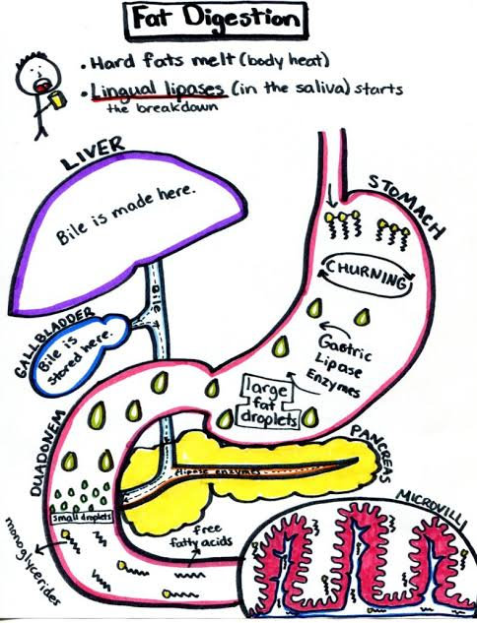

Slide 26
FAT METABOLISM

Slide 27
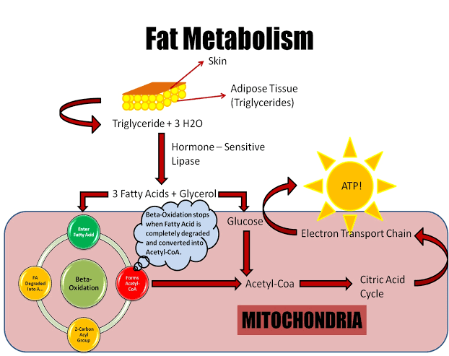

Slide 28
Except the central nervous system and red blood cell all other cell and tissue of body oxidixe fatty acid and yield energy.
The oxidation of fat occurs in mitochondria.
Beta oxidation is major pathway for fat oxidation.
Fatty acid converted into acetyl CoA.
Before the triglyride is hydrolyzed into fatty acid and glycerol.
Acetyl coA enter to the citric acid cycle.

Slide 29
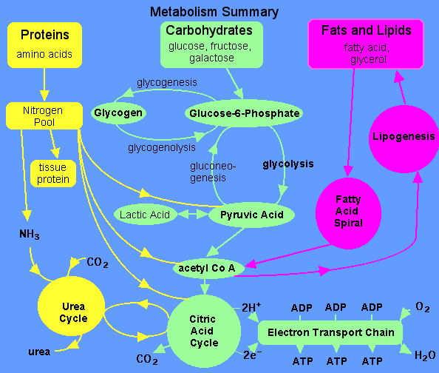

Slide 30
Malnutrition
Obesity
Cardiovascular disorder
Atherosclerosis
Fat and cancer:high incidence of breast, colon and uterine cancer.

Slide 31
What Is Heart Disease and What Factors Increase Risk?
Cardiovascular disease is the number-one killer of adults in the United States
Fat and Cholesterol
Accumulate in the arteries
Arteries narrow
Blood flow is impeded
Decrease oxygen and nutrients
Not enough oxygen to the heart
CHEST PAIN

Slide 32
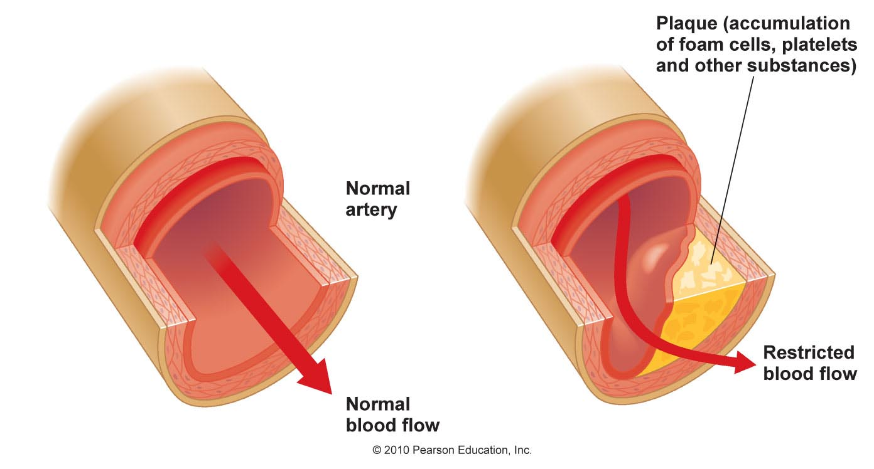
Atherosclerosis
Figure 5.24

