Slide 1
MALE EXTERNAL GENITAL ORGANS:
MADE BY : ZAINAB JINIA
1ST YR BHMS 2019-2020

Slide 2
TESTIS: MALE GONAD, HOMOLOGUS TO OVARY IN FEMALE SUSPENDED IN SCROTUM BY SPERMATIC CORD. PLACED OBLIQUELY , LEFT ONE IS AT LITTLE LOWER LEVEL.
FEATURES :
SHAPE : OVAL COMPRESSED FROM SIDE TO SIDE.
DIMENSION : 3.75CM LENGTH, 2,5CM BROAD , 1.8 CM THICK.
WEIGHT : 10 TO 15 GM.

Slide 3
EXTERNAL FEATURES :
TWO POLES :
TWO SURFACES :
TWO BORDERS :
UPPER POLE : | COONVEX & SMOOTH , PROVIDES ATTCHMENT TO SPERMATIC CORD.
LOWER POLE: | CONVEX & SMOOTH.
MEDIAL SURFACE : | SMOOTH & CONVEX .
LATERAL SURFACE: | SMOOTH & CONVEX
ANTERIOR BORDER: | FULLY COVERED BY TUNICA VAGINALIS.
POSTERIOR BORDER: | PARTIALLY COVERED BY TUNICA VAGINALIS . EPIDIDYMIS LIES ALONG LATERAL SIDE.

Slide 4
TESTIS :

Slide 5
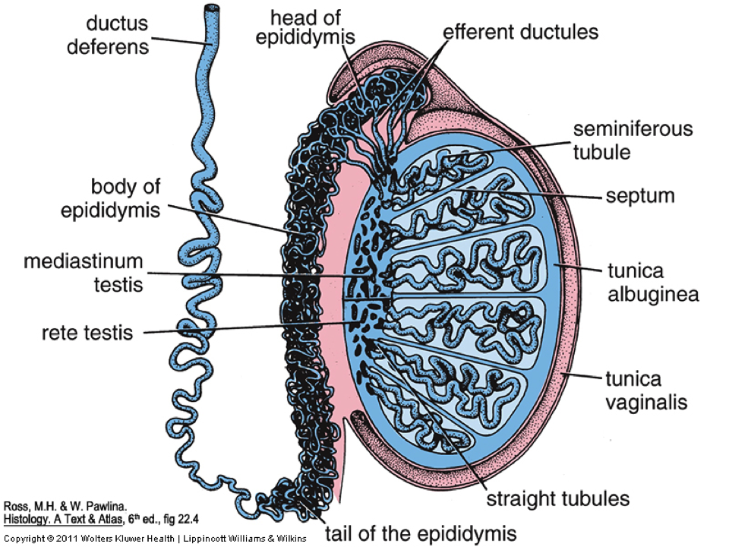
COVERINGS OF TESTIS :
COVERING FROM OUTSIDE TO INSIDE ARE :
TUNICA VAGINALIS : REPRESENTS PROSESSUS VAGINALIS, CONTAINS PARIETAL & VISCERAL LAYER . COVERS WHOLE TESTIS ACCEPT POSTERIORLY .
TUNICA ALBUGINEA : WHITE, DENSE FIBROUS COVERING ALL AROUND. POSTERIOR BORDER FORM INCOMPLETE VERTICAL SEPTUM , CALLED MEDIASTINUM TESTIS. NUMEROUS SEPTA ARISES WITH 200 TO 300 LOBULES.
TUNICA VASCULOSA: INNERMOST , VASCULAR , LINNING THE LOBULES.

Slide 6
STRUCTURE OF TESTIS:

Slide 7
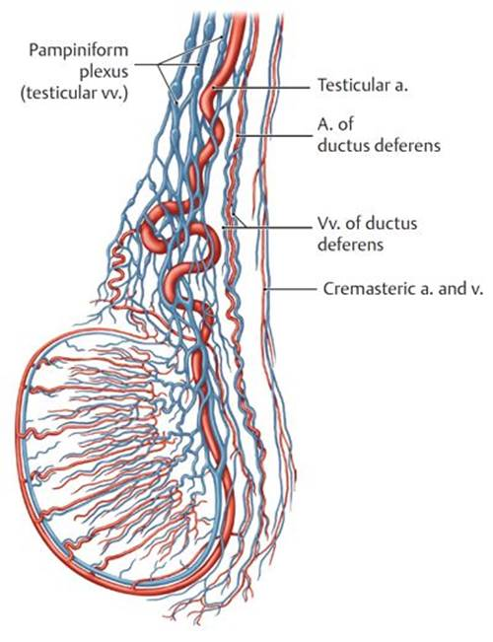
ARTERIAL SUPPLY: TESTICULAR ARTERY VENOUS DRAINAGE : FORMS PAMPINIFORM PLEXUSES, CONDENSES INTO 4 VEINS AT SUPERFICIAL INGUINAL RING , & 2 VEINS AT DEEP INGUINAL RING .ULTIMATELY ONE VEIN DRAINS INTO INFERIOR VENACAVA ON RIGHT SIDE & LEFT RENAL VEIN INTO LEFT SIDE.
LYMPHATIC DRAINAGE : PREAORTIC & PARA-AORTIC LYMPH NODES .
NERVE SUPPLY : SYMPATHETIC NERVE T10.

Slide 8
HISTOLOGY OF SEMINIFEROUS TUBULES : HERE CELLS ARE ARRANGED WITHIN 4 TO 8 LAYERS . THE SPERMETOGENIC CELLS & SUPPORTING CELLS , THESE TWO TYPES OF CELLS ARE FOUND. SPERMATOGENIC CELLS INCLUDES 1) PRIMARY SPERMATOCYTES 2) SECONDARY SPERMATOCYTES 3) SPERMATIDS 4)SPERMATOZOA. SERTOLI CELLS ARE SUPPORTING & PROTECTING CELLS & HELPS IN MATURATION OF SPERMATOZOA. INTERSTITIAL LEYDIG CELLS SECRETS TESTESTERONE. THE ACTIVITY OF LEYDIG CELLS ARE CONTROLLED BY ICSH OF ANTERIOR PITUITARY.

Slide 9
CLINICAL ANATOMY:
MONORCHISM : UNILATERAL ABSENCE OF TESTIS
ANORCHISM : BILATERAL ABSENE OF TESTIS.
UNDESCENDED TESTIS : THE TESTIS MAY LIE IN LUMBAR, ILIAC, INGUINAL OR UPPER SCROTAL REGION.
ECTOPIC TESTIS : THIS MAY OCCUPY ABNORMAL POSITION , AS DEVIATES FROM NORMAL ROUTE.
HERMAPHRODISM : INDIVIDUAL MAY SHOWS SOME FEATURE OF FEMALE WHEREAS SOME OF MALES.
TESTIS & EPIDIDYMIS IS SITE OF TUMORS & INFECTIONS.
VARICOCOELE: PRODUCED BY DILATION OF PAMPINIFORM PLEXUS.

Slide 10
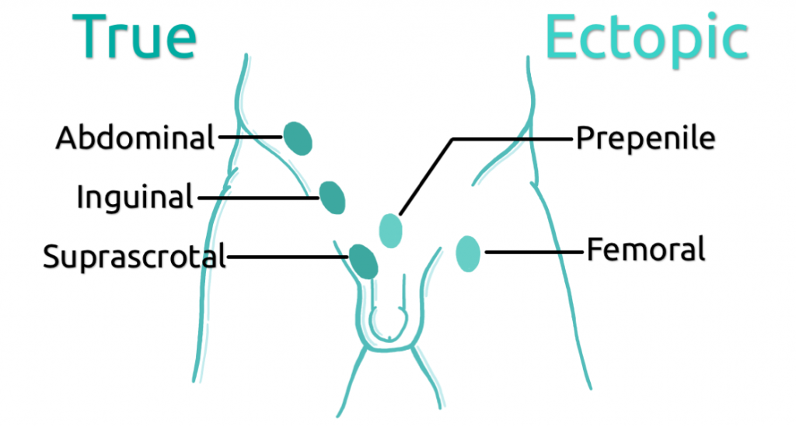
CLINICAL ANATOMY :

Slide 11
H
THANK U SO MUCH.
HOPE U WILL LIKE IT…..

