Slide 1

THE FEMALE REPRODUCTIVE
SYSTEM

Slide 2
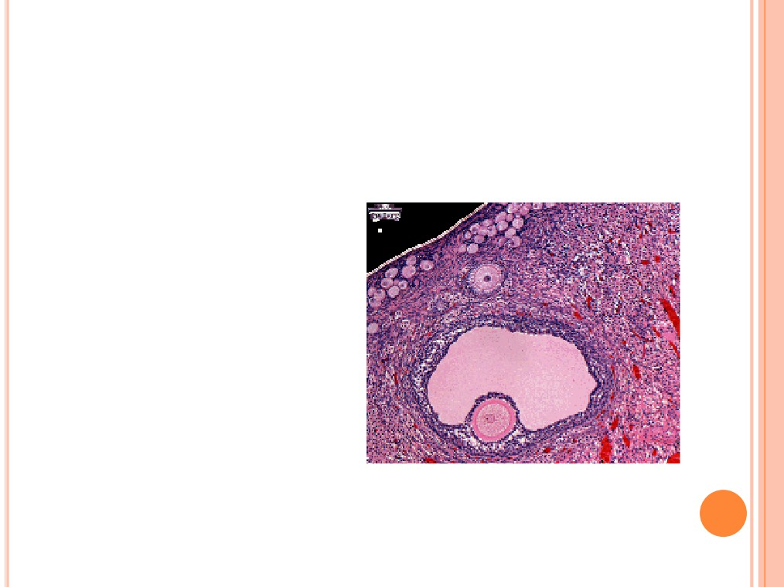
FEMALE REPRODUCTION
○ Unlike males, who are
able to produce sperm
cells throughout their
reproductive lives,
females produce a
finite number of egg
cells.
○ During early fetal
development germ
cells migrate into the
ovaries and
differentiate into
oogonia

Slide 3
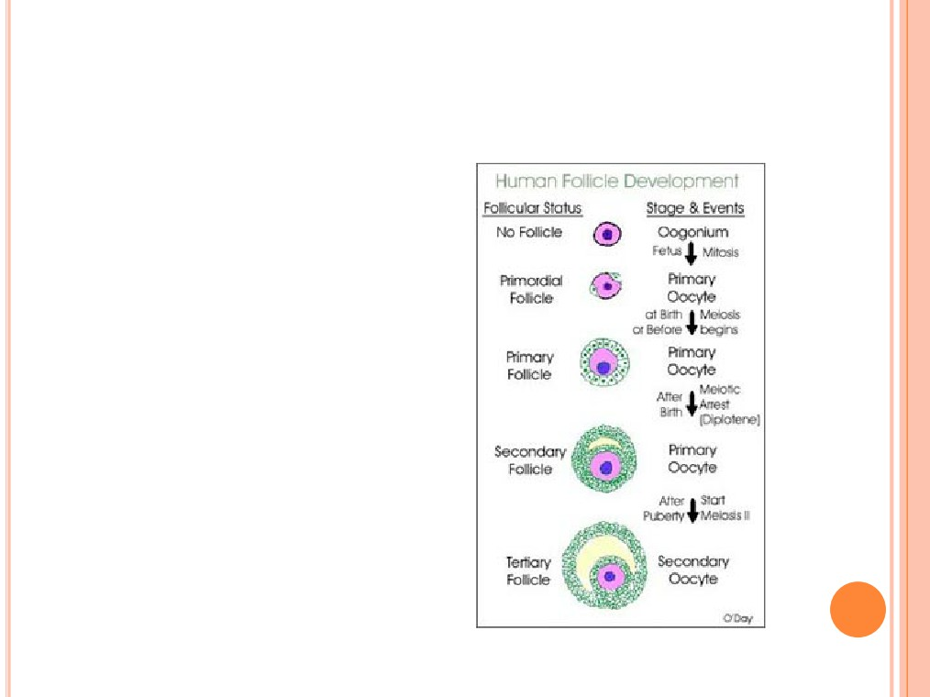
OOGONIA
○ The oogonia divide by
mitosis for the next few
months and some
differentiate into
primary oocytes.
○ By fifth month there are
about 7 million primary
oocytes, but most will
degenerate during the
next 2 months

Slide 4
OOGONIA
be
○ Those that remain will
layer of squamous
epithelial cells (follicle
cells) called a primordial
follicle.
mary
○ Degeneration of pri
○ At birth =1millions
○ At puberty 400,000 remain
○ Only 400-500 will reach
maturity

Slide 5
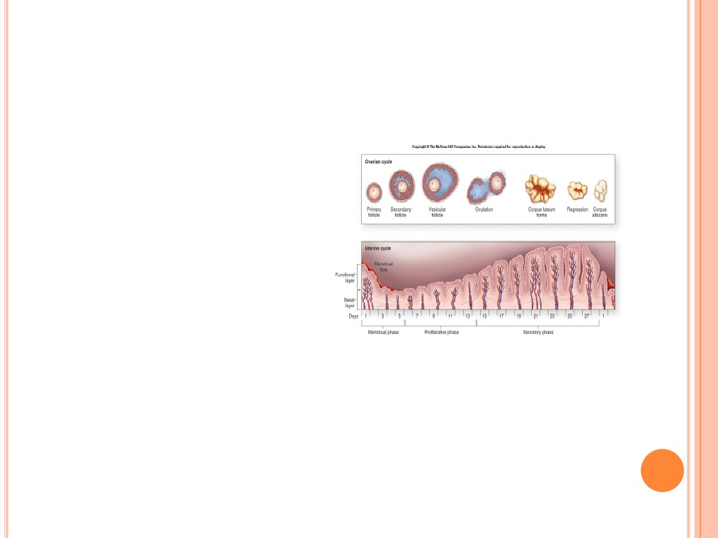
OVARIAN CYCLE
○ Monthly changes thating
a woman’s reproductive
life.
○ Each month FSHrdial
follicles to grow and
mature (follicular phase)
○
Ovulation- release of the
egg (LH)
○ Luteal phase the corpus
luteum produces
progesterone that
maintains uterine walls
If fertilization does not occur,
the corpus luteum degenerates,
within 2 weeks into a mass of
scar tissue called the corpus
albicans

Slide 6
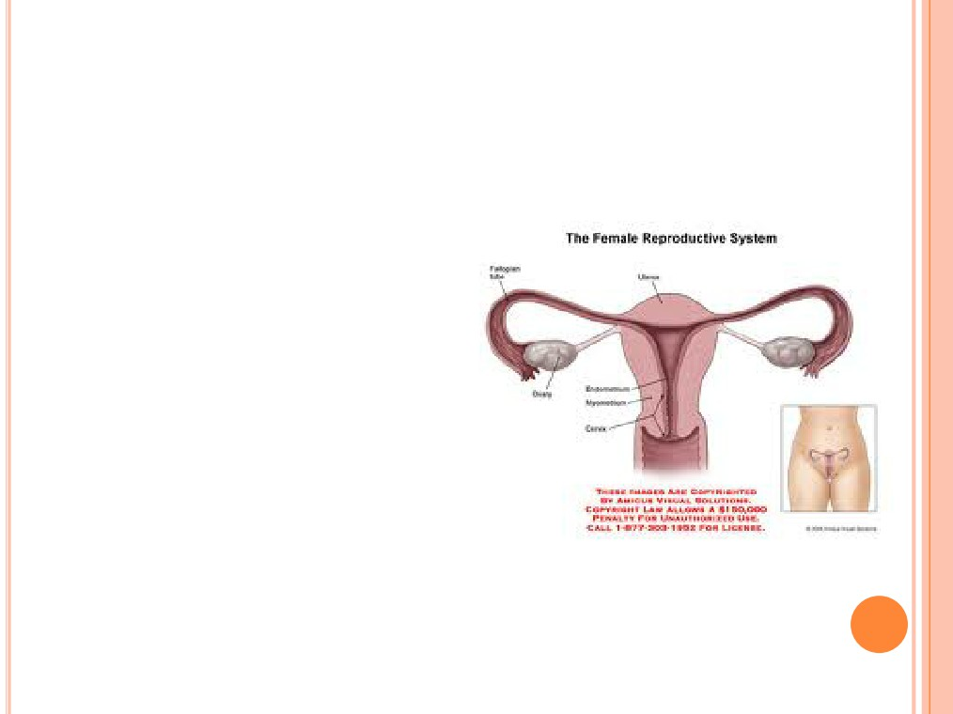
GROSS ANATOMY
○ The ovaries are solid,ut 2
cm in length and 1 cm in
width.
○
Like the testes, they
develop from embryonic
tissue along the posterior
abdominal wall, near the
kidneys.
○ Accessory organs include
the uterine tubes, uterus,
and vagina.

Slide 7
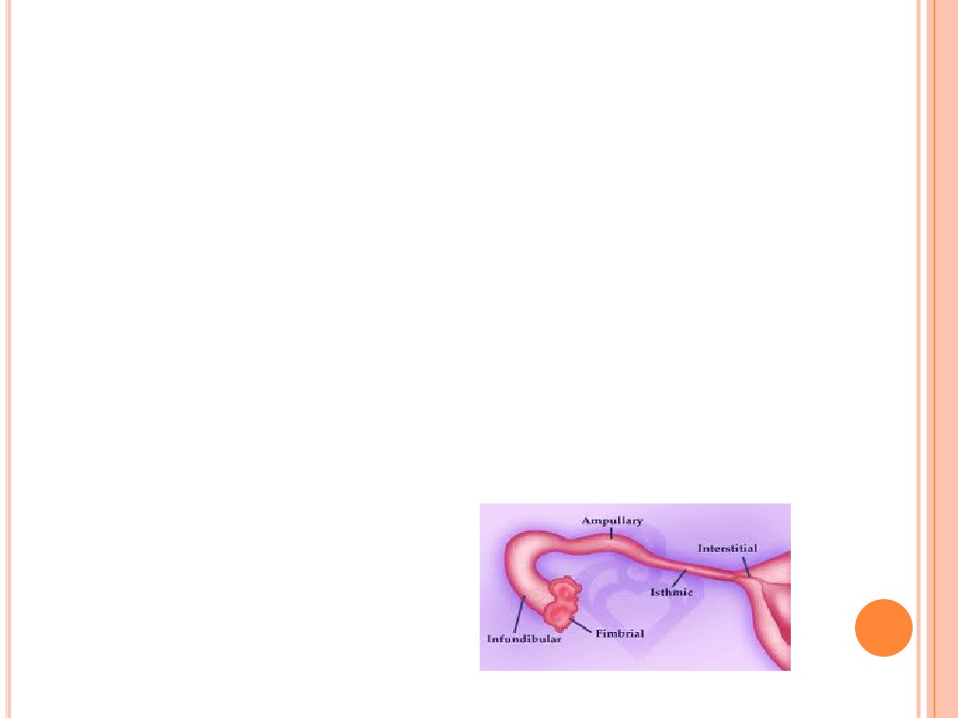
UTERINE TUBES
(FALLOPIAN TUBES)
○
Receive the ovulated oocyte and provide a site for
fertilization
○
Empty into the superolateral region of the uterus via
the isthmus
○
Expand distally around the ovary forming the ampulla
○ The ampulla ends in the funnel-shaped, ciliated
infundibulum containing fingerlike projections called
fimbriae
7

Slide 8
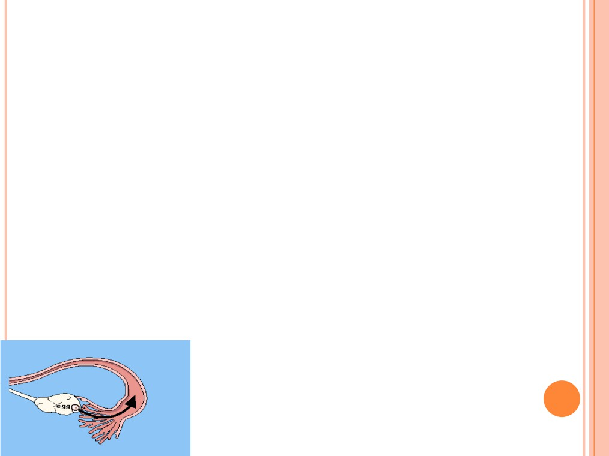
UTERINE TUBES
(FALLOPIAN TUBES)
○ Function: events occurring in the uterine tube
Fimbriae sweep oocyte into tube, cilia &
peristalsis move it along, sperm
reaches oocyte in ampulla, fertilization
occurs within 24 hours after ovulation
& zygote reaches uterus about 7 days
after ovulation
8

Slide 9
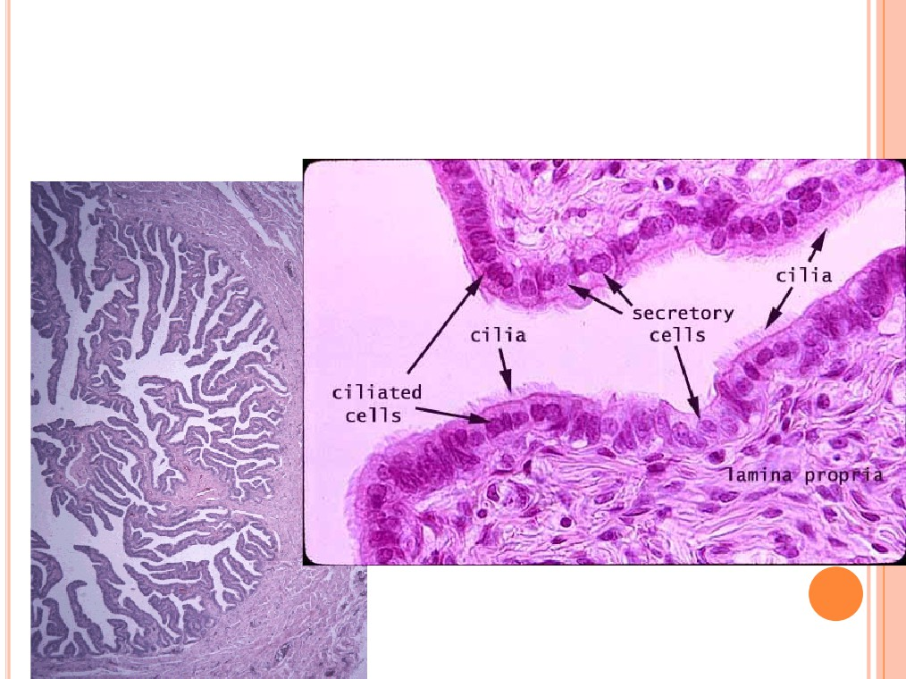
FALLOPIAN TUBE HISTOLOGY
Cilia sweep egg/zygote
toward the uterus

Slide 10

UTERUS
○
Hollow, thick-walled organ located in the pelvis
anterior to the rectum and posterosuperior to the
bladder
○
Body: Major portion of the uterus
○
Fundus: Rounded region superior to the entrance of
the uterine tubes
○ Isthmus: Narrowed region between the body and
cervix
10

Slide 11
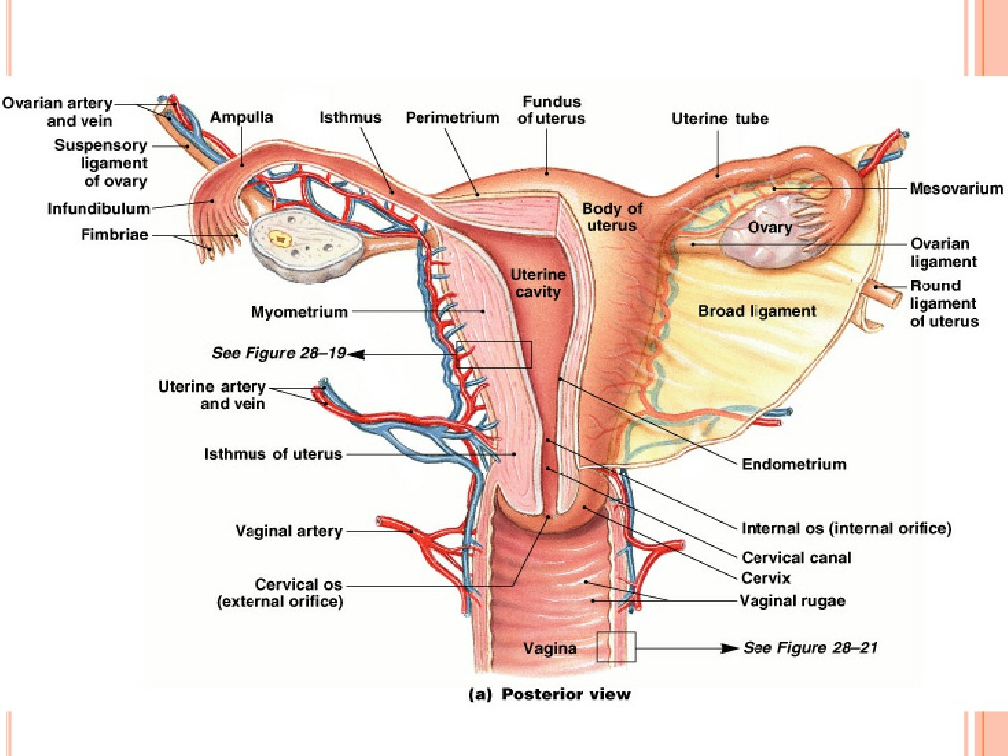
UTERUS

Slide 12
UTERINE HISTOLOGY
○
Endometrium
Simple columnar epithelium
Stroma of connective tissue and endometrial glands
Stratum functionalis: Shed during menstruation
Stratum basalis: Replaces stratum functionalis
each month
○
Myometrium
3 layers of smooth muscle
○
Perimetrium
● Visceral peritoneum
12

Slide 13
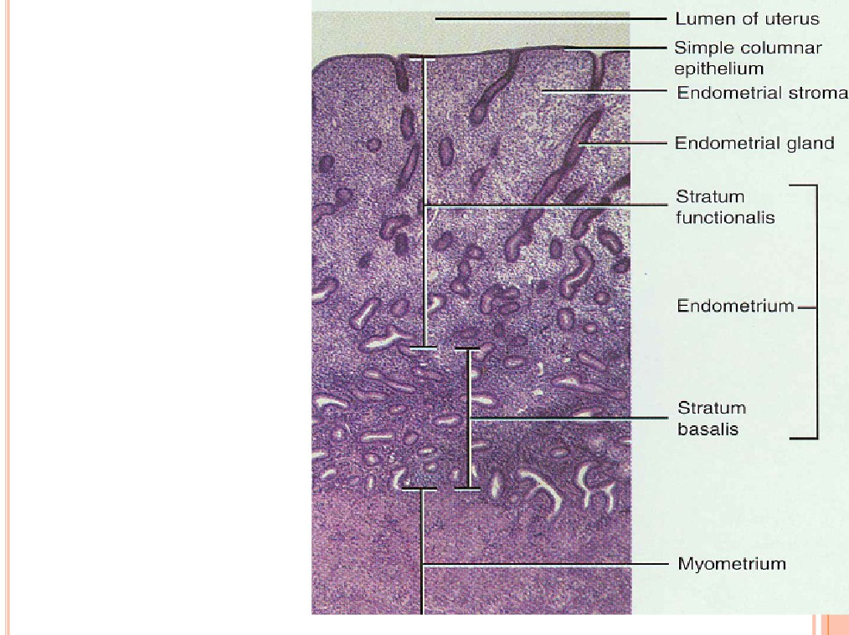
UTERINE
HISTOLOGY
1

Slide 14
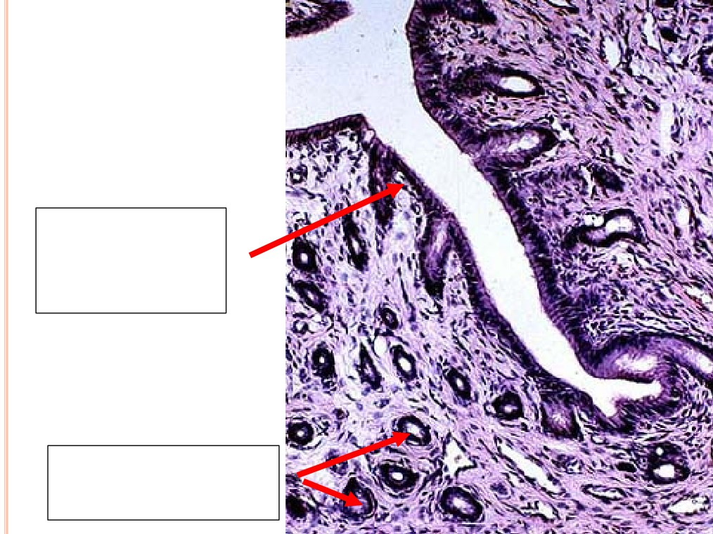
ENDOMETRIUM
Simple
columnar
epithelium
Endometrial
glands

Slide 15
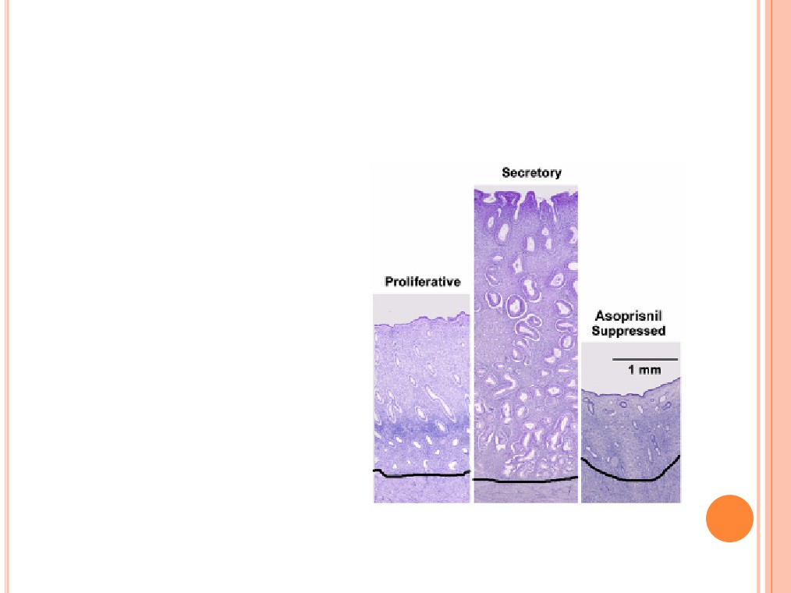
ENDOMETRIUM
○
Proliferative phase: glands
and blood vessels scattered
throughout the functional
zone with little or no
branching.
○
New glands form and
endometrium thickens.
○
Secretory phase: glands are
enlarged and have branches.
Preparing the endometrium
for implantation
○ If no implantation then
endometrium breaks down
and menstruation begins.

Slide 16
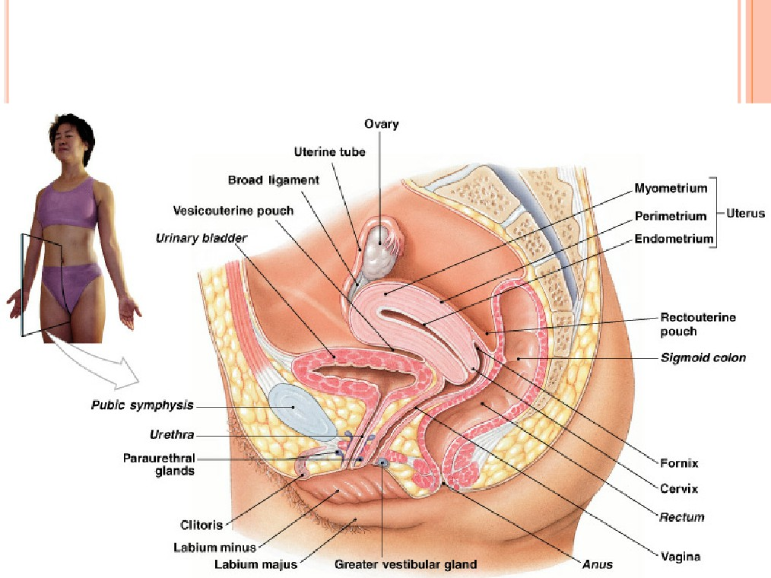
FEMALE: LATERAL VIEW

Slide 17
CERVIX
○
Narrow lower neck of the uterus which projects into
the vagina inferiorly
○
Cervical canal - cavity of the cervix that
communicates with:
The vagina via the external os
The uterine body via the internal os
○ Cervical glands secrete mucus that covers the
external os and blocks sperm entry except during
midcycle
17

Slide 18
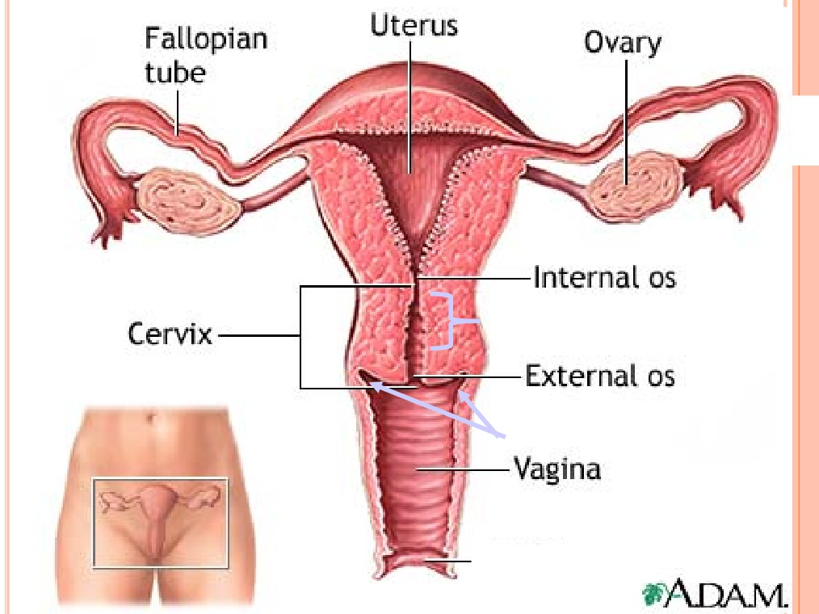
Endocervical canal
Fornix
1

Slide 19
VAGINA
○
Thin-walled tube lying between the bladder and the
rectum, extending from the cervix to the exterior of
the body
○
Wall consists of three coats: fibroelastic adventitia,
smooth muscle muscularis, and a stratified
squamous mucosa
○
Mucosa near the vaginal orifice forms an incomplete
partition called the hymen
○ Vaginal fornix: upper end of the vagina surrounding
the cervix
19

Slide 20
FEMALE EXTERNAL GENITALIA
○
Mons pubis: fatty pad over the pubic symphysis
Labia majora & minora: folds of skin encircling
○
vestibule where find urethral and vaginal openings
Clitoris: small mass of erectile tissue
○
○
Bulb of vestibule: masses of erectile tissue just deep to
the labia on either side of the vaginal orifice
○ Perineum: Area between the vagina and anus
20

Slide 21
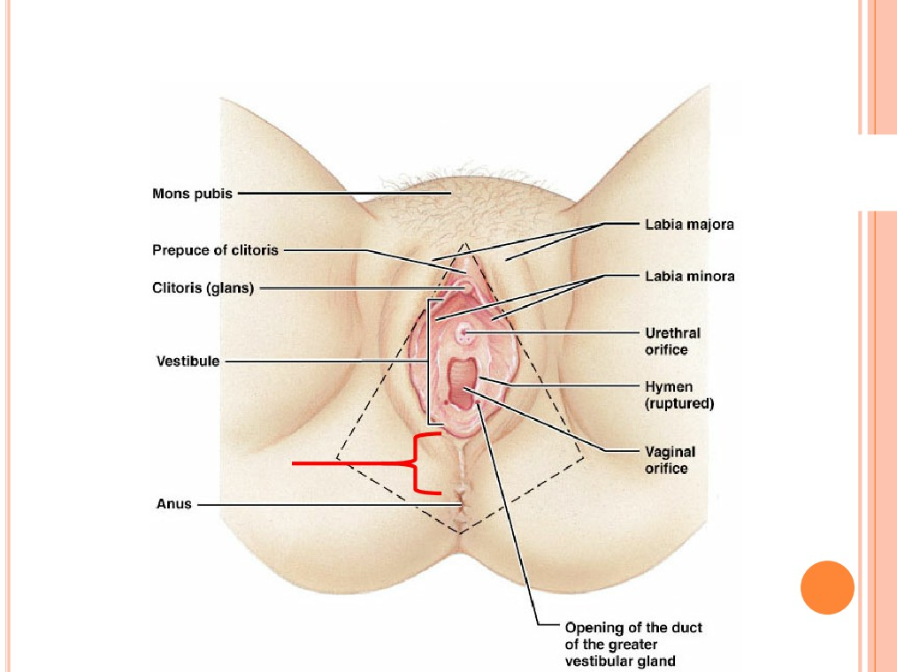
FEMALE EXTERNAL GENITALIA
Perineum
2

Slide 22
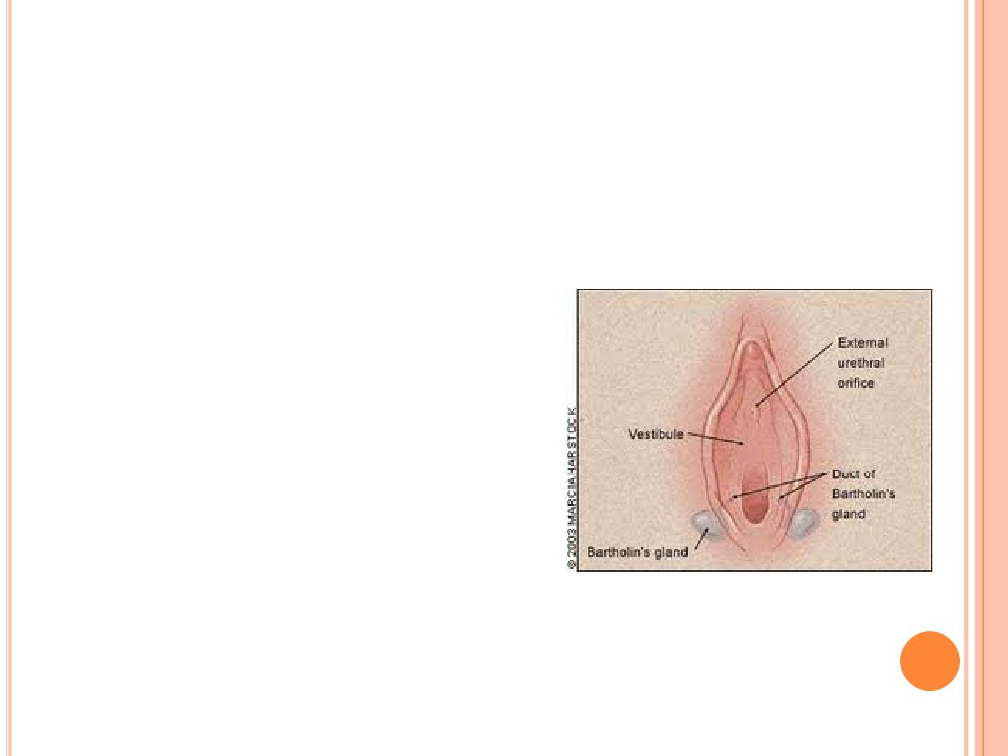
BARTHOLIN’S GLANDS
(AKA: VESTIBULAR GLANDS)
○
The Bartholin's glands are located on each side of the
vaginal opening.
○
They secrete fluid that
helps lubricate the vagina.
○
Sometimes the ducts of
these glands become
obstructed.
● Fluid backs up into the gland
and causes swelling
(Bartholin's cyst)
22

Slide 23
MAMMARY GLANDS
○
Modified sweat glands that produce milk (lactation)
Amount of adipose determines size of breast
Milk-secreting glands open by lactiferous ducts at the
nipple
Areola is pigmented area around nipple
Suspensory ligaments suspend breast from deep fascia of
pectoral muscles (aging & Cooper’s droop)
● Mammary line is a thickened ridge of embryonic tiwwue
that extends from the axilla to the groin.
23

Slide 24
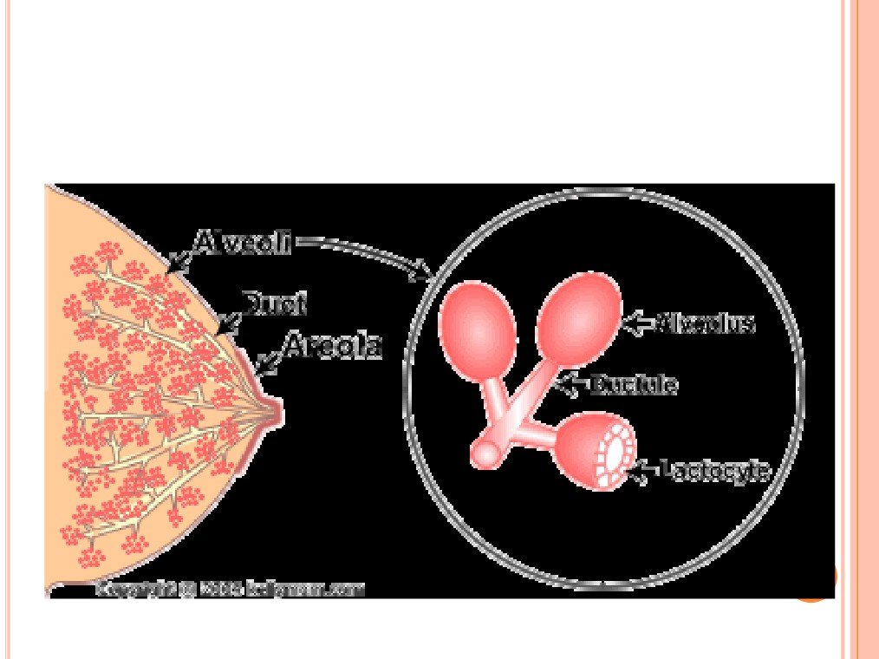
BREAST

Slide 25
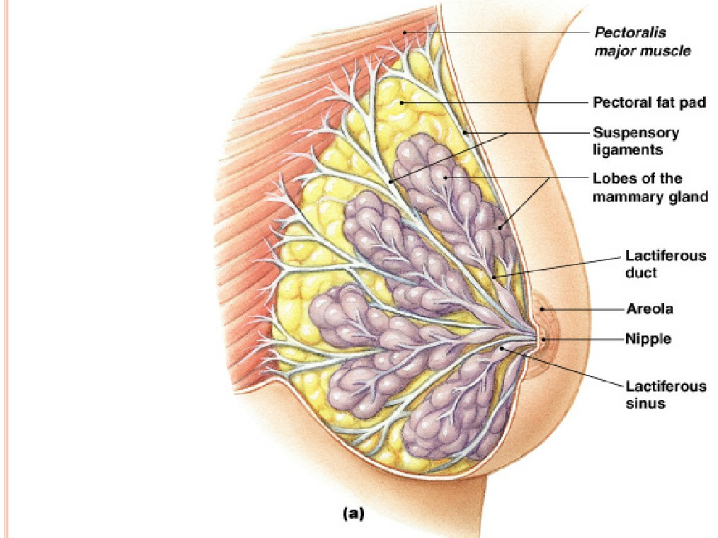
BREAST
○ Prolactin from
the pituitary
gland stimulates
the synthesis of
milk
○ Oxytocin from
the posterior
pituitary gland
stimulates milk
ejection
2

Slide 26
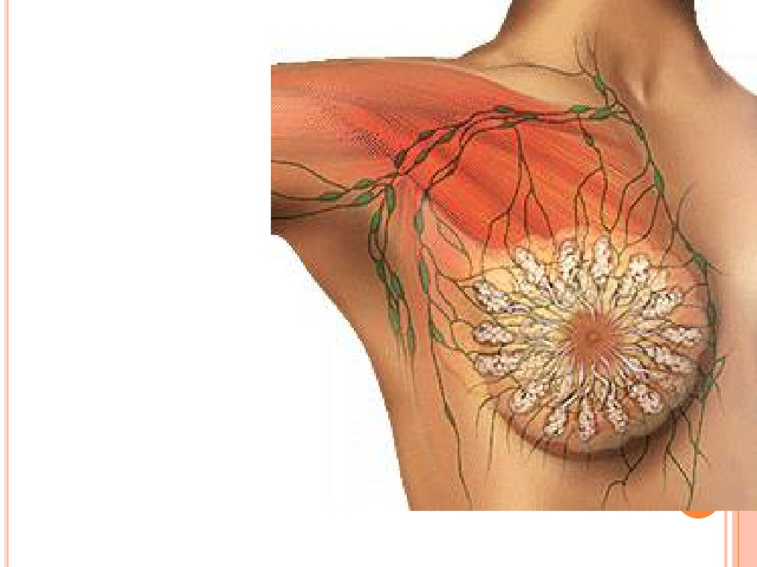
LYMPHATIC
DRAINAGE
○ Lymph nodes
draining the
breast are
located in the
axilla.
26

Slide 27
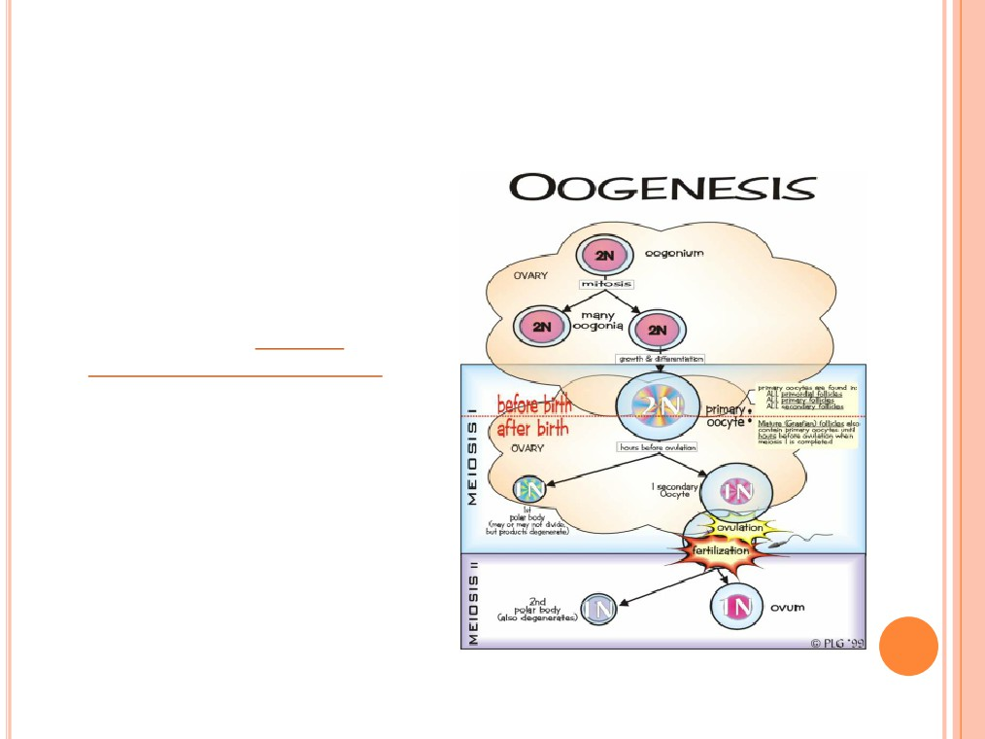
OOGENESIS: BEFORE BIRTH
ment,
○ During fetal develop
divide by mitosis to make
primary oocytes
gin
○ Primary oocytes be
prophase I until puberty
es:
● Primordial folliclt
surround the oocyte in the
ovary
● 2 million present at birth
● 400,000 remain at puberty
27

Slide 28
OOGENESIS: AFTER PUBERTY
○
Each month, hormones cause several follicles to
develop, which triggers the primary oocyte to
resume meiosis I
○
Polar bodies: When the cell divides, all the
cytoplasm and organelles stay with one of the new
cells, the other cell is just DNA, and is called a
polar body and is discarded
Secondary oocyte: The stage at which ovulation
occurs.
28

Slide 29
OOGENESIS: AFTER PUBERTY
○
The secondary oocyte begins meiosis II, but stops in
metaphase II
○
The secondary oocyte is ovulated
○ Meiosis II is completed only if it is fertilized.
29

Slide 30
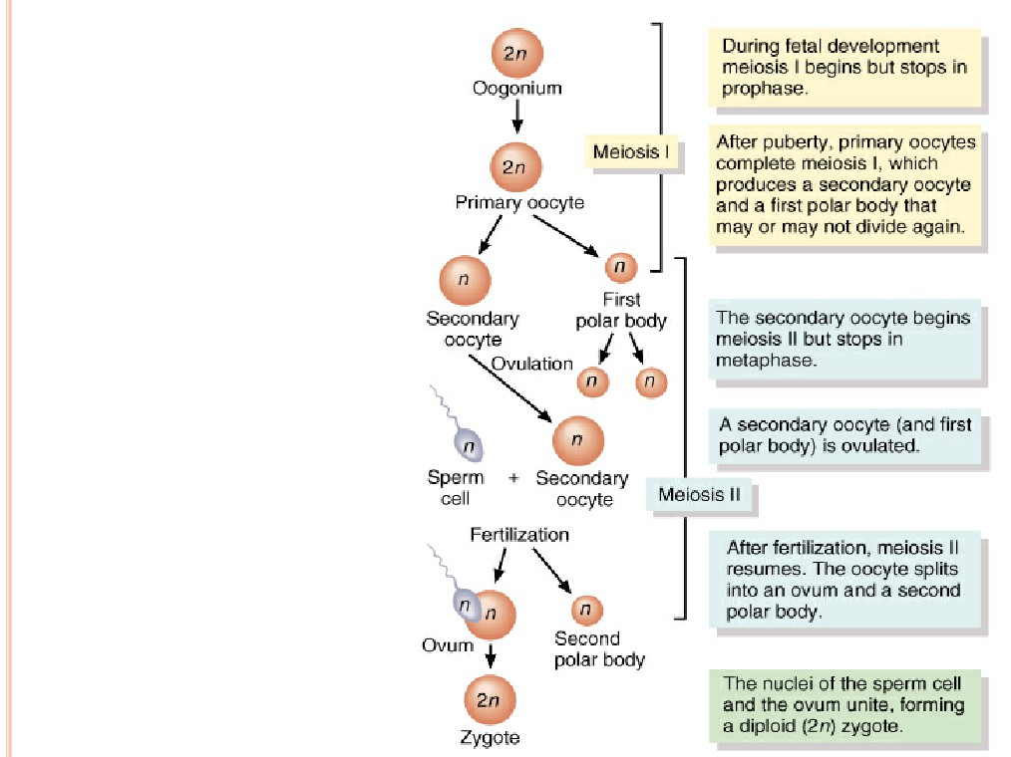
OOGENESIS
3

Slide 31
LIFE HISTORY OF OOGONIA
millions by
As a fetus, oogonia divide to produce
oocytes & stop in
Some develop into primaryI
● 200,000 to 2 million present at birth
in at puberty but only 400 mature during a
● 40,000 rema
Each month, hormones cause meiosis I to resume
in several follicles so that meiosis II is reached by
ovulation
Penetration by the sperm causes the final stages of
meiosis to occur
31

Slide 32
OVARIES
○
Each follicle consists of an immature egg called an
oocyte
○
Cells around the oocyte are called:
Follicle cells (one cell layer thick)
Stimulated to mature by FSH from the pituitary gland
Granulosa cells (when more than one layer is present)
Thecal cells: Cells in the ovarian stroma
○
Thecal & granulosa cells work together to produce
estrogen
○ A protective layer of glycoprotein forms around the
egg called the zona pellucida
32

Slide 33
FOLLICLE DEVELOPMENT
1.
Primordial follicle: one layer of squamous-
like follicle cells surrounds the oocyte
2.
Primary follicle: two or more layers of
cuboidal granulosa cells enclose the oocyte
Secondary follicle: has a fluid-filled space
between granulosa cells that coalesces to
form a central antrum
3.
4.
Graafian follicle: secondary follicle at its
most mature stage that bulges from the
surface of the ovary
5.
Corpus luteum : ruptured follicle after
ovulation
33

Slide 34
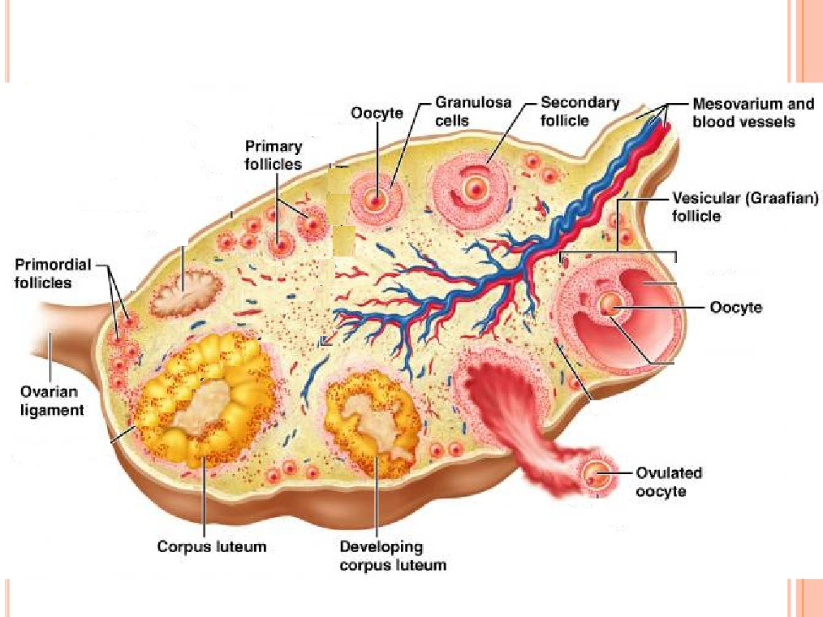
OVARY HISTOLOGY

Slide 35
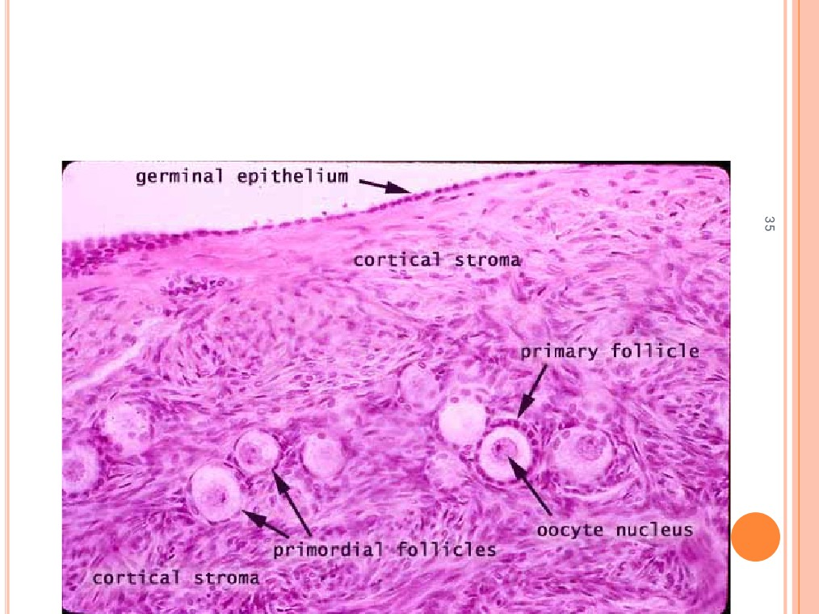
OVARY HISTOLOGY

Slide 36
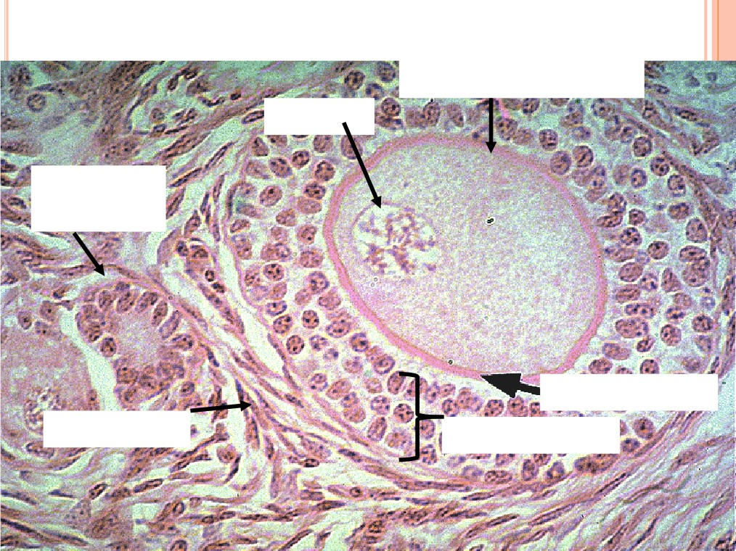
Primary Follicle
1° Oocyte
(arrested in prophase I)
Nucleus
Primordial
follicle
Zona pellucida
Thecal cells
Granulosa
cells
3

Slide 37
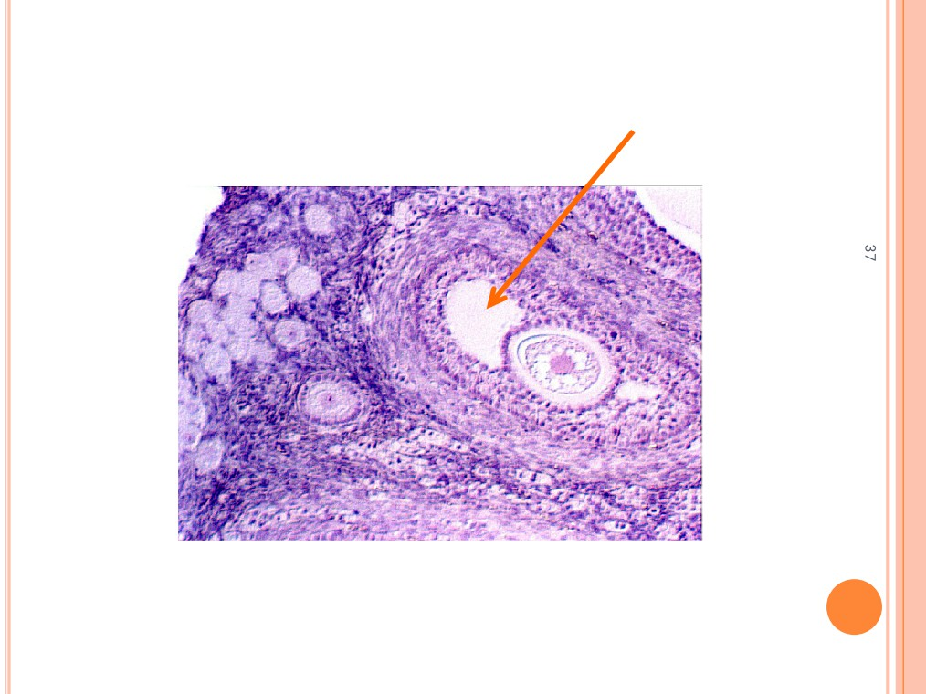
Fluid-filled antrum
SECONDARY FOLLICLE

Slide 38
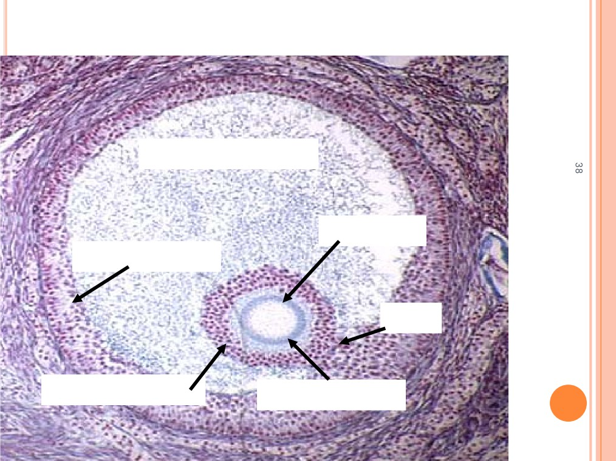
GRAAFIAN FOLLICLE
Fluid filled antrum
Oocyte 2°
Granulosa
cells
Stalk
Corona radiata
Zona pellucida

Slide 39
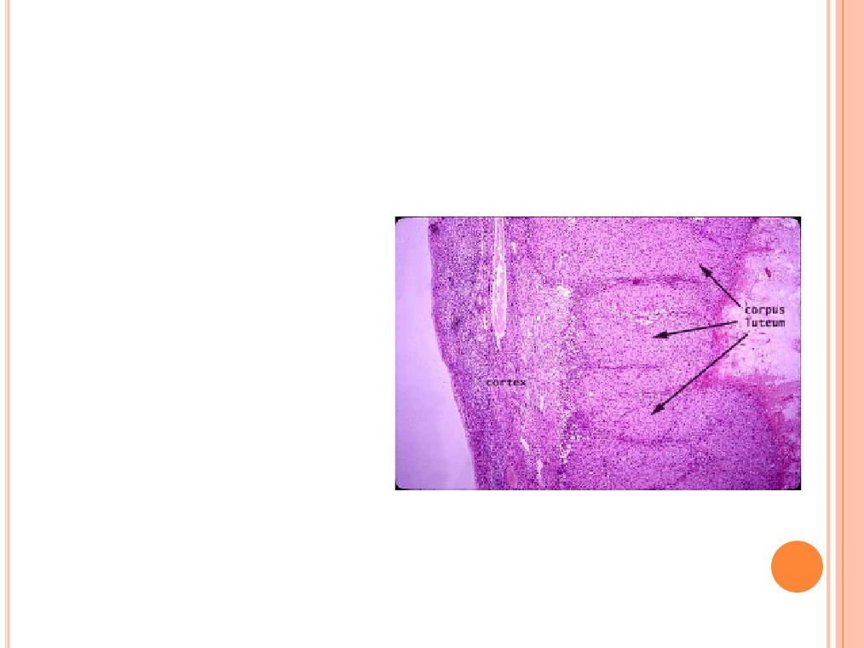
CORPUS LUTEUM
○ After ovulation, the
remains of the follicle
are transformed into a
structure called the
corpus luteum.
○ If a pregnancy occurs,
it produces
progesterone to
maintain the wall of the
uterus during the early
period of development.

Slide 40
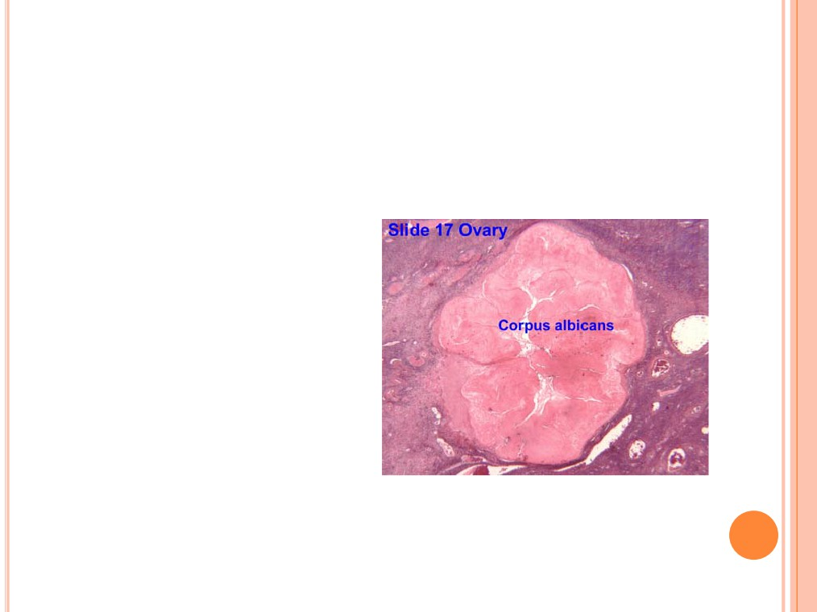
CORPUS ALBICANS
○ If fertilization does not
occur, the corpus
luteum will begin to
break down about 2
weeks after ovulation.
○ Degeneration occurs
when fibroblasts enter
the corpus luteum and
a clump of scar tissue
forms called the
corpus albicans.

Slide 41
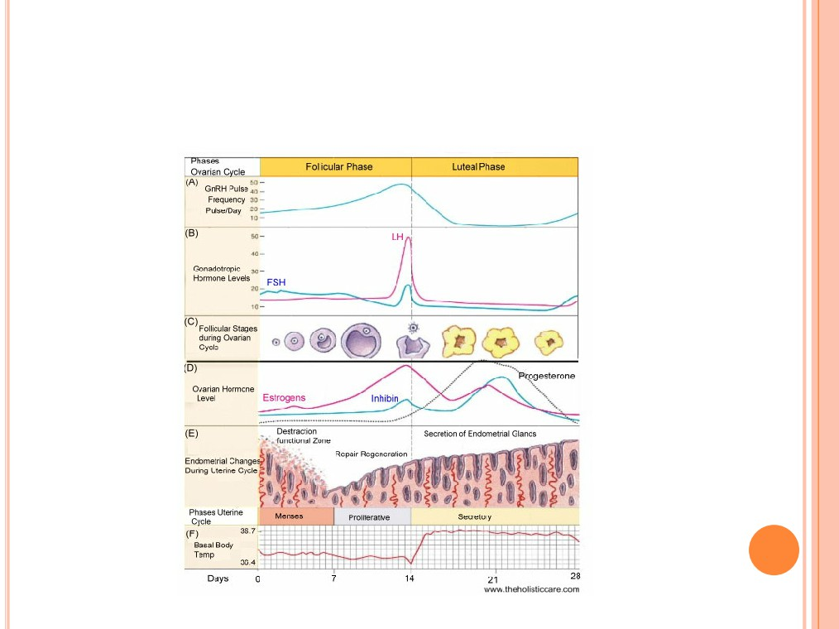
OVARIAN AND UTERINE CYCLES

Slide 42
TODAY’S ACTIVITIES
○ View female reproductive organs on the models
○ View slides of ovaries, fallopian tubes, uterus-
proliferative, secretive, menstrual

