Slide 1

Midwifery

Slide 2
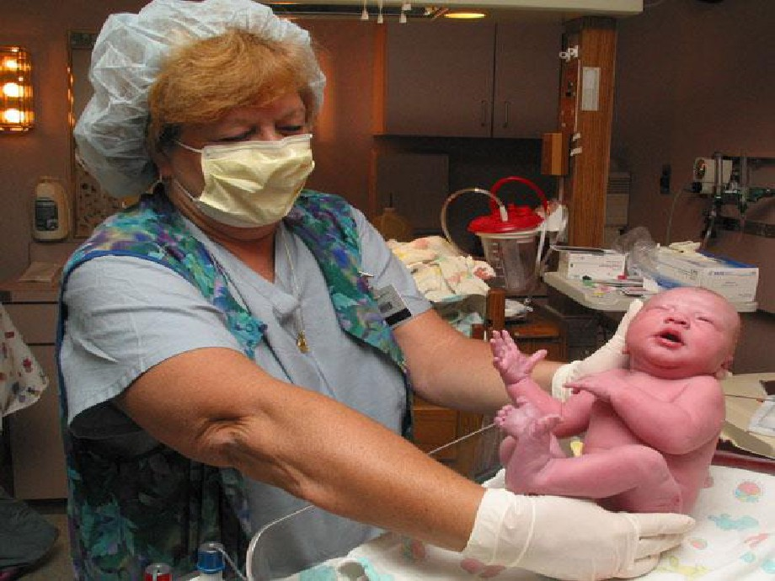

Slide 3
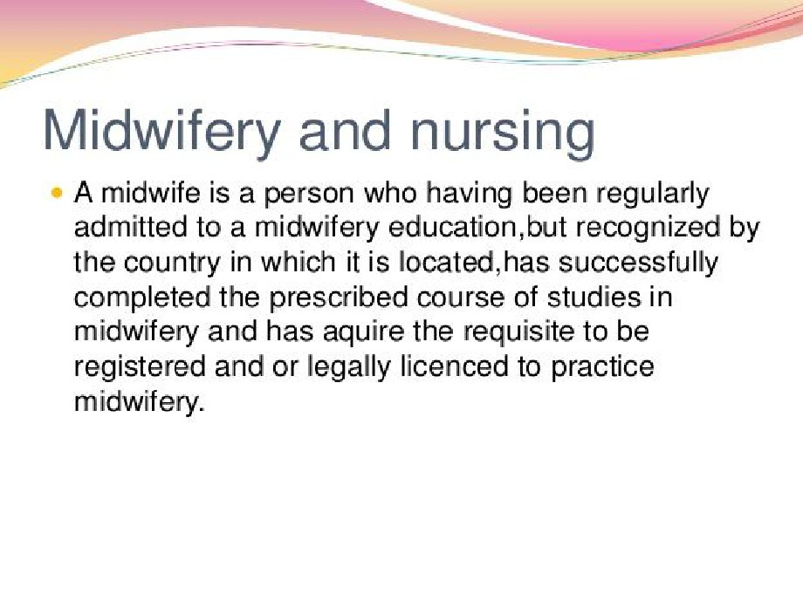

Slide 4

Nurse-Midwifery
• Midwifery model-care that safeguard the birth
process as natural and holistic.
• Medical (or illness) model-care is based on birth
is more of a disease state.
• Intrapartum/neonatal mortality rate same for
birth center or hospital (term/low risk)

Slide 5
SCOPE
CERTIFIED NURSE MIDWIFE
• Registered Nurse
• Advanced Practice Nurse (APN)
• Master’s degree in Nursing
• Specializing in Midwifery
• Credentialing necessary for state licensing

Slide 6
Training and Registration
• 1840s: midwifery added to the medical
curriculum
• 1850s: diplomas awarded by medical
schools
•
1862: King’s College Hospital introduces
midwifery training for nurses
•
1902: Midwife Registration Act

Slide 7
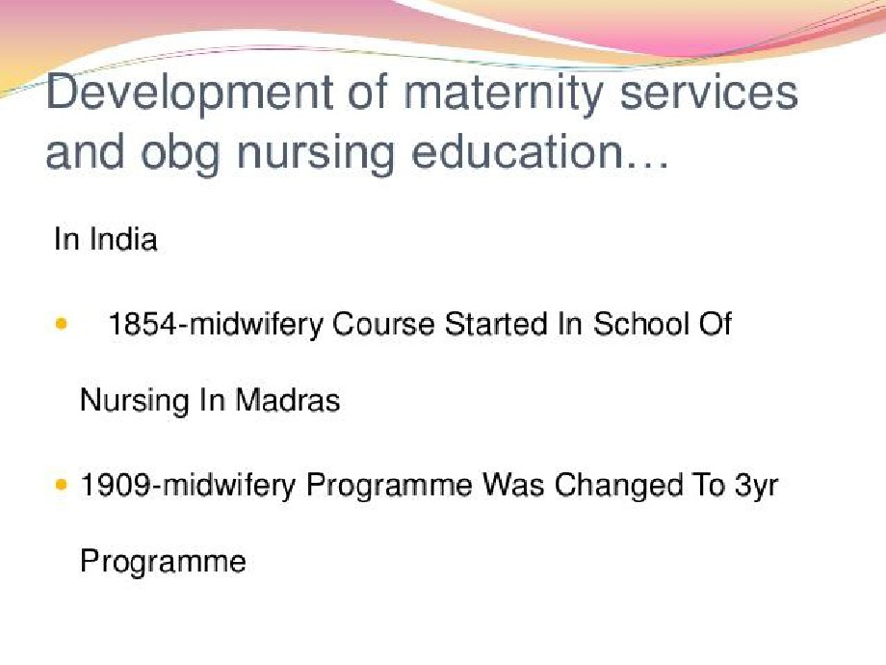

Slide 8


Slide 9
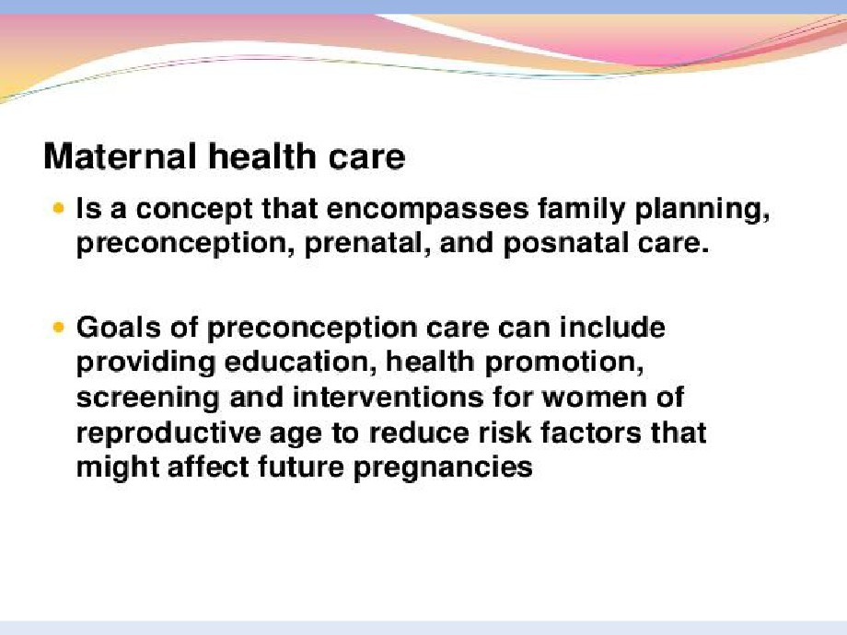

Slide 10
Maternity Nursing in the
21st Century
• Antepartum Care
• Intrapartum Care
• Technology in OB

Slide 11
“Partum”
• Parturition: birth
• Partum: regarding time period to the birth
• Antepartum: before birth or prenatal
• Intrapartum: during the birth process
• Postpartum: after the birth (usually regarded as
the first 42days)

Slide 12
Home to Hospital-History
•
1900 <5% USA babies born in hospital
•
1940 50%
•
1970 99%
•
2005 99%

Slide 13
21st Century- more factors
• Increased maternal age
• ART-assisted reproductive technologies
• Advances in genetic counseling and
prenatal diagnosis
• Evidence-based care
• Efforts to meet goals of Healthy People
2010 and Safe Motherhood Initiatives in
developing countries
• Rising awareness of CAM (complimentary
& alternative medicines)

Slide 14

Twins 4/1000

Slide 15

West Triplets 1/7,000-10,000

Slide 16
Attending labor and birth
• Provide safe, satisfying care
• Patient and family are active participants
• Informed consent
• Appropriate use of technology

Slide 17
Technology for the 21st Center
• Birthing rooms
• Delivery rooms
• Operative suites

Slide 18

C-Section Rooms

Slide 19
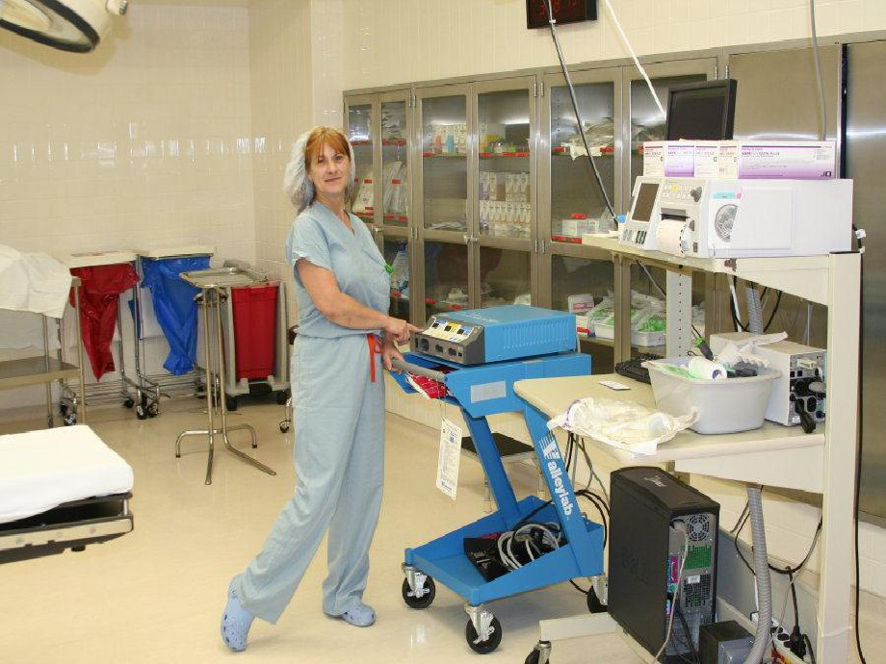

Slide 20
Latest Technologies
• Electronic Fetal Monitoring (EFM)
• Ultrasonography
• Infusion pumps
• Electronic monitoring devices:
1. Non-invasive
2. Invasive

Slide 21
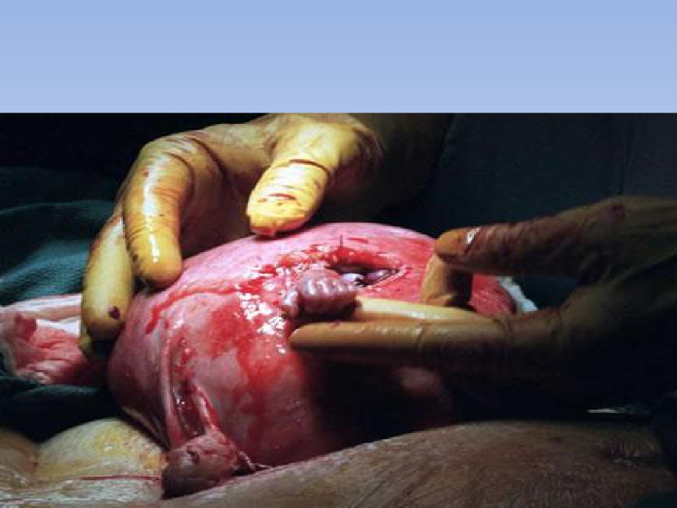
Fetal Surgeries

Slide 22
Latest Technologies
• Electronic Fetal Monitoring (EFM)
• Ultrasonography
• Infusion pumps
• Electronic monitoring devices:
1. Non-invasive
2. Invasive

Slide 23
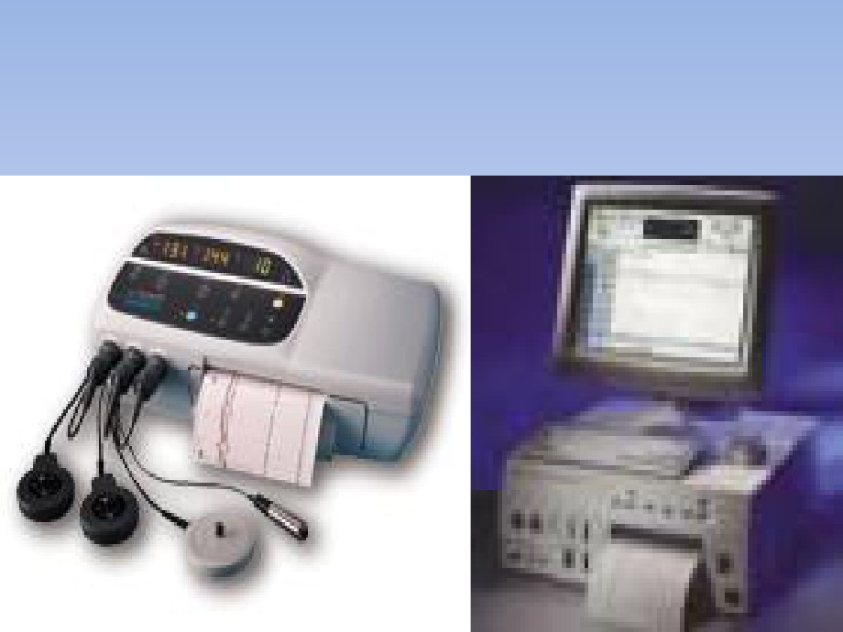
EFM

Slide 24
Antepartum testing with EFM
• NST-non-stress test
• CST-contraction stress test
• BPP-biophysical profile
All assess fetal well-being

Slide 25

Doppler

Slide 26
Ultrasonography
• Done at all stages of pregnancy
• Transvaginal or transabdominal approach
• Done for maternal or fetal indications
• Done in office, clinic, mobile centers, ob unit,
L & D

Slide 27
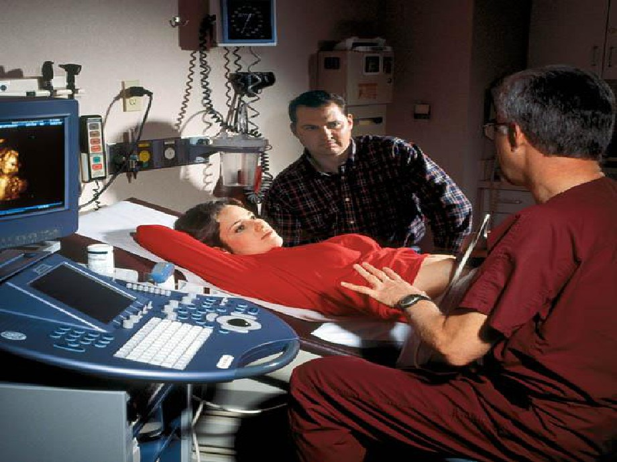

Slide 28
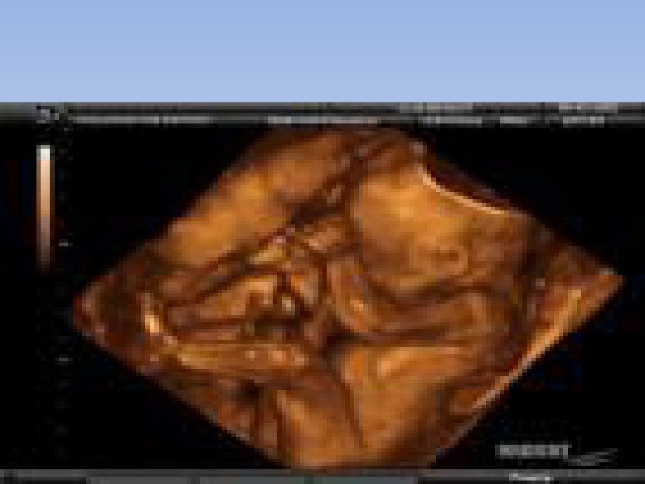
3-D & 4-D Ultrasound

Slide 29
Critically Ill OB
• Continuous cardiac monitoring
• Invasive hemodynamic monitoring
• CVP
• Arterial lines
• Pulmonary artery lines
• Ventilator

Slide 30
Genetics
• Human Genome Project
• Relationship to Maternity Nursing
• Advanced maternal age
• Patterns of inheritance
• Prenatal testing
• Genetic counseling
• Ethics and other

Slide 31

Finally Why Midwifery Care
Matters to Women
• “This has been a
dream birth that
made this day one
of the most
beautiful days of my
life.”

