Slide 1


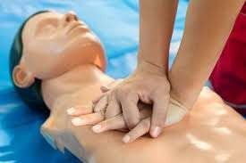
NURSING EDUCATION
CARDIO-PULMONARY RESUSCITATION (CPR)

Slide 2

INTRODUCTION
 Approximately 50 % of all deaths due to cardiovascular disease. CPR is the
basic life saving skill. Utilized In
or
cardiac, respiratory cardiopulmonary arrest .To
maintain
tissue oxygenation.
 In Clinical death : first 4-6 min ,at this this time someone recovered completely by CPR.

Slide 3


Cont…
 1980 -Development of cardiopulmonary resuscitation due to the works of Peter Safar(Viana) and He Develop ABC of CPR.

Slide 4

MEANING OF CPR
Cardio means “of the heart” & pulmonary means “of the lungs”.
Resuscitation is a medical word that means “to revive”-to bring back to life
The person giving C.P.R. is called a rescuer.

Slide 5

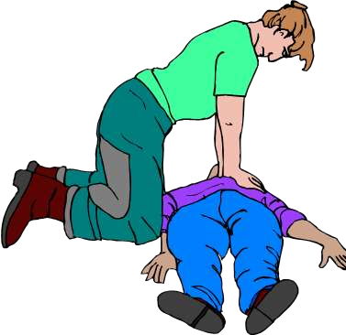
DEFINITION OF CPR
C.P.R. is
an artificial method of
circulating blood & oxygen through a body and attempting to keep the brain alive. (American heart association)
C.P.R. is an emergency life-saving procedure that is done when someone’s breathing or heartbeat has stopped.

Slide 6

PURPOSE
To maintain the sufficient perfusion of the brain.
To maintain the sufficient perfusion other vital organs until an adequate spontaneous cardiac output can be established.
To prevent brain damage.

Slide 7

INDICATION FOR CPR
Cardiac arrest
Respiratory arrest
Drowning
Head injury with unconsciousness
Electric shock
Airway obstruction
Acute M.I.
Hypovolemic shock
Drug overdose
Pulmonary edema

Slide 8

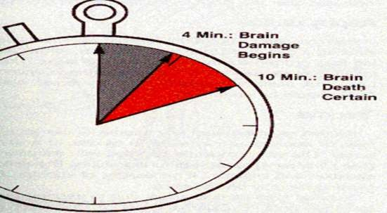
Physiology
 Permanent brain damage begins after only 4 minutes without oxygen & death can occur as soon as 4-6 minutes later. C.P.R. can restore circulation of oxygen rich blood to the brain.

Slide 9


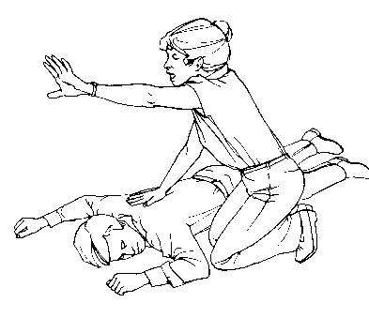
STEPS FOR CPR PROCEDURE
Check for responsiveness:-
Shake or tap the person gently. See if the person moves or
makes a noise. Seen safety.
 Call 108 if there is no response:- Shout for help & send someone to call 108/skilled assistance if you are alone

Slide 10

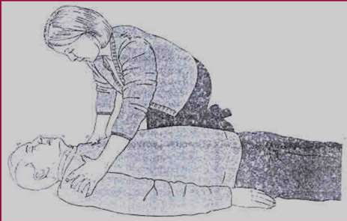
CONT..
 Position of the person:-
Carefully place the person on their back On hard surface. If there is a chance
the person has a spinal
injury, two person to
people should move the
prevent the head neck twisting.
Check pulse & Respiration.
&

Slide 11

CONT…
Perform chest compression:-
During CPR remember the order C A B
C-CIRCULATION
A-AIRWAY
B- BREATHING

Slide 12
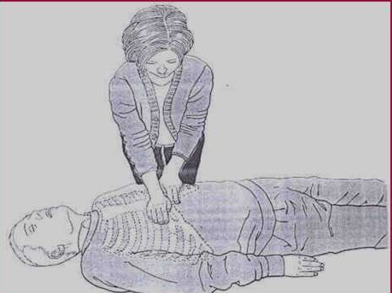
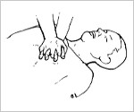
CONT…
Place the heal of one hand on the breastbone- right b/w the nipples.
Place the heal of your other hand on the top of the first hand.

Slide 13
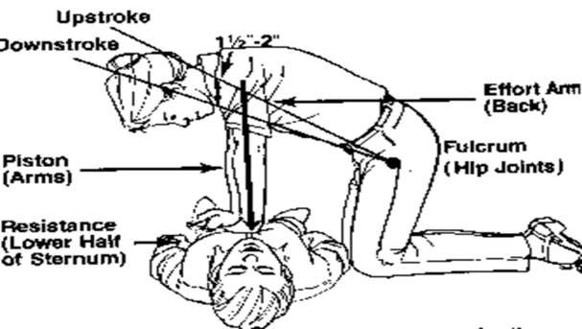
CONT…
Now your shoulder, elbow, and heel should form a straight line towards the compression site.
Position your body directly over your hands.

Slide 14
CONT…
DEPTH
Rate /min
Ratio for one
Ratio for two
ADULT
1.5-2
inches
100/min
30:2
30:2
Child
1-1.5
inches
100/min
30:2
15:2
Infant
.5-1 inches
>100/min
30:2
15:2
Newborn
.5-.8
>120/min
15:2
5:1

Slide 15

CONT…..
 Open the air way:-
Lift the chin with two fingers. At the same time tilt the head by pushing down on the forehead with the other hand. If foreign bodies are present in the airway they must be removed.
Head tilt contraindicated in cervical injury.

Slide 16
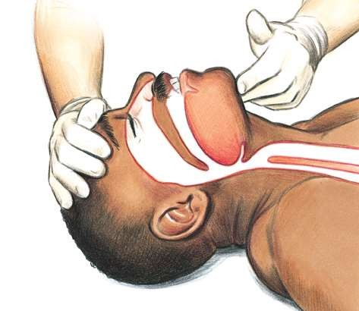
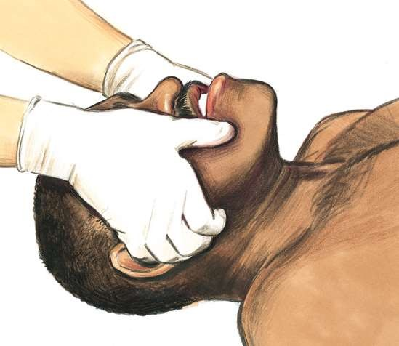
CONT…
HEAD TILT–CHIN LIFT
JAW THRUST

Slide 17

CONT….
Look, listen & feel the breathing:-
Place your ear close to the person’s mouth & nose. Watch for chest movement. Feel for breath on your cheek.
If the person is not breathing or has trouble breathing:-
Cover the victim’s mouth tightly with your mouth.
Pinch the nose closed.
Keep the chin lifted & head tilted.

Slide 18
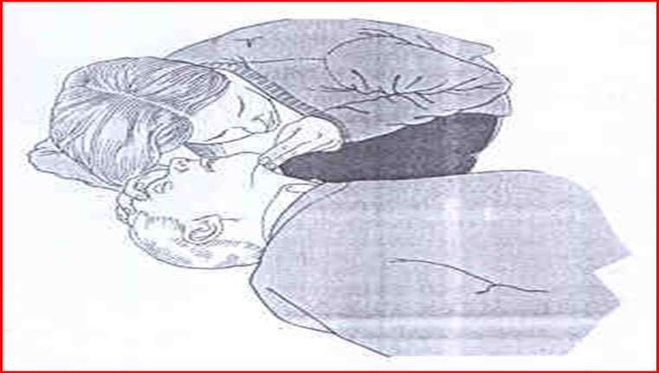
CONT…
Look, Listen, Feel

Slide 19
CONT….
Give two rescue breaths. Each breath should take about a second & make the chest rise.
Continue C.P.R. (30 chest compression followed by 2 breaths then repeat) until the person recovers or help arrives.

Slide 20

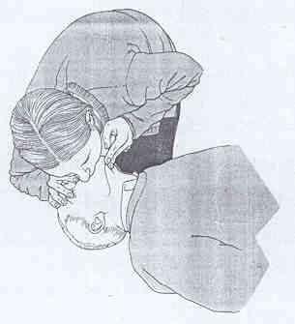
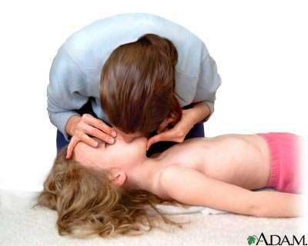
Mouth to mouth breathing

Slide 21

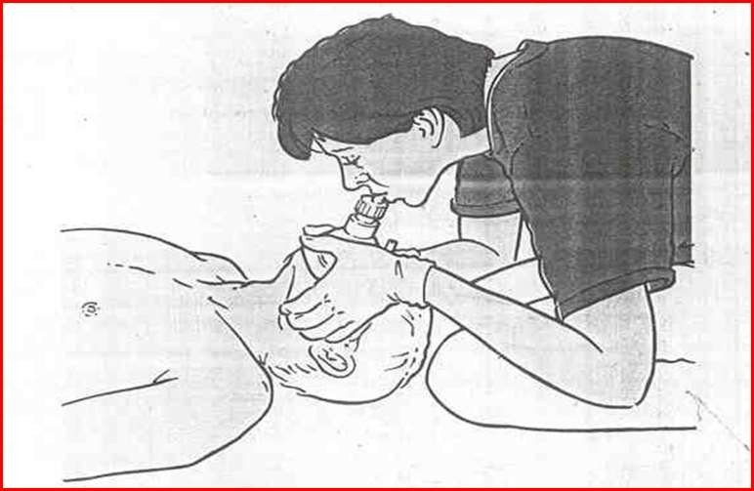
MOUTH TO MASK

Slide 22

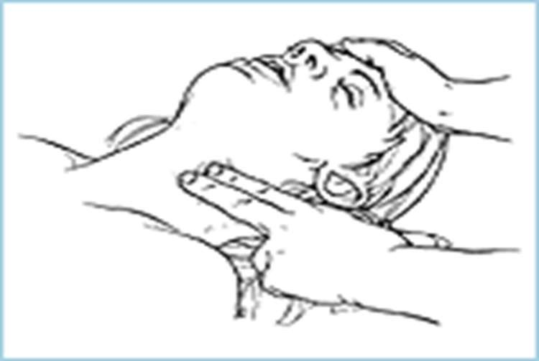
PALPATING PULSE

Slide 23

DEFIBRILLATION
If an AED (automated external defibrillator) for adult is available use it as soon as possible.
Most frequent arrest rhythm Ventricular Fibrillation / Ventricular Tachycardia.
Treatment is defibrillation
Successful conversion diminishes over time

Slide 24

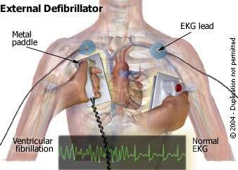
PLACING ELECTRIC PAD

Slide 25



DIFIBRILLATION NOT USED FOR:
Sinus rhythm
Bradycardia
Asystole

Slide 26
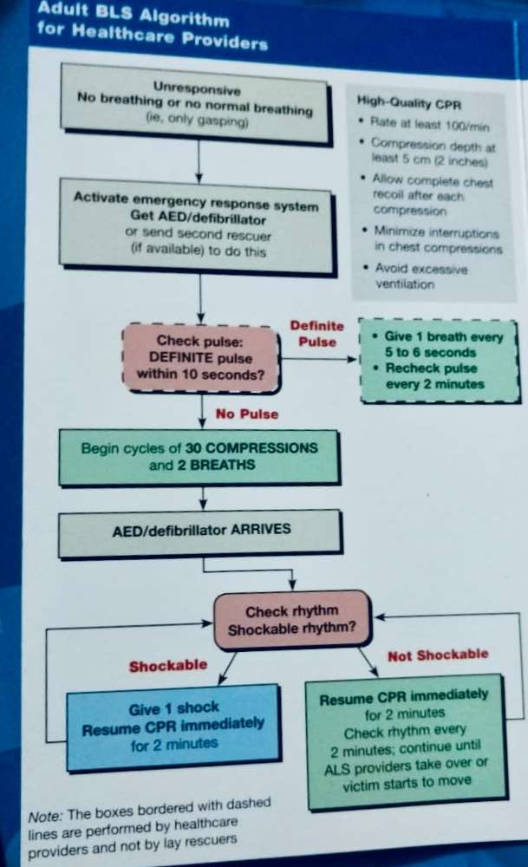


Slide 27
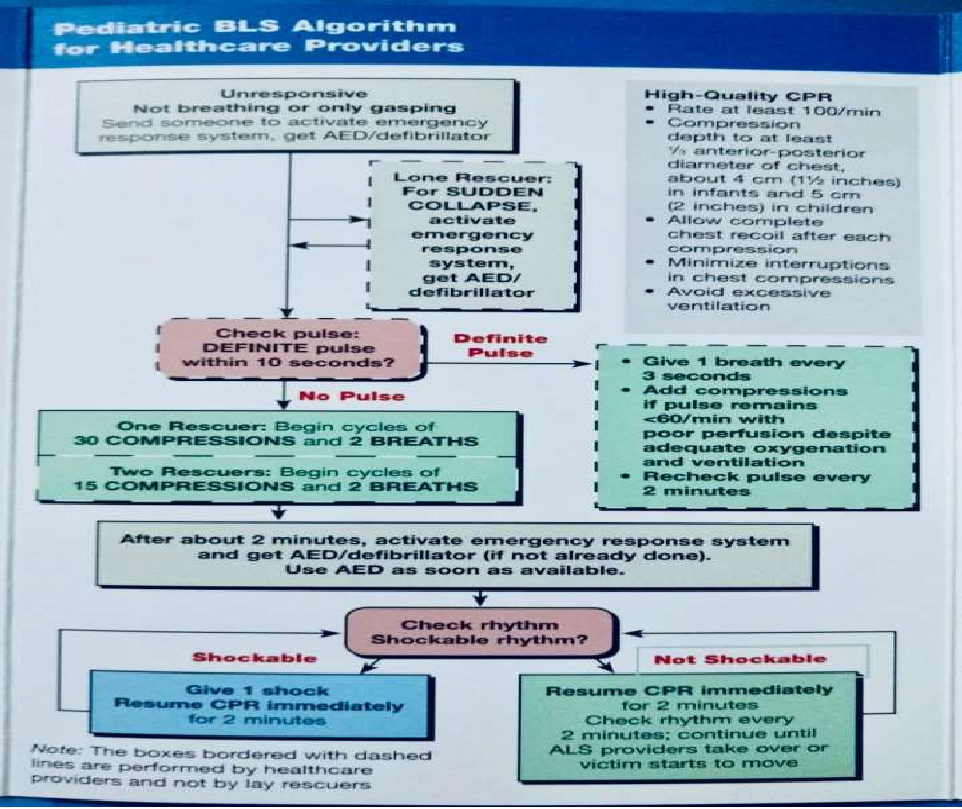

Slide 28
CONT..
 TERMINATION OF C.P.R.
Struggling movements
Return of pulsation
Spontaneous respiration
Recordable BP
Improved color

Slide 29

PRECUATION
Do not leave the victim alone
Do not give chest compression if the victim has a pulse.
Do not give the victim anything to eat or to drink
Avoid moving the victims head or neck if spinal injury is a possibility.
Do not slap the victims face or throw water on the face to try & revive the person.
Do not place a pillow under the victims head.

Slide 30

FACTS ABOUT CPR
CPR doubles a person's chance of survival from sudden cardiac arrest.
75% of all cardiac arrests happen in people's homes.
If CPR is started within 4 minutes of collapse and defibrillation provided within 10 minutes a person has a 40% chance of survival.

Slide 31

INJURY BY CPR
Rib fracture
Rib separation
Laceration liver ,lung, spleen
Air or blood in chest cavity.
Vomiting
OVERCOMING BY
Proper hand location. Compression straight down.

Slide 32

FAILURE OF CPR
Delay starting
Using improper technique
Victim has massive heart attack
Delay defibrillation

Slide 33


