Slide 1
Restraints

Slide 2
Definition :-
These are the protective devices employed to prevent client client from harming to himself or others ,
to immobilise body part ,
To restrict acvity ,
To promote a feeling of security
In the client who need It.

Slide 3
Objective :-
To avoid client from injury.
To prevent interruption of therapy.
To prevent confused client from removing any
Life supportive equipment.
To reduce the risk of injury to others.

Slide 4
Types of Restraints :-
1. anklets and wristlets restraints.
2. Elbow and Knee restraints.
3. Milt restraints.
4. Body jacket , restraints.
5.Mummy restraints
6.safety belts
7. splints, plaster cast , sand bags , bandages , etc
8. environment control restraints

Slide 5
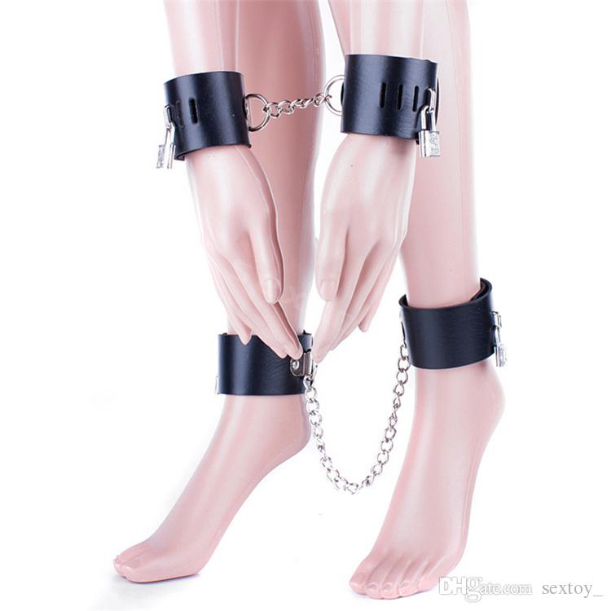
Anklets and Wristlets restraints:-
Those are used to restrict the activity of limbs in client.
To immobilise one or more limbs during procedure
ex :- violent behaviour of pt.

Slide 6
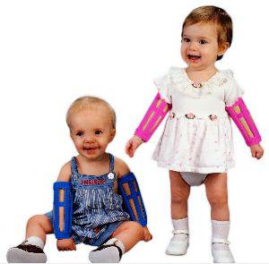
Elbow and knee restraints.
It is applied to prevent flexion of elbow and knee joint.

Slide 7
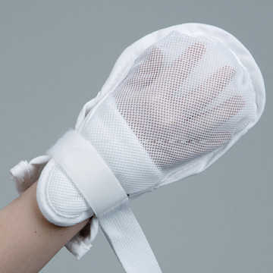
Mitt restraints
It is used for children or confused patient to prevent them using their finger or hands for removing tubes , dressing , and other appliance used in treatment.

Slide 8
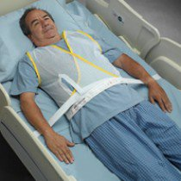
Body jackets
It is used for children and adult
Jacket restraints attached to the client’s bed frame.

Slide 9
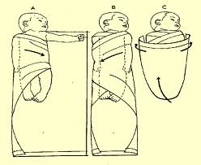
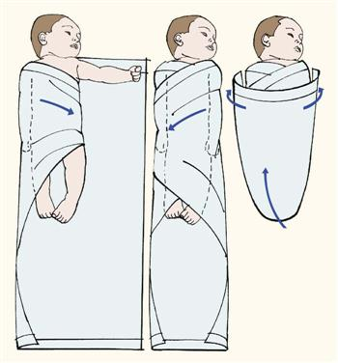
Mummy restraints
Its used to restrict the movement of limb in small child during rx.

Slide 10
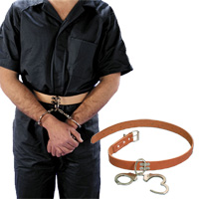
Safety belts
These are frequently used on stretchers and operation tables in orders to prevent client from falling
Belt restraints prevent the client from falling and leaving bed.

Slide 11
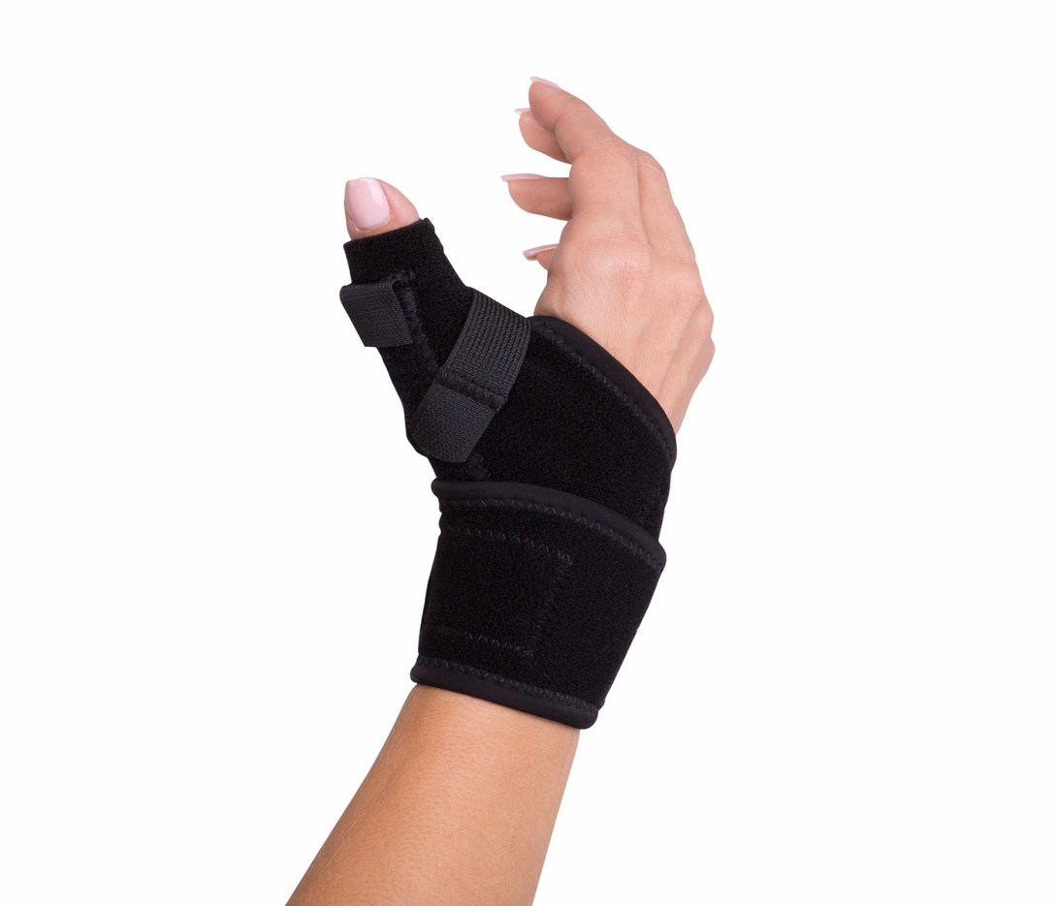
7. splints, plaster cast , sand bags , bandages , etc are used to restrict movement of different part of the body.

Slide 12
Envt control
A. side rails :- those are attached to both side of bed to prevent the client from getting out and falling out.
B. quite rooms :-
hazards free and commonly used for psychiatric pt.

