Slide 1
Digestion of protein

Slide 2
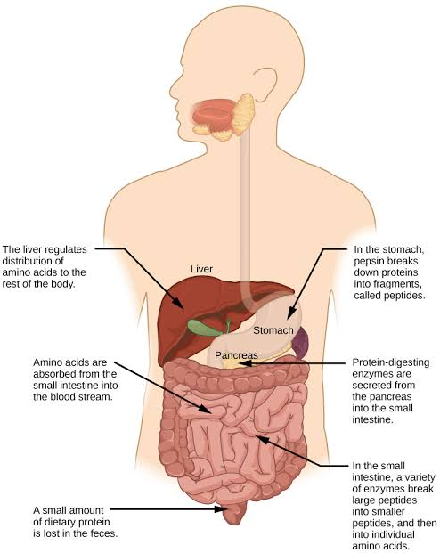

Slide 3
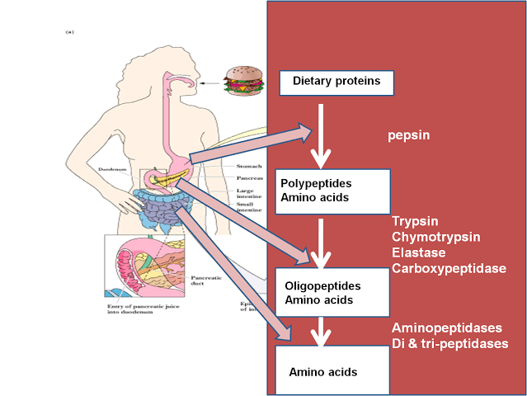

Slide 4
In mouth
Mechanical breakdown occur in the mouth.
In stomach
Protelytic enzyme in stomach is pepsin. First produced inactive form pepsinogen and get actived by strong acid hcl secretion.
Large polypeptide is brokedown in small peptide by pepsin.
Renin is secreted infant and children act on milk protein casein and produce curd. (coagulate curd)

Slide 5
In small intestine
In the small intestine the protelytic enzyme is secreted by pancreas and intestine itself.
 | Inactive enzyme | activator | Active enzyme
intestine | trypsinogen | entrokinease | trypsin
 | chymotripsinogen | trypsin | Chymotripsin Aminopeptidase dipeptidase

