Slide 1
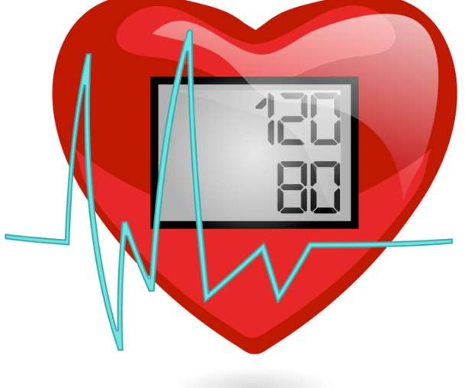

Slide 2
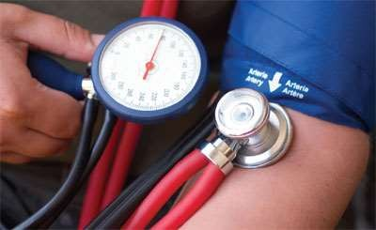
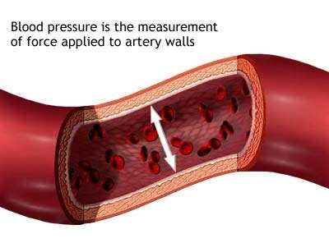
Blood pressure is the force or pressure of the blood against the walls of the blood vessels.
Arterial blood pressure is a measure of the pressure exerted by the blood as it flows through the arteries. It is the result of the ejection of blood from the left ventricle into the aorta.

Slide 3
Blood pressure is mentioned in terms of systolic blood pressure over diastolic blood pressure.
Systolic blood pressure is the highest pressure attained in arteries during systole and diastolic blood pressure is the lowest arterial pressure during diastole

Slide 5
The systolic pressure is the pressure as a result of contraction of the ventricles. When the left ventricle contracts and pushes blood into the aorta the pressure produced within the arterial system is called the systolic blood pressure.
In adults it is about 120 mmHg.

Slide 6
The diastolic pressure is the pressure when the ventricles are at rest.
When complete cardiac relaxation occurs and the heart is resting after the ejection of blood, the pressure within the arteries is called diastolic blood pressure.
In an adult it is about 80 mmHg.

Slide 7
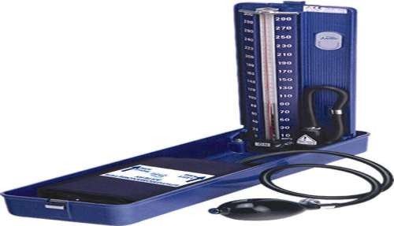
Arterial blood pressure is
measured with a sphygmomanometer.
Blood pressure is recorded as a fraction: systolic pressure over the diastolic pressure, and expressed in millimeters of mercury (mm Hg).
A typical blood pressure for a healthy adult is 120/80 mmHg.

Slide 8
Pulse pressure
The difference between systolic and diastolic blood pressures is the pulse pressure.
A normal pulse pressure is about 40 mmHg.

Slide 9
Factors Affecting Blood Pressure
Age: The pressure rises with age, reaching a peak at the onset of puberty, and then tends to decline.
Exercise: Physical activity increases the cardiac output and hence the blood pressure.
Stress: Stimulation of the sympathetic nervous system increases cardiac output and vasoconstriction of the arterioles, thus increasing the blood pressure.
Race: African Americans tend to have higher blood pressures than European Americans. The exact reasons are unclear.

Slide 10
Sex: Females have lower blood pressures than
males due to hormonal
variations. higher
After blood
menopause, women have
pressures.
Medications: Many medications, including caffeine, may increase or decrease the blood pressure.
Obesity: Predispose to hypertension.
Positions: Sitting, standing or lying down position cause slight variation in BP.
Diurnal variations (time of day): Pressure is lowest early in the morning, when the metabolic rate is lowest, then rises throughout the day and peaks in the late afternoon or evening.

Slide 11
Medical conditions: Any condition affecting the cardiac output, blood volume, blood viscosity, and/or compliance of the arteries has a direct effect on the blood pressure.
Temperature: Because of increased metabolic rate, fever can increase blood pressure. However, external heat causes vasodilation and decreased blood pressure. Cold causes vasoconstriction and elevates blood pressure.

Slide 12
Regulation of blood pressure
Regulation by cardio vascular center
Neural regulation
Hormonal regulation
Auto regulation

Slide 13
1. Regulation by cardiovascular center
The cardiovascular (CV) center in the medulla oblongata controls neural, hormonal, and local negative feedback systems that regulate blood pressure.
Groups of neurons within the CV center regulate heart rate, contractility (force of contraction) of the ventricles, and blood vessel diameter. Some neurons stimulate the heart (cardiostimulatory center); others inhibit the heart (cardioinhibitory center).
Some neurons control blood vessel diameter by causing constriction (vasoconstrictor center) or dilation (vasodilator center) which is referred as the vasomotor center. All group of neurons in the CV center neurons communicate one another and function together.

Slide 14
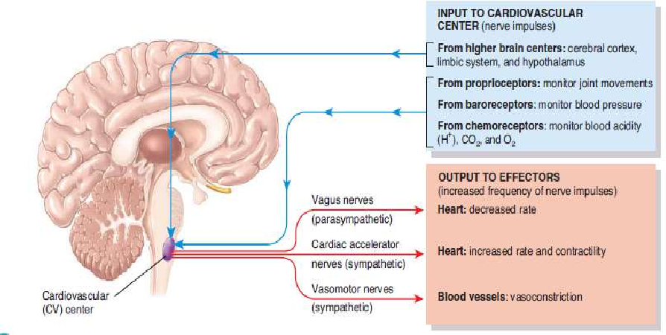

Slide 15
The cardiovascular center receives input both from higher brain regions and from sensory receptors (proprioceptors, baroreceptors, and chemoreceptors).
Output from the cardiovascular center flows along sympathetic and parasympathetic neurons of the ANS.
Increases
heart
rate and contractil ity
Sympath etic impulse
via cardiac accelerator
nerves
Sympatheti c stimulation
Reach heart
Increases BP

Slide 16
Para
sympathe tic impulse
Via vagus nerve
Reach
heart
Inhibitory
action
Decrease heart rate
Decrease
BP
The cardiovascular center also sends impulses to smooth muscle in blood vessel walls via vasomotor nerves. This produce sympathetic stimulation and results in vasoconstriction. Thus increases BP.

Slide 17
2. Neural regulation
The nervous system regulation of BP is a negative feed back mechanism via baroreceptor reflexes and chemoreceptor reflexes.
i. Baroreceptor reflexes
Baroreceptors are pressure-sensitive sensory receptors, located in the aorta, internal carotid arteries and other large arteries in the neck and chest. They send impulses to the cardiovascular center to help regulate blood pressure.
The two most important baroreceptor reflexes
are the carotid sinus reflex and the aortic reflex.

Slide 18
Baroreceptors in the wall of the carotid sinuses initiate the carotid sinus reflex helps to regulate blood pressure in the brain. Nerve impulses from the carotid sinus reach the cardiovascular center via glossopharyngeal nerves.
Baroreceptors in the wall of the aorta initiate the aortic reflex, which regulates systemic blood pressure. Nerve impulses from aortic baroreceptors reach the cardiovascular center via vagus (X) nerves.

Slide 19
Decrease BP
impulses from baroreceptors to CV center
parasympathetic stimulation sympathetic stimulation
secretion of epinephrine and norepinephrine by the adrenal medulla
Increased heart rate vasoconstriction Increased CO systemic vascular resistance
Increase BP
negative feed back

Slide 20
ii. Chemoreceptor Reflexes
Chemoreceptors are sensory receptors that monitor the chemical composition of blood located close to the baroreceptors of the carotid sinus and arch of the aorta. Chemoreceptors detect changes in blood level of O₂, CO₂, and H⁺.
Hypoxia (lowered O₂ availability), acidosis (an increase in H⁺ concentration) or hypercapnia (excess CO₂) stimulates the chemoreceptors to send impulses to the cardiovascular center.
In response, the CV center increases sympathetic stimulation to arterioles and veins, producing vasoconstriction and increases blood pressure.

Slide 21
3. Hormonal regulation
Hormonal regulation of BP is done by
Renin–angiotensin–aldosterone system
Epinephrine and norepinephrine
Antidiuretic hormone (ADH)
Atrial natriuretic peptide

Slide 22
i. Renin–angiotensin–aldosterone system
Renal blood flow Blood volume Blood pressure
Secretion of renin by kidneys
Angiotensinogen
Angiotensin 1
by ACE
Angiotensin 2
Secretion of aldosterone
Vasoconstriction
Increases blood pressure

Slide 23
When renal blood flow is reduced or blood volume decreases or BP drops the enzyme renin is secreted by kidney cells. Renin converts the plasma protein angiotensinogen, produced by the liver, to angiotensin 1. Angiotensin converting enzyme (ACE) converts angiotensin 1 to angiotensin 2. Angiotensin 2 causes vasoconstriction and increases blood pressure. Also angiotensin 2 stimulates secretion of aldosterone which causes vasoconstriction and increases blood pressure.

Slide 24
ii. Epinephrine and norepinephrine
In response to sympathetic stimulation, the adrenal medulla releases epinephrine and norepinephrine. These hormones increase cardiac output by increasing the rate and force of heart contractions. Thus increases BP.
Sympathetic stimulation
Release of epinephrine and norepinephrine Increase heart rate and contractions Increase CO
Increase BP

Slide 25
iii. Antidiuretic hormone (ADH)
Decreased blood volume
ADH released from the posterior pituitary
Vasoconstriction
ADH promotes movement of water from kidney tubules into bloodstream
blood volume and urine
output
Increases CO
Increases blood pressure

Slide 26
iv. Atrial natriuretic peptide
Atrial natriuretic peptide (ANP) is released by cells in the atria of the heart. ANP lowers blood pressure by causing vasodilation and by promoting the loss of salt and water in the urine, which reduces blood volume.

Slide 27
4. Auto regulation
The ability of a tissue to automatically adjust its blood flow to match its metabolic demands is called autoregulation.
In heart autoregulation is an important contributor to increased blood flow through the tissue.
Stimuli that cause autoregulatory changes in blood flow are;
Physical changes: Warming promotes vasodilation, and cooling causes vasoconstriction.
Vasodilating and vasoconstricting chemicals

Slide 28
HOW TO MEASURE BP?
Arterial pressure is most commonly measured via a sphygmomanometer, which historically used the height of a column of mercury to reflect the circulating pressure. Blood pressure values are generally reported in millimeters of mercury (mm Hg)
Measured by wrapping an inflatable pressure cuff around patient’s upper arm. This cuff is part of a machine called a sphygmomanometer. It is best to measure blood pressure when you are relaxed and sitting.

Slide 29
STEPS TO MEASURE THE BP?
Patients arm should be supported, with his/her upper arm at heart level, back supported, legs uncrossed, and feet on the floor. Your upper arm should be bare, with sleeve comfortably rolled up.
Medical personnel should wrap the blood pressure cuff snugly around your upper arm. The lower edge of the cuff should be 1 inch above the bend of your elbow.

Slide 30
The cuff must be inflated quickly, either by pumping the squeeze bulb or pushing a button. Patient would feel tightness around his/her arm.
Next, the valve of the cuff should opened slightly, allowing the pressure to slowly fall.
As the pressure falls, the reading when the sound of blood pulsing is first heard is recorded. This is the systolic pressure.

Slide 31
5. As the air continues to be let out, the sounds would disappear. The point at which the sound disappears is recorded. This is the diastolic pressure.
Inflating the cuff too slowly or not high enough may cause a false reading. If you loosen the valve too much, you won't be able to determine your blood pressure.

Slide 32
THANK YOU

