Slide 1
SUCTIONING
JAHID NOYDA

Slide 2
INTRODUCTION
Suctioning involve a flexible catheter to remove secretion from res. Tract.
When client is unable to clean res. Tract secretion with coughing nurse must clear airway with suctioning.
Primary suctioning technique are oropharyngeal , nasopharyngeal , orotracheal and nasotracheal.

Slide 3
Definition
Oropharyngeal Suctioning:-
It is the process of removing secretions from the oral cavity and pharynx. It is performed when client is able to cough effectively but unable to clear secretions by expectorator or swallowing.

Slide 4
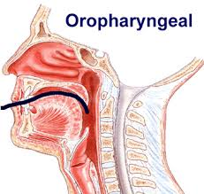

Slide 5
Orotracheal and Nasotracheal Suctioning :-
It is necessary when client with pulmonary secretions is unable to cough out and does not have an artificial airway.
An artificial airway can be oral airway, an endotracheal nasotracheal or tracheostomy tube.

Slide 6
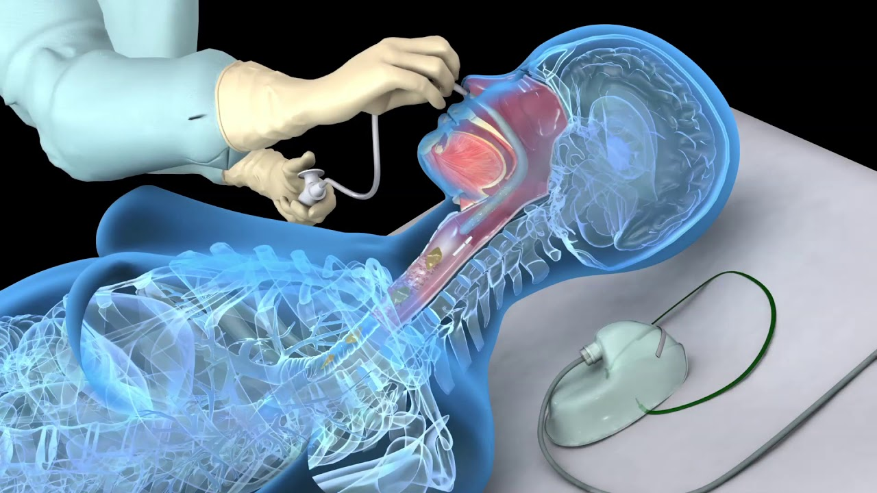

Slide 7
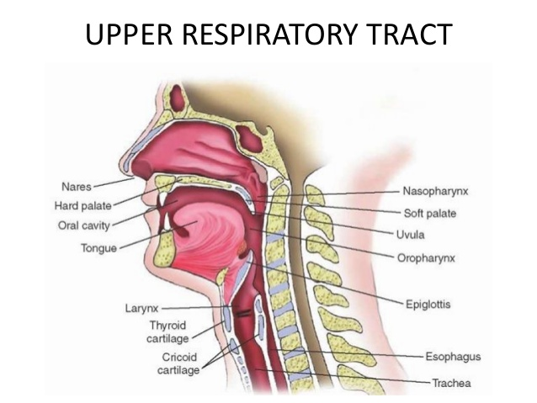

Slide 8
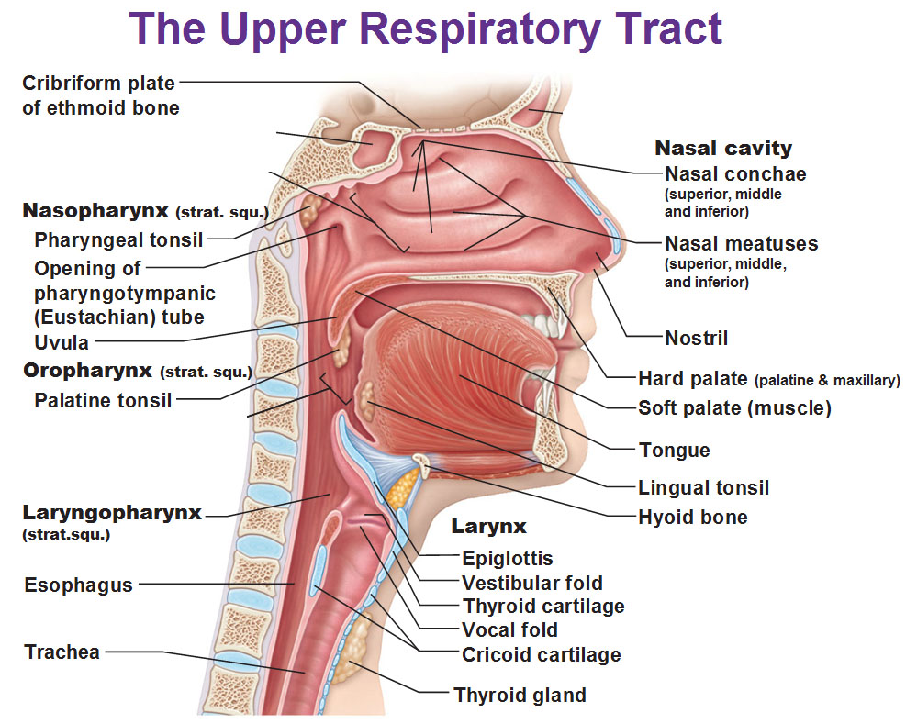

Slide 9
Oral airway
The oral airway, the simplest type of artificial airway, prevents obstruction of the trachea by displacement of tongue into the oropharynx in unconscious client.
Indications for an artificial airway include
    decreased level of consciousness,
    airway obstruction,
    mechanical ventilations and removal of tracheal secretions.

Slide 10
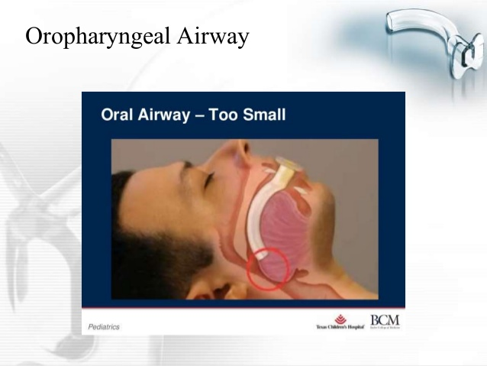
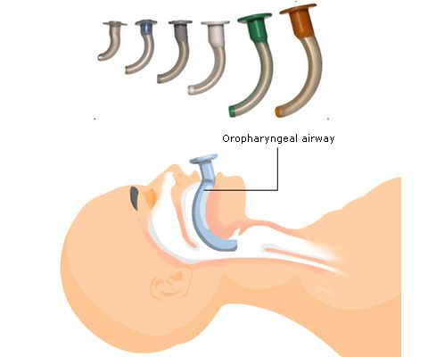

Slide 11
TRACHEAL AIRWAY
TRACHEAL AIRWAY
Artificial tracheal airway includes endotracheal, nasotracheal types.
These allow easy assess to the client s trachea for deep tracheal suctioning. Removal of tracheal secretions must be done following aseptic technique

Slide 12
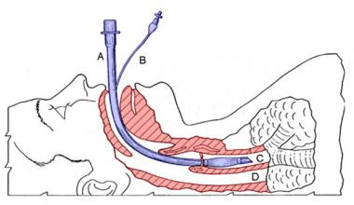

Slide 13
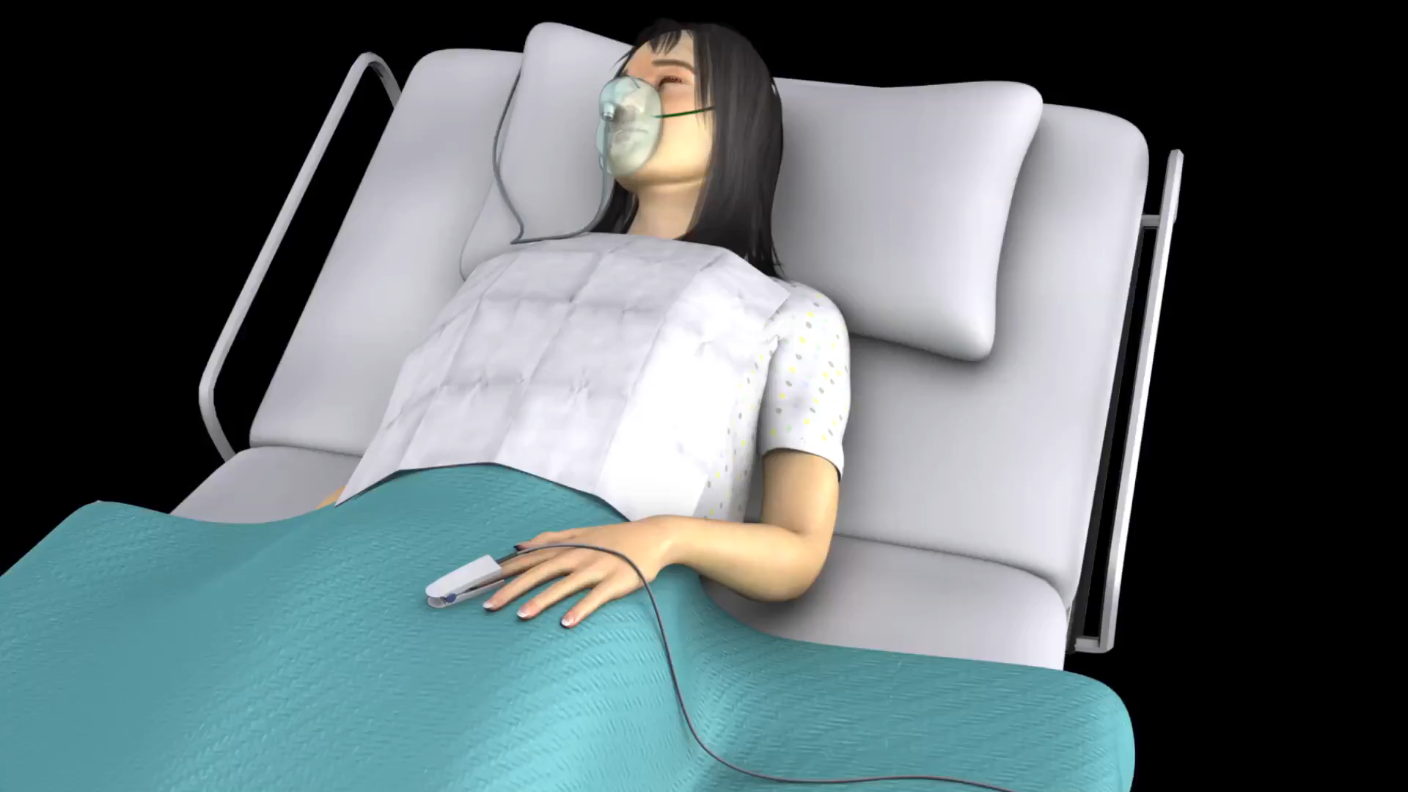

Slide 14
Purpose…
To remove secretions that obstruct the airway
To facilitate ventilation.
To obtain secretions for diagnosis purpose.
To prevent infection that may result from accumulated secretions

Slide 15
Article for oropharyngeal and Nasopharyngeal Suctioning
Appropriate size sterile suction catheter / smallest diameter that effectively
portable or wall suction with connecting tube or y connector
Sterile water / normal saline in bowl.
Face mask
Gloves
Towel or waterproof pad. Tongue depressor
Nasal or oral airway

Slide 16
Procedure
Assess for sign and symptoms which indicate presence of upper airway secretions, gurgling respirations, restlessness, vomitus in mouth .
Explain the procedure to client and also to relatives
Prepare necessary equipment and supplies.
Maintain the privacy of the patient.
Give semi fowler’s position to the patient with the head turned to one side. For doing nasal suctioning, place the client in the semi fowler s position with neck hyperextended
Place an unconscious client in the side lying position facing towards the nurse.
Select the proper suction pressure for the type of suction unit. For wall suction Unit is 110 -150 mm of Hg in adults
95-110 mm of Hg in children
50- 95 mm of Hg in infants

Slide 17
Wash hands.
Wear gloves.
Using gloved hand, with coiled catheter, attach the catheter with the connecting tubing of suction machine.
Place a towel on the pillow or under the chin.
a) For nasopharyngeal suctioning, gently insert catheter into the nostril. Guide the catheter medically along the floor of nasal cavity. .
For oropharyngeal suctioning, gently insert the catheter into one side of mouth, and guide the catheter to the oropharynx.
Do not apply suction during insertion.
While withdrawing, cover the suction part with thumb, gently withdraw it by rotating.

Slide 18
The procedure should not take more than 15 seconds inside lungs.
Flush the catheter with sterile solution and apply suction.
Suck the secretions from mouth or under tongue after suctioning nasopharynx and oropharynx.
Wash hands after suctioning & discard the used catheter.
Record the amount, consistency, color, odor of secretions & client s response to procedure.

Slide 19
INHALATION

Slide 20
Definition
INHALATION is defined as the taking air or other vapors into lungs through mouth or nose.
It is the breathing of a vapor containing a medication.
The medication may be added as a liquid to a vaporizer, then converted into a vapor or may come prepared as a vapor It may be simple normal saline.
In case of drugs: - Drugs may be given by inhalation for either a systematic or a local effect. The systemic effect is produced immediately because of large surface area of the lungs and the rich supply of blood vessels.
Drugs used for local effect may be in the form of medicated steam and fumes, although the fumes are rarely used:

Slide 21
Types of Inhalation
1. Dry Inhalation 2. Moist Inhalation

Slide 22
(I) Dry inhalation:
The inhalation of fumes from volatile drugs, is known as dry inhalation. E.g. : Ether, Chloroform, Nitrous oxide, Menthol, Eucalyptus, Spirit, Ammonia.
(II) Moist inhalation:
The inhalation of plain steam or steam impregnated with a drug is known as moist inhalation. Moist steam inhalation is defined as utilization of moist heat to loosen lung congestion and helps to liquify secretions, e.g. steam, tincture benzoic,

Slide 23
Purpose :-
To relieve inflammation of mucus membrane in acute colds and in sinusitis.
To relieve irritation in bronchitis whooping cough by moistening
To provide antiseptic action on the respiratory tract.
To provide warmth and moist air following operations e.g. Tracheostomy
To soften secretions which are thick.
To relive cough.

Slide 24
General Instructions :-
The temperature of water should remain between 120 and 160°F .
Water in inhaler should remain just below the spout to avoid scalding. The spout of inhaler must be placed' m such a way that the patient can t touch it or put his face too near. -
Keep the patient warm and prevent drought before, during 8: after inhalation. ~ When volatile drugs are used, keep clients eyes closed to prevent drug irritation to the conjunctiva. Observe the patient closely throughout the procedure

Slide 25
Check :-
The doctor’s order for any specific instructions.
General condition and diagnosis of patient.
Self-care ability to follow instruction.
Type, duration and medication of inhalation.
Articles available in unit.

Slide 26
Equipment :-
A tray containing.
Nelson’s inhaler
Large bow.
Face towel &.patient towel
Sheet
Gauze pieces
Cotton swabs
Swab stick
Kidney tray and paper bag

Slide 27
Preparation of patient and environment : -
Explain the procedure to patient. .
Allow the patient to empty the bladder and bowel, if necessary Give bed pan 0r urinal bed ridden patients. .
Provide Fowler's position with back rest, cardiac table and extra pillows.
Close windows, door and put off the fans to prevent draught.
Provide sputum mug within the reach of patient.
Provide a face towel to remove sweat from face during inhalation.
Arrange the articles at bed side. Keep client s eyes closed incase volatile drugs are used, because volatile drugs may irritate the conjunctiva.

Slide 28
Procedure :-
Wash hands.
Open mouth piece of steam inhaler and cover with sterile gauze & attach to inhaler.
Close spout of inhaler with cotton ball.
Pour boiling water up to spout.
Add medicine if needed or if prescribed by physician.
Close inhaler with mouth piece and take to bed side of patient.
Keep spout away from patient s face and remove cotton ball.
Instruct the patient to take deep breath through mouth & breath out through nose.
Continue procedure for 15 20 minutes.
Keep patient warm throughout to prevent chilling.
Give chest physiotherapy & encourage patient to cough out sputum.

Slide 29
After care :-
Remove the inhaler from the patient.
Use face towel to wipe off perspiration from patient s face.
Remove the accessories and make the patient comfortable.
Replace the articles after cleaning.
Wash hands.
Record the procedure in nurse s record sheet

Slide 30
Pulse Oximetry :-
Pulse oximetry offers a non-invasive means of estimating the arterial oxygen saturation (SaO2).
The pulse oximeter uses infrared light to determine the percentage of hemoglobin that has combined with oxygen.
A sensor attached to the Client’s finger or ear lobe allows assessment of heart rate and oxygen saturation either intermittently or continuously.
Oximetry is a convenient and painless alternative to needle sticks. It is simple for use and provides intermediate data

