Slide 3
PURPOSE OF IOL
When the risks of continuation of pregnancy either to the mother or to the fetus is more, iduction is indicated.
Before induction one must ensure the gastational age as well as pulmonary maturity of the fetus.

Slide 7
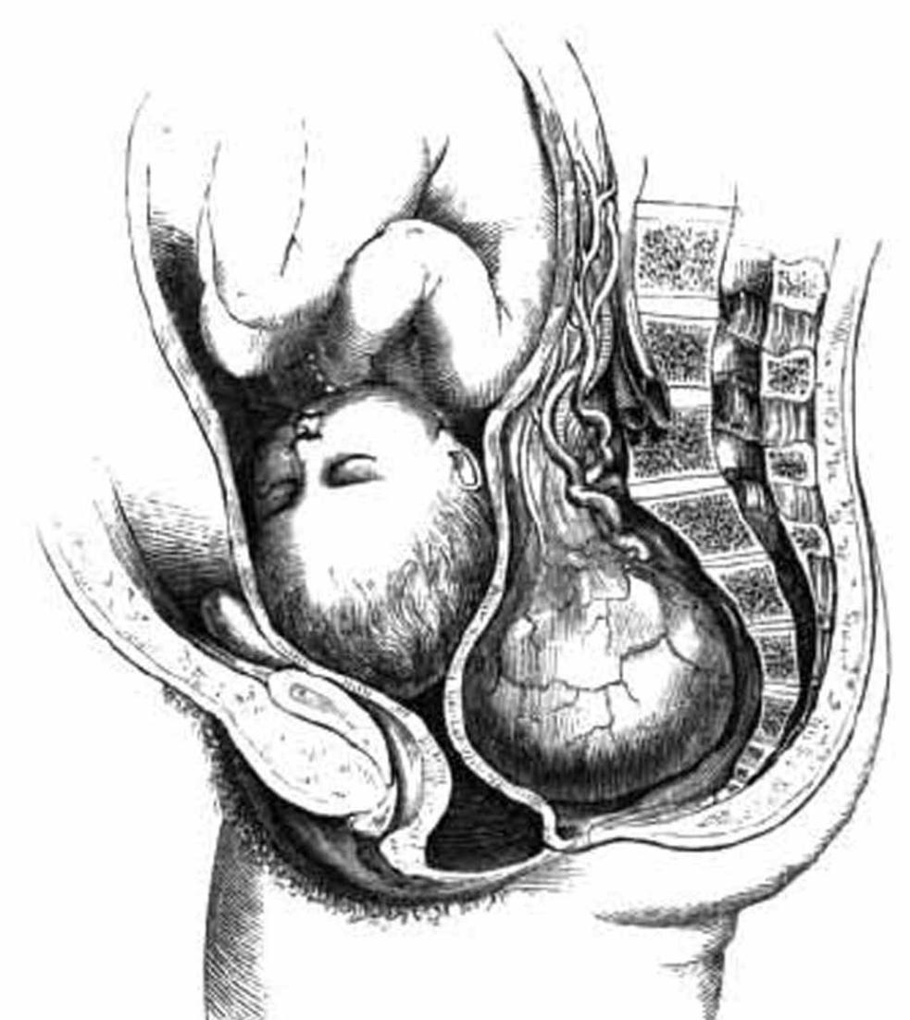
Active genital herpes infection
High risk with fetal compromise
Heart disease
Pelvic tumour

Slide 10
MEDICAL INDUCTION
Drugs used
Prostaglandins
- PGE2 = Dinoprostone
- PGE1 = Misoprostol
2. Oxytosin
3. Mifepristone

Slide 11
PROSTAGLANDIN
1. PGE2 (Dinoprostone ) = important for cervical ripening
- 0.5 mg dose repeated after 6 hours.
2. PGE1 ( Misoprostol ) = being used either transvaginally or
orally for IOL
- 25 microbram every 4 hours.
- total 6-8 doses are used.
OXYTOCIN
- acts by (a) receptor mediation
(b)voltage mediated ca channel
(c) prostaglandin production
MIFEPRISTONE( Progesterone receptor antagonists )
blocks both progesterone and glucocorticoid receptors.

Slide 12
SURGICAL INDUCTION
ARM – Artificial rupture of the membrane
LRM – Low rupture of the membrane
Stripping the membranes
ARM- Amniotomy
Mechanism – (a ) Streching of the cervix
- ( b ) sepration of cervix ( liberation of prostaglandins)
- ( c) reduction of amniotic fluid volume
Effectiveness depends on (1) state of cervix
(2) station of the presenting part

Slide 13
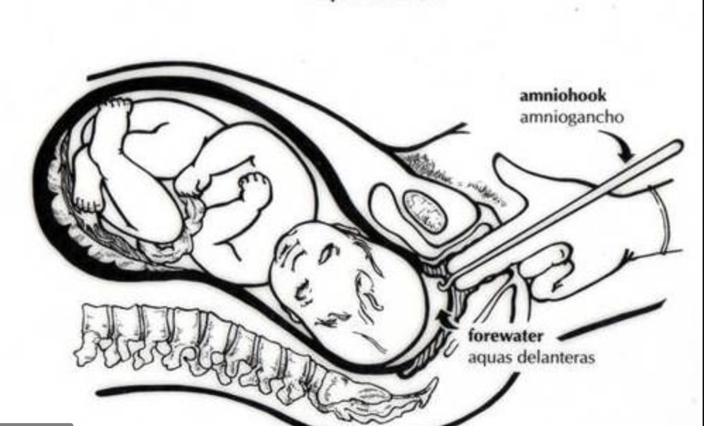
Advantages of amniotomy
(a) High success rate
(b) Chance to observe the amniotic fluid for blood or meconium
(c) To use fetal electrode

Slide 14
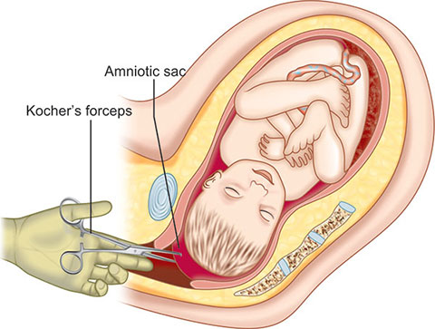
LRM
Procedure
The patient with her empty bladder.
Patient with lithotomy position.
Full surgical asepis is to be taken.
2 fingers are introduced into vagina amered with antiseptic ointment.
The index finger is passed through the cervical canal beyond the IOS.
1 or 2 finger still in the cervical canal with palmer surface.
A long Kocher’s forceps with the blades closed .
Blades are opened to seize the membranes and are torn by twisting movements.
Amnihook is used to scratch over the membranes.

Slide 15
STRIPPING THE MEMBRANE
Stripping of the membranes means digital separation of the chorioamniotic membranes from the wall of cervix and lower uterine segment.
Criteria for membrane strippping are
(a) The fetal head must be well applied to the cervix
(b) The cervix should be dilated so as to allow the introduction of the
examiner’s finger.
COMBINED INDUCTION
The combined medical and surgical methods are commonly used to increase the efficacy of induction by reducing the induction delivery interval.
- By Nafisha Hala (38)

