Slide 1
Fetal circulation
PREPARED BY
MS.PARUL SHARMA

Slide 2
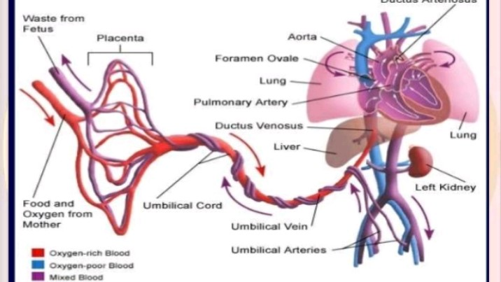

Slide 3
The fetal circulation differs mainly from the adult one by the placenta of 3 major vascular shunt.
Ductus venosus:(between the umbilical vein and inferior vena cava)
Foramen oval: (between the right and left atrium)
Ductus arteriosus: (between the pulmonary artery and descending aorta)

Slide 4
The rational of these shunt is to divert to oxygenated blood from the less functioning organ as lung, liver, kidney, and intestine as placenta carry there function to the brain, heart and part of the body.
As the placenta acts as the intermidediary organ of transfer between the mother and fetus, fetal circulation differs from that required extra uterine existence.

Slide 5
The fetus receive oxygen through the placenta because the lung do not functions as organs of respiratory in the uterus.
In fetal circulation have tow arteries and own vein
Artery carry deoxygenated blood and vein carry oxygenated blood.

Slide 6
The following function
The umbilical vein transport blood rich oxygen and nutrients from the placenta to mother.
This vein travels along the anterior abdominal wall of the fetus to liver, and than umbilical vein divided into two branches.
About half of blood passes into the the liver and the rest enters a shutting vessals called the Ductus venosus that bypass the liver.

Slide 7
The Ductus venosus travels a short distance and joins the inferior vena cava.
There, the oxygenated blood from the placenta is mixed with deoxygenated blood from the lower parts of the fetal body.
This blood continue through the vena cava to the right atrium.

Slide 8
As the relatively high in oxygen enters the left atrium of the fetal heart, a large proportion of it is shunt directly into the left atrium through an opening in the aerial septum called the foramen ovale.
The more highly oxygenated blood that enters the left atrium through the foramen ovale is mixed with a small amount of deoxygenated blood returning from the pulmonary vein.

Slide 9
This mixed moves into the left ventricles and is pumped into the aorta.
Some of this blood reaches the myocardium by means of the coronary arteries and some reaches the tissues of the brain through the carotid arteries.
The rest of the blood entering the right atrium, as well as the large proportion the deoxygenated blood entering from the superior vena cava, passes into right ventricles and out through the pulmonary artery.

Slide 10
Enough blood reaches the lung tissue to sustain them
Most of the blood in the pulmonary arteries bypasses the lungs by entering the Ductus arteriosus, which connects, the pulmonary artery to descending portion of the aortic arch.

Slide 11
Some of blood carry by the descending aorta lead to the various part in the lower region of the body.
The rest of the blood passes into the umbilical iliac artery and lead to the placenta.

Slide 12
Changing in after birth
Umbilical vein is obliterated and become round ligament of the liver.
Umbilical arteries are obliterated and become round ligament of the liver.
Ductus arteriosus close( functionally 3-4 days and anatomical 3 weeks)
The Ductus venosus close ( functionally within few hrs and anatomical 2 month)
Foramen oval close ( after the umbilical cord is tied and cut)

Slide 13
