Slide 1
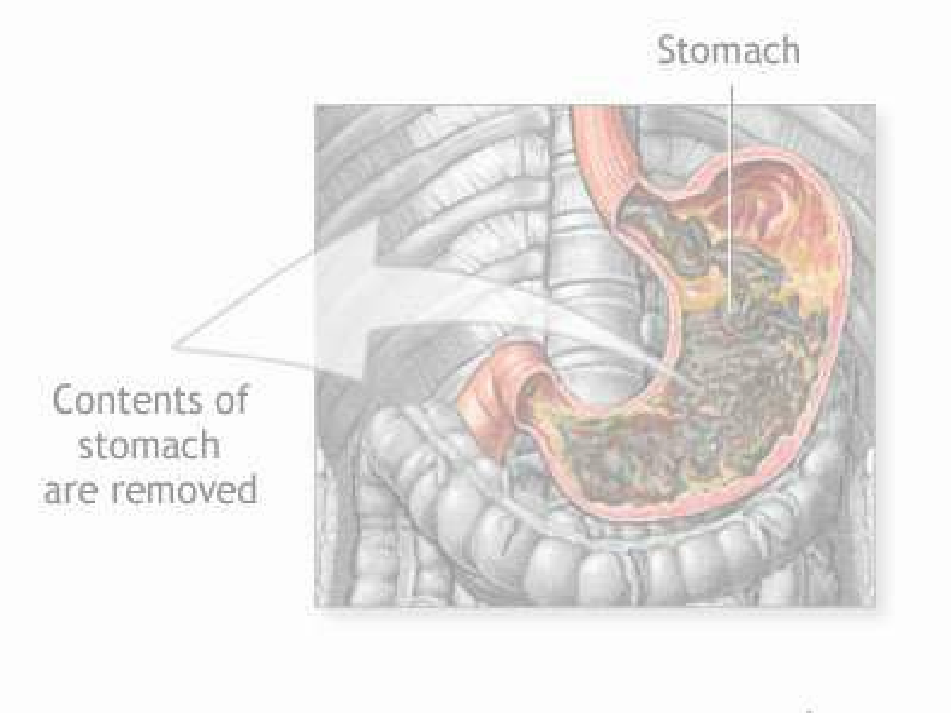
GASTRIC LAVAGE

Slide 2

DEFINATION
• Gastric lavage also commonly called stomach
wash or gastric suction, is the process of
cleaning out the contents of the stomach. It
has been used for eliminating poisons from
the stomach.

Slide 3



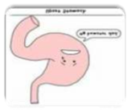

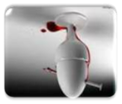
PURPOSE
1.For urgent removal of ingested
substance to decrease systemic
absorption.
2.To empty the stomach before
endoscopic procedure.
3.To diagnose gastric hemorrhage and
to arrest hemorrhage.

Slide 4





1.With patient has
ingested poison.
3.Collecting stomach
acid for tests.
INDICATIO
N
2.Cleaning the stomach
4.Relieving pressure in
someone with a
blockage in the
intestines.
before and upper
endoscopy in someone who
has been vomiting blood.

Slide 5





CONTRAINDICATION
1.Loss of airway protective
reflexes, such as in a patient with a
depressed state of consciousness.
AW.
2.Ingestion of a corrosive substance
such as a strong acid or alkali.
AW.
3.Ingestion of a hydrocarbon with
high aspiration potential.
AW.
4.Patients who are at risk of
hemorrhage or gastrointestinal
perforation.

Slide 6
TECHNIQUE
1.Gastric lavage involves the passage of a tube
via the mouth or nose down into the
stomach, followed by sequential
administration and removal of small
volumes of liquid.
2.The placement of the tube in the stomach
must be confirmed either by air insufflation
while listening to the stomach, by pH
testing a small amount of aspirated stomach
contents, or x-ray. This is to ensure the
tube is not in the lungs.

Slide 7
CON’T…
3.Lavage is repeated until the returning fluid
shows no further gastric contents.
4. If the patient is unconscious or cannot
protect their airway then the patient should
be intubated before performing lavage.

Slide 8
COMPLICATION
1.Aspiration pneumonia.
While taking the unwanted poison and drugs out of
the stomach (lavage), the substances might
accidentally enter the respiratory canal, into the
lungs and cause aspiration pneumonia.
2.Laryngospasm.
Uncontrolled and involuntary muscle contraction
(spasm) of the larynx cord.
3.Hypoxia and hypercapnia
.
Lack of oxygen in the body tissues.

Slide 9
COMPLICATION
4.Bradycardia
Pulse is slow and lower than normal.
5.DYSPNEA
•
Patient might experience dyspnea due to a tube
inserted through the oropharynx that can obstruct
the patient airway, which cause low oxygen supply.
6.Mechanical injury
to the throat, esophagus, and
stomach.

Slide 10


