Slide 1
Mobility and
Immobility
Mr. Jahid Noyda
H.N. Shukla Rajkot.

Slide 2
Mobility and Immobility
Mobility refers to the ability to engage in activity free movement which includes walking, running, sitting, standing, lifting, pushing, pulling, and performing activities of daily living (ADLs).
Muscle tone
Energy
Musculoskeletal and neurological system

Slide 3
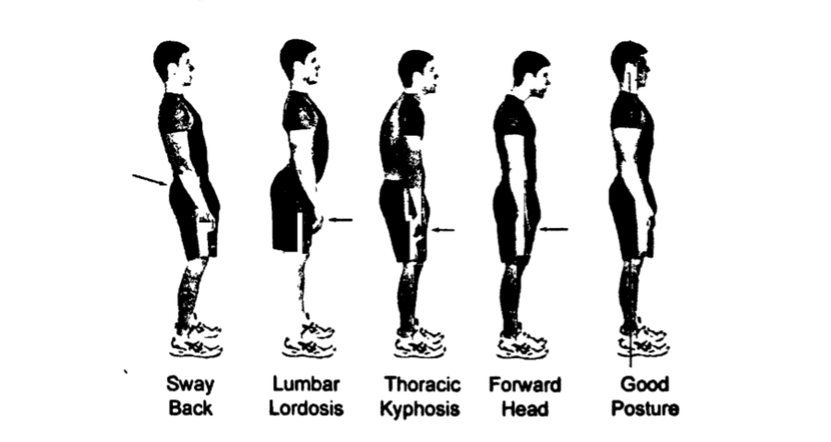

Slide 4
IMPORTANCE OF BODY MECHANICS
Proper body mechanics are important for nurses in their work and also equally beneficial to the patient.
Proper body alignment and posture prevent fatigue and deformities.
It promotes physiological function of the body. It aids in circulation and digestion.
It minimizes the expenditure of energy.
It helps in maintaining balance of body without under strain and spasm resulting in backache.
It helps in maintaining size and shape of thoracic, abdominal and pelvic cavities & thus prevents kyphosis, lordosis, scoliosis etc.
It contributes to one’s beauty.

Slide 5
  Good posture promotes balance, reduces strain and injury to support structures, facilitates respiratory effort, enhances gastrointestinal processes, and gives an appearance of confidence and health. A correct postural stance is maintained by a well-functioning musculoskeletal system.

Slide 6
Body alignment refers to the position of body parts in relation to each other
The benefits of proper alignment and posture include
(1) client comfort;
(2) prevention of contractures;
(3) promotion of circulation;
(4) less stress on muscle, tendons, nerves, and joints; and
(5) prevention of foot drop (plantar flexion).

Slide 7
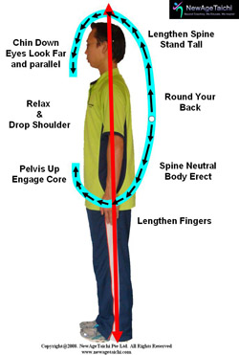
PRINCIPLES FOR CORRECT BODY MECHANICS
1. Standing position
Head extended with chin tucked in.
Chest should be most forward part.
Shoulders should be slightly abducted.
Elbows lightly flexed.
wrist straight“
Fingers flexed.
Abdomen flat and relaxed
Buttocks contracted

Slide 8
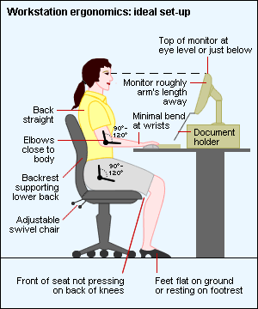
2. Sitting

Slide 9
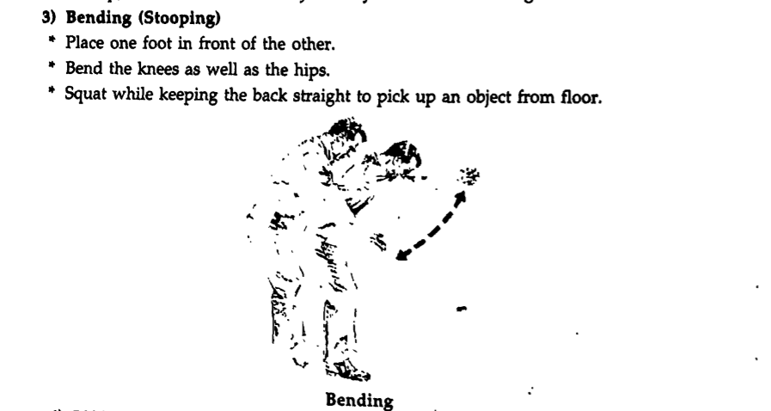
Bending ( stooping )

Slide 10
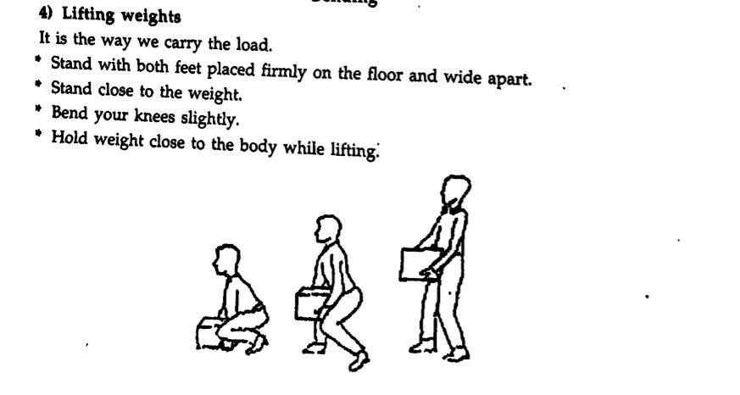
4. Lifting

Slide 11

5.Pushing

Slide 12
6. Carring
Place both feet flat on the floor.
Hold the object close to the body near the centre of gravity.
Hold head erect and supine straight

Slide 13
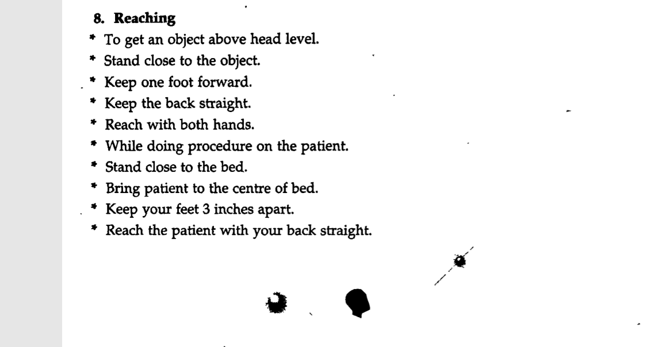

Slide 14
Alteratlons In Body Allgnment & Moblllty
immobility: It is the inability to move a body part or the whole body. Immobilization can be prescribed or unavoidable restriction of movement.

Slide 15
Types of immobility:
Social immobility: May be thought as an interruption in or withdrawal from normal patterns of social interaction.
Emotional immobility: can occur when stressors exceed the coping ability of an individual.
Intellectual immobility:- can occur in persons who lack the ability to acquire needed knowledge.
Physical immobility:- can be caused by physical problems or by necessary therapeutic measures.

Slide 16
ALTERED/IMPAIRED MOTOR FUNCTION RELATED TO DISEASE
1. Neuromuscular Disease.
  Muscle weakness
2.masculoskeletal disease.
  Bones and joints
3. CNS
  Tumor

Slide 17
Exercise

Slide 18
Exercise is any physical activity involving muscles that elevates the heart rate above resting levels.
Exercise reduces joint pain and stiffness, and increases flexibility, muscle strength.
It also helps with weight reduction and contributes to an improved sense of well being

Slide 19
Benefits of exercise
Normalizes glucose tolerance
Improves gait and balance.
Improves cardiovascular function.
Increases energy
Promotes bone density
Improves mobility
Promotes weight loss
Reduces blood pressure
Lowers cholesterol
Promotes rest and relaxation
Improves sleep

Slide 20
Range of motion (ROM)
Definition:-
  Range of motion (ROM) is the range, measured in degrees of a circle, through which the bones of a joint can be moved.
  Range of motion is the maximum amount of movement available at a joint in one of the three planes of the body, sagittal, frontal or transverse.

Slide 21
Sagittal plane :- It is a line that passes through the body from front to back, dividing the body into left and right side.
Frontal plane :- Plane that passes through the body from side to side and dividing the body into front and back.
Transverse plane : It is a horizontal line that divides the body into upper and lower portion.

Slide 22
Types of ROM Exercise
1) Active ROM Exercises
  Used for the client who are able to move his or her joints independently.
2) Passive ROM Exercises
  Used for clients who does not have voluntary motor control, passive ROM exercises are of choice.

Slide 23
TYPES OF movements AT VARIOUS :-
1) Flexion : Decrease in the angle between circulatory bones.
Bending motion that decreases the angle of the joint bringing two bone closer together
- Movement of palm toward inner aspect of forearm
- Making a fist.

Slide 24
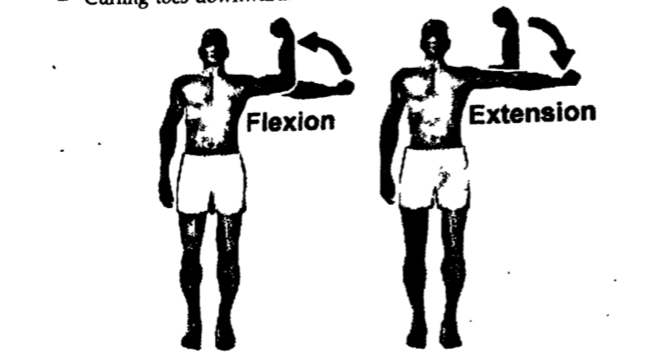

Slide 25
2. Extension :-
  Straightening a joint. There is increase in angle between circulating bones often to restore a part of the body to the anatomical position after it has been flexed.
  Head in erect position.

Slide 26
3) Hyperextension :
Moving a joint part normal, extension or continuation of extension beyond the anatomical position is called hyperextension.

Slide 27
4) Abduction :-
  Moving a joint or extremity away from midline of the body.
  e.g.Moving of the palm laterally at wrist joint.
  Moving the femur laterally at the hip joint.
5) Adduction :
Moving a joint or extremity toward the midline of the body.
e.g. Bringing finger together.

Slide 28
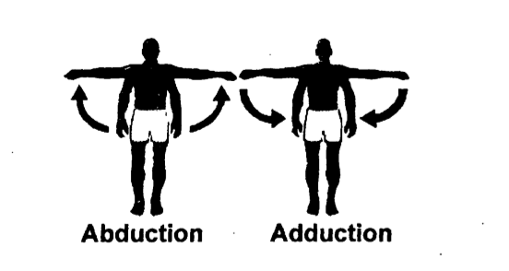

Slide 29
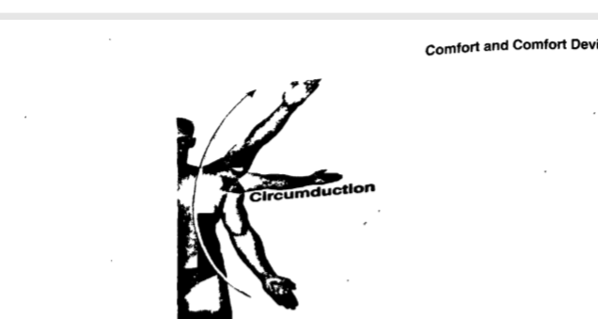
6) Circumduction :
Moving a body part in widening circles. It occurs as a result of continuous sequence of flexion, abduction, extension and adduction. Eg. Moving the humerous in circle at the shoulder joint.

Slide 30
7) Rotation : In rotation, a bone revolve around its own longitudinal aXIS.
E.g. Turning head from side to side.
Two types : .
I . a) Internal rotation : Turning a joint or an extremity on Its axis towards body’s midline
. e.g. Turning foot and leg toward other leg. _
b) External rotation :
Turning a joint or an extremity on its axis away from the bOdy s midline.
e.g. Turn foot and leg away from other leg.

Slide 31
8) supination :-
Turning the body or a body part to face upward. Supination is a position of at eithr forearm or foot.
Supination of the forearm occurs when palm face front of the body parts.
9) Pronation :-
turning body or body parta to face downward.

Slide 32
10) Inversion ;-Turning the feet inward, so toes are pointing toward the Midline.
inversion is the movement of the sole towards the median plane.
11) Eversion :
Eversion is the movement of the sole of the foot away from the median plane. Turning the feet outward so toes are pointing away from the midline.

Slide 33
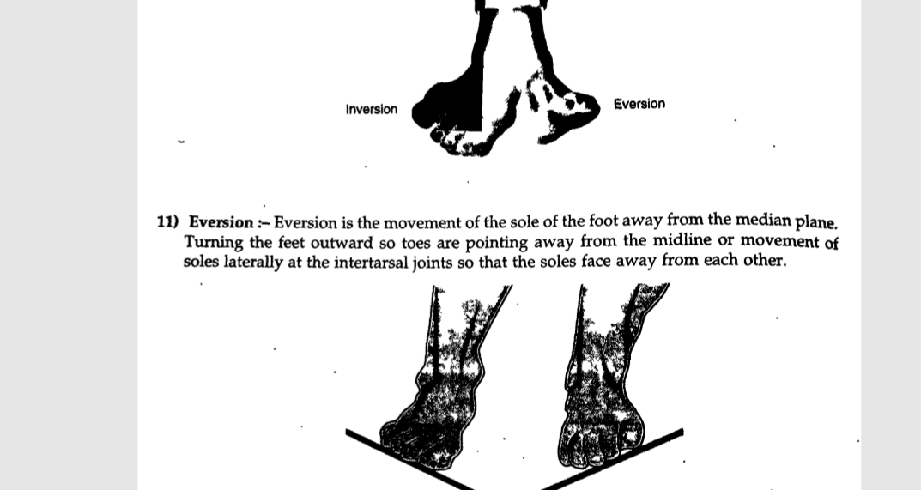

Slide 34
BODY POSITIONS

Slide 35
1. Dorsal or horizontal recumbent or supine position
In this position, the patient lies flat on his legs together. His head may be supported with a pillow and his legs either extended or slightly flexed.

Slide 36
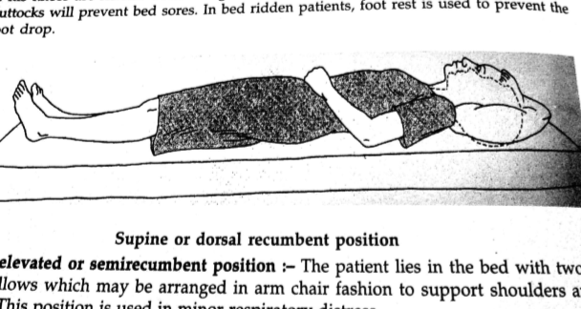

Slide 37
2) Dorsal elevated or semi recumbent position
The patient lies in the bed with two or more pillows which may be arranged in arm chair fashion to support shoulders arms elbows. This position is used in minor respiratory distress.

Slide 38
3) Prone Position
The patient lies on the abdomen face turned sideways, with one small pillow under the ankle. The head rests on a pillow. One or both arms rest in a comfortable way either beyond the head or at the sides of head.

Slide 39
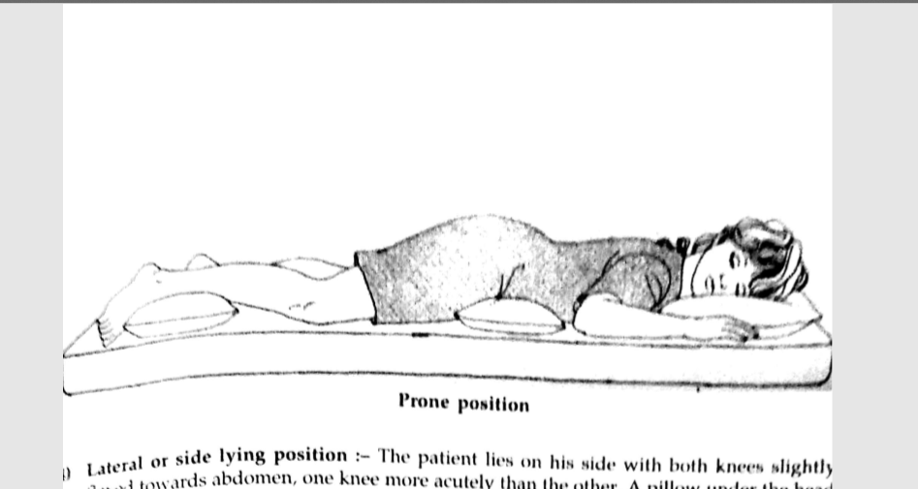

Slide 40
4). Lateral or side lying position
The patient lies on his side with both knees slightly flexed towards abdomen, one knee more acutely than the other. A pillow under the head support the head, a pillow at the back gives support to the back, a pillow in front supports the arms and abdomen, a pillow between knees takes weight of upper leg

Slide 41
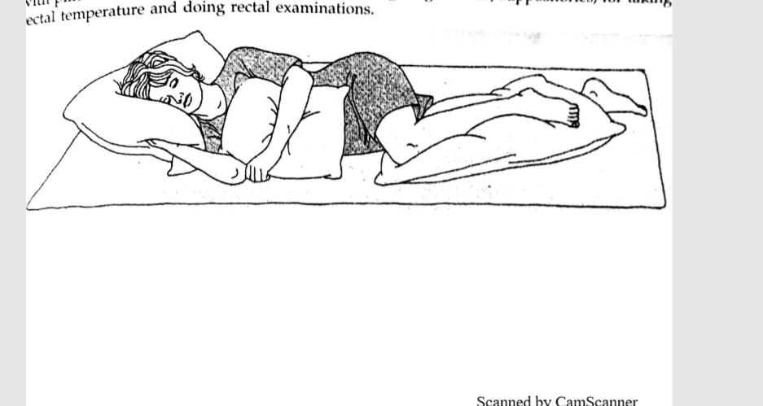

Slide 42
5) Fowler’s Position :
This is the more erect position, in which the effort is made to maintain the position of the patient in sitting position as nearly upright as possible.
This position can be maintained by means of a backrest and additional pillows.
The arms should be supported on pillows so that the patient sits with arms supported in an arm chair fashion.

Slide 43
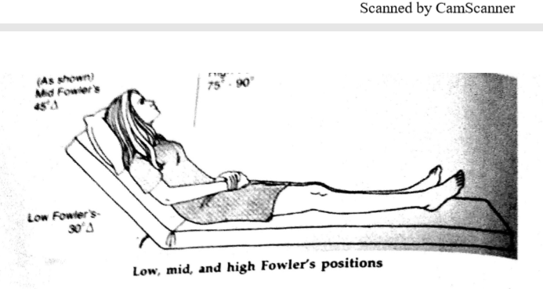

Slide 44
Sim s lateral or left lateral prone position :-
In this position, the patient lies on his left side. One pillow is placed under the head with left cheek resting on it.
The left arm is drawn behind the back and the right arm may be in any position comfortable for the patient.
The right thigh is flexed against the abdomen.
This position is used for vaginal and rectal examination.

Slide 45
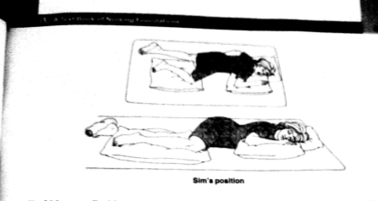

Slide 46
Lithotomy Position :
Patient lies on his back with one pillow under the head.
The legs are well separated and thighs are well flexed on abdomen and legs on the thigh.
The patients buttocks brought to the extreme edge of the table and legs are supported on the strips. If the calf muscles are pressed or if position is prolonged, there is danger of embolism.

Slide 47
