Slide 1
Vagina

Slide 2
Synonym
Kolpos=vagina(colposcopy,colpotomy and colporrhaphy).

Slide 3
Definitions
Vagina is a fibromuscular canal, forming the female copulatory organ.
The term vagina means a sheath.

Slide 4
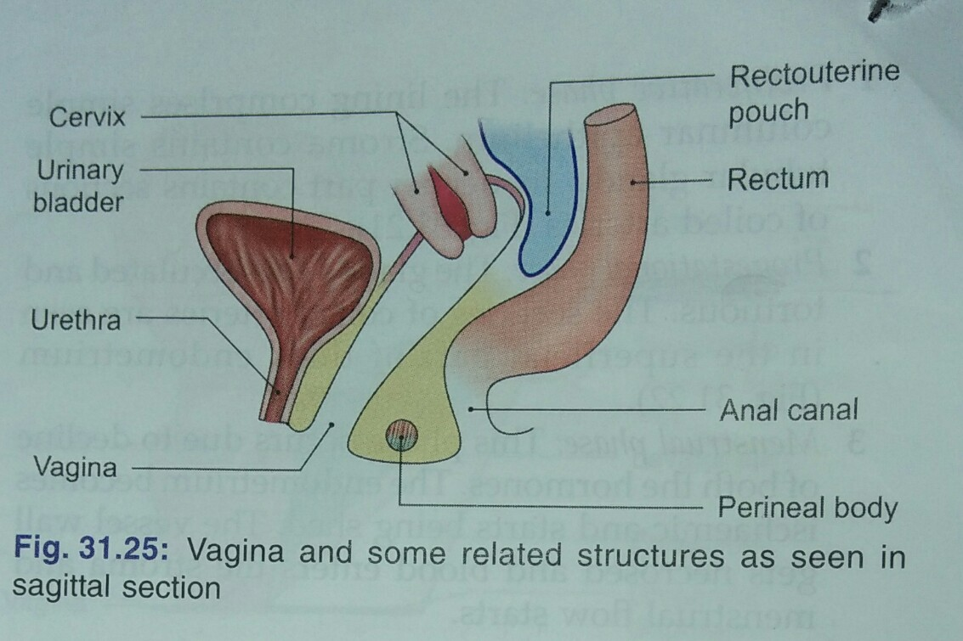
Extent and situation
Extent from vulva to uterus.
Situated behind bladder and the uretra, and in front of rectum and anal canal.

Slide 5
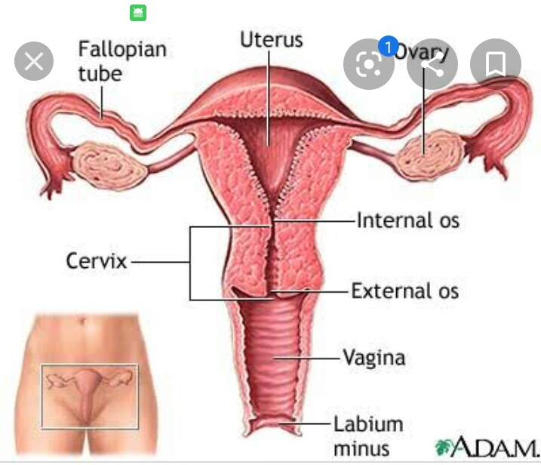
Direction
Erect posture, vagina is directed upward and backward.
Long axis of uterus cervix form and angal of 90 with long axis of vagina.

Slide 6
Size snd Shape
Anterior wall of vagina is 8cm long and posterior wall is10cm long.
Diameter of vagina gradually increases from below upward.
Upper enf or vault is roughly 5cm twise the size of lower end.
The lumen is circular at upper.
Below the cervix, the anterior and posterior wall are in contact with each other.
The lumen is transverse slit in the middle part, and is H-shaped in the lower part.

Slide 7
In the virgin:
The lower end of vagina is oartially closed by hymen.
In married women:
The hymen is represented by rounded elevations around the virginal orifice, the circular hymennales.

Slide 8
Fornices Of vagina
The interior of the upper end of vagina is form a circular groove that surrounds the protruding cervix.
The groove becomes progressively deepar from before backward and is arbitrarity divided into four part called vaginal fornices.
(1)Anterior fornix
(2)Posterior fornix
(3)Lateral fornix

Slide 9
Relation
Anterior wall | Posterior wall
Upper half is related to base of bladder. | Upper one-fourth is separated from the rectum by the rectouterine pouch.
Lower half to the urethra. | Middle two-fourth are sepatated from the rectum by loose connective tissue
 | Lower one-fourth is separated from the anal cnal by perineal body and muscles attached to it

Slide 10
Lateral wall
Upper one-third:
Trsnsverse cervical ligament of pelvic fascia
Ureter gets crossed by uterine artery
Middle one-third:
Pubococcygeus part of levator ani
Lower one-third:
It pierces perineal membrane
Bulb of vestibule
Bulbospongiosus
Duct of greter vestibular gland of bartholin

Slide 11
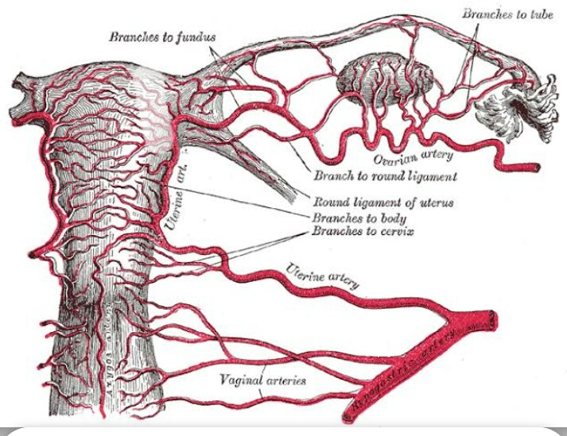
Arterial supply
Vaginal branch of internal iliac artery
Upper part is supplied by cervicovaginal branch of uterine artery.
Lower part is supplird by middle rectal and internal pudendal arteries.

Slide 12
Venous drainage
Vaginal venous plexus drain in internal iliac veins throgh vaginal veins

Slide 13
Lymphatic drainage
Upper one-third, vagina drain into external iliac nodes
Middle one-third, internaliliac nodes.
Lower one-third into superficial inguinal nodes.

Slide 14
Nerve supply
Lower one-third:
Pain sensitive,pudendal nerve
Upper two-thirds:
sympatheticL1,2
Parasympathetics2 tos4

Slide 15
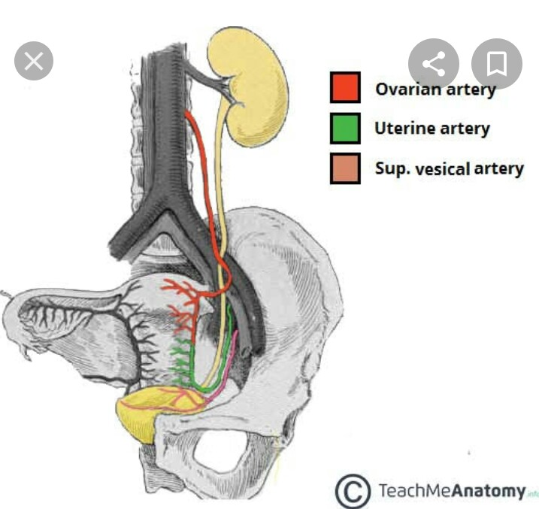
Ureter in female pelvis

Slide 16
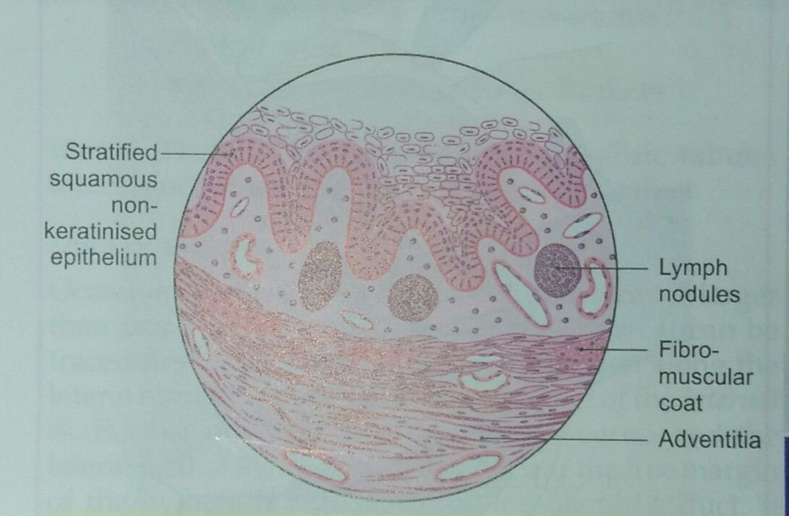
Histology
Mucous membrane is lined by non- keratinised stratifide sqamous epithelium.
Lamina propria is made up of loose conective tissue.
Muscle coat consists outer connective tissue and inner circular layer.
Outer fibrous coat is usual connective tissue.

Slide 17
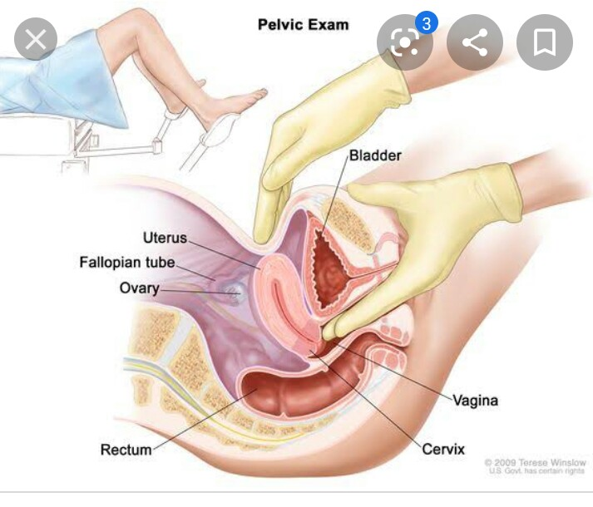
Clinical anatomy
Vaginal examination
By, inspection
Palpation
Vaginal laceration
Vaginitis
Prolapse
Neoplasms
Episiotomy

