Slide 4
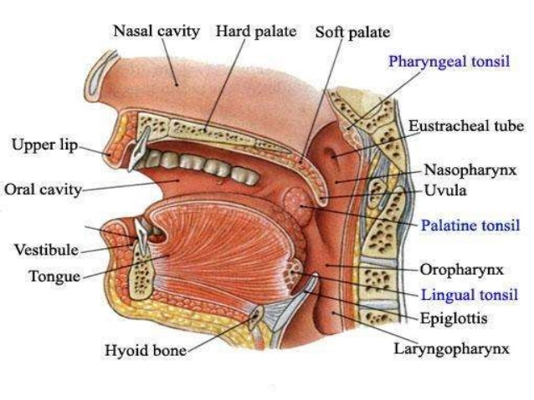

Slide 30
Structures associated with the larynx
Superiorly- The hyoid bone and the root of the tongue
Inferiorly- it is continuous with trachea
Anteriorly- the muscles attached to the hyoid Bone and the muscles of the neck
Posteriorly- laryngopharynx and 3rd to 6th cervical vertebrae
Laterally- the lobes of the thyroid gland.

