Slide 1
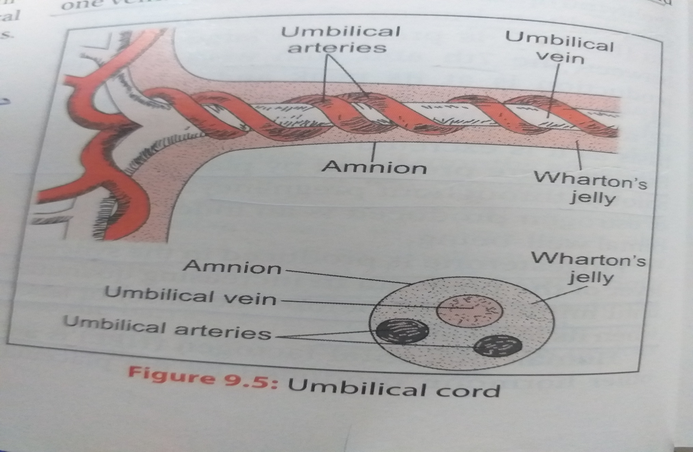
UMBELICAL CORD

Slide 2
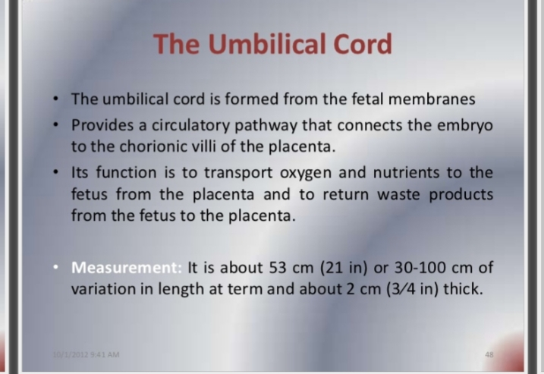

Slide 3
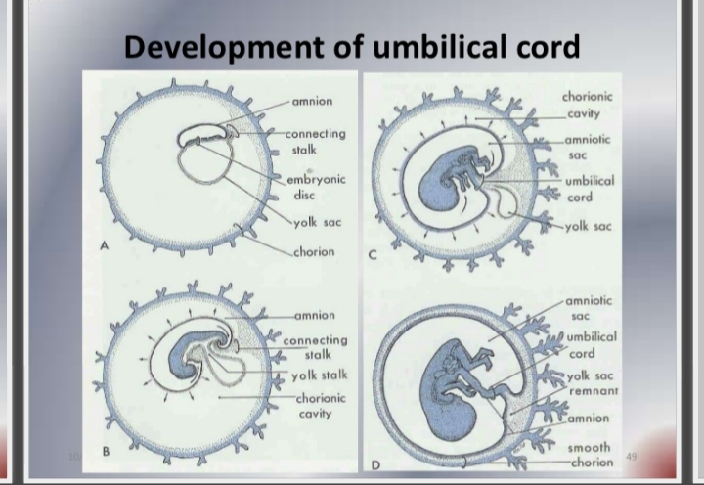

Slide 4
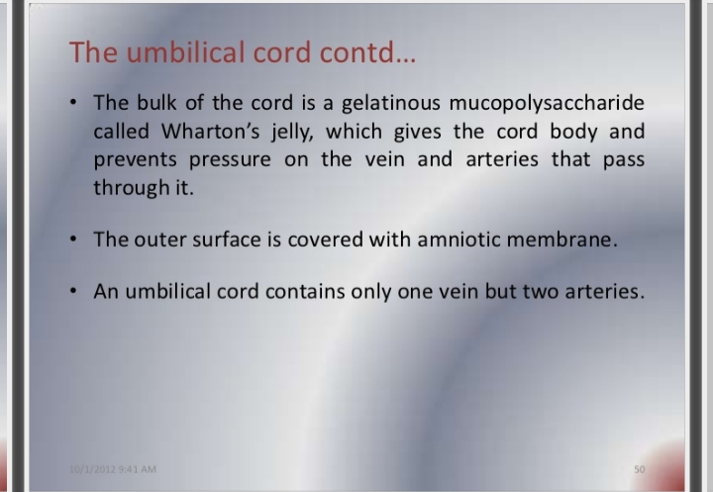

Slide 5


Slide 6
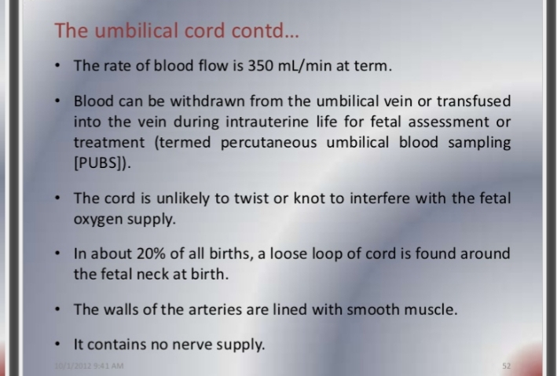

Slide 7
The length of average cord is 50cm
A cord is consider to be short when its length less than 40cm.
Certain cord are longer and with longer cord, problem can arise.
It may become wrapped round neck or body of the fetus or become knotted.
A trunk knot occurs when has passage through a loop in the cord and real knot has been created.

Slide 8
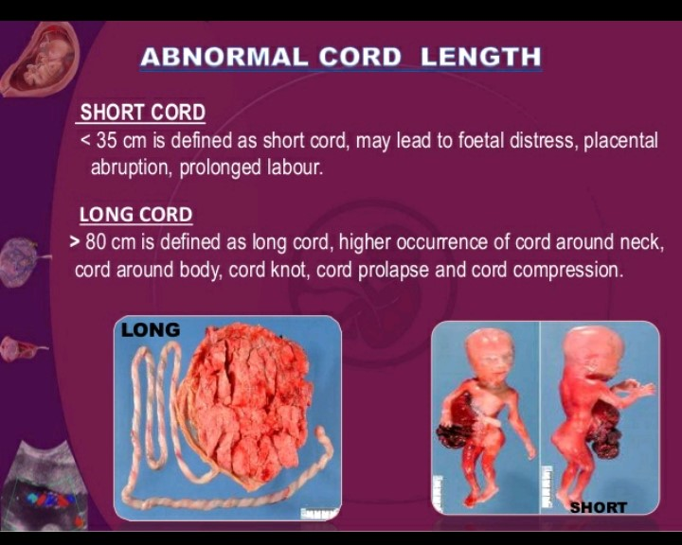
Variation, anomalies and abnormality of the umbilical cord and its insertion.
1.

Slide 9
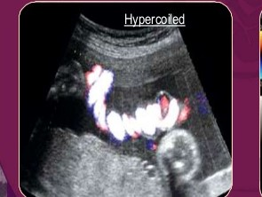
2.) cord looping

Slide 10
The average length of cord is 50-55 cm.
Cord long than 100 cm will become looped.
Signal or multiple loop cause a short cord with all its complication.
Looping of the cord around the neck may causes fetal distress due to tightening of cord around the neck during descend.

Slide 11
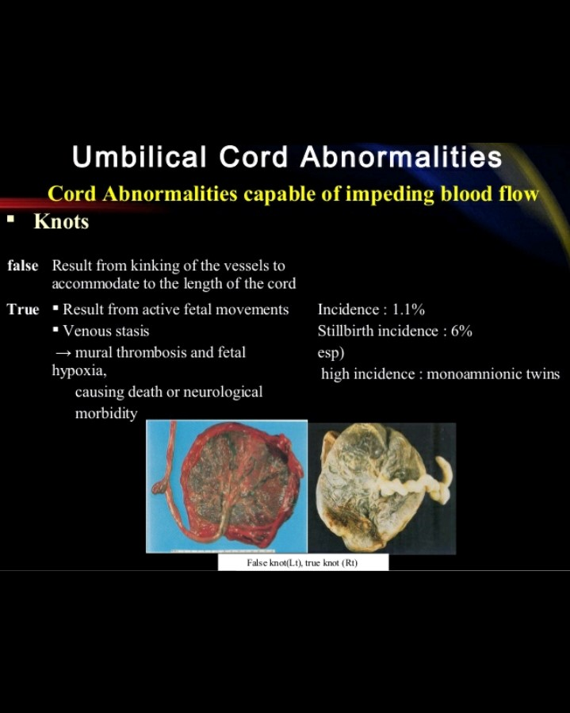
3) Cord knotting.

Slide 12
It may become wrapped round neck or body of the fetus or become knotted.
A trunk knot occurs when has passage through a loop in the cord and real knot has been created.
True knotting is most likely to occur in one of two situation:
1)Small fetus, long cord, and large amount of amniotic fluid
2)Multiple gestation within a single amnion.

Slide 13
4.) markedly decreased amount of Wharton's jelly may be seen in malnourished and postmature new born.
5.) Rarities:
Other condition that may occur in the cord are hematomas, tumors, cyst, and edema.
Hematomas usually result of rupturing of the umbilical vein.

Slide 14

2.) battledore placenta:
6.)

Slide 15
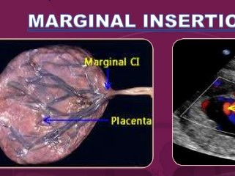
A.) Battledore placenta

Slide 16
a variation in which the umbilical cord is inserted at the edge of margin of the placenta.
Marginal insertion of the cord is less than 10%

Slide 17
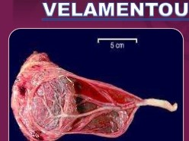
B.) velamentous placenta:

Slide 18
The cord is insert into the edge of some distance from the placenta.
A velamentous insertion can be dangerous for the fetus.

Slide 19
C.) vasa previa
It is a dangerous anomaly with a high perinatal mortality if rupture occur.
Vasa previa refer to the blood vessels, covered only with amnion and running between the chorion and amnion, which present the at the os by crossing it ahead at cervical os.

Slide 20
7.) ABNORMAL UMBILICAL VESLSE
abnormal umbilical blood vessals in the umbilical cord has high correlation with fetal anomalies.
About one third of babes born with only one umbilical arties will have multiple and several malformation.

