Slide 1


Slide 2

 Midwifery is an ancient profession, with a proud tradition
of providing care for women and babies during pregnancy
and childbirth. The earliest birth attendants were women.
In ancient mythology, goddesses (but not gods) were
present at deliveries. In “primitive” tribes studied by
anthropologists in the last century, the laboring woman
would be accompanied by her mother or other female
relative. Birthing stools and midwives are also mentioned
in the Old Testament.

Slide 3

 The history of obstetrics is inextricably linked with
the history of midwifery. Obstetric ix the Latin word
for midwife: it is thought to derive from obstare (to
stand before”), because the attendant stood in front
of the woman to receive the baby. Only in the 20th
century did the subject taught in medical schools
change its name from “midwifery” to “obstetrics,”
perhaps because a Latin name seemed more academic
than the Anglo-Saxon, derived from mid, “with,”
and wyf, “woman.”
 In france- wise women.

Slide 4

 Midwives were known by many different titles in
antiquity, ranging from iatrinē (Gr. nurse), maia (Gr.,
midwife), obstetrix (Lat., obstetrician),
and medica (Lat., doctor).[28] It appears as though
midwifery was treated differently in the Eastern end
of the Mediterranean basin as opposed to the West.
In the East, some women advanced beyond the
profession of midwife (maia) to that of gynaecologist
(iatros gynaikeios, translated as women's doctor), for
which formal training was required.

Slide 5

 Midwifery:
 The art of assisting women in the childbirth has grown
fulfilling its meaning “with women at birth”.
 Midwife(ICM-1992):
 A midwife is a person who, having been regularly
admitted to a midwifery educational programme, duly
recognized in the country in which it is located, has
successfully completed the prescribed course of studied in
midwifery & has acquired the requisite qualifications to
be registered & or legally licensed to practice midwifery.

Slide 6

 In ancient Egypt, m zed
female occupation, as attested by the Ebers
Papyrus which dates from 1900 to 1550 BCE. Five
columns of this papyrus deal with obstetrics and
gynecology, especially concerning the acceleration
of parturition and the birth prognosis of the
newborn. The Westcar papyrus, dated to 1700 BCE,
includes instructions for calculating the expected
date of confinement and describes different styles of
birth chairs. Bas reliefs in the royal birth rooms at
Luxor and other temples also attest to the heavy
presence of midwifery in this culture.
 Hippocrates (460BC), organized trained &
supervised midwives. He believed that the fetus had
to fight its way out of the womb & membranes.

Slide 7

 Aristotle(384-322
Embryology described the uterus & the
female pelvic organs. He also described
the essential qualities of the midwife.
 Midwifery in Greco-Roman antiquity
covered a wide range of women, including
old women who continued folk medical
traditions in the villages of the Roman
Empire, trained midwives who garnered
their knowledge from a variety of sources,
and highly trained women who were
considered female physicians.

Slide 8
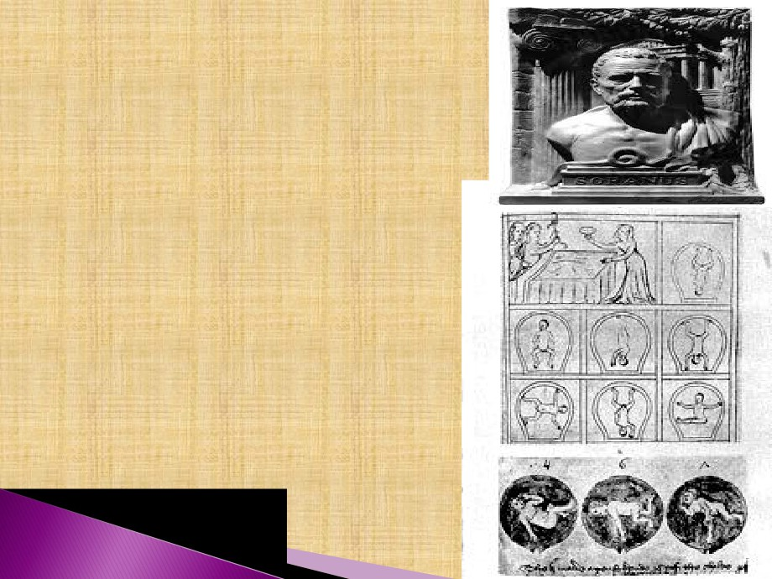
 Soranus of Ephesus writes on
gynaecology.
 These illustrations, from a 14th
century version of Soranus'
Gynaecology, depict a variety of
foetal positions within the uterus
which is shown as an upside-down
jar or vessel. In Medieval texts, the
word vas (vessel) was used as a
synonym for woman'. In the top
picture, a woman in labour is shown
hanging onto a rope. Soranus
appreciated that infants did not
always present head first, and in
difficult labours, he recommended
podalic version' whereby a hand is
inserted into the uterus and the baby
drawn out feet first..

Slide 9
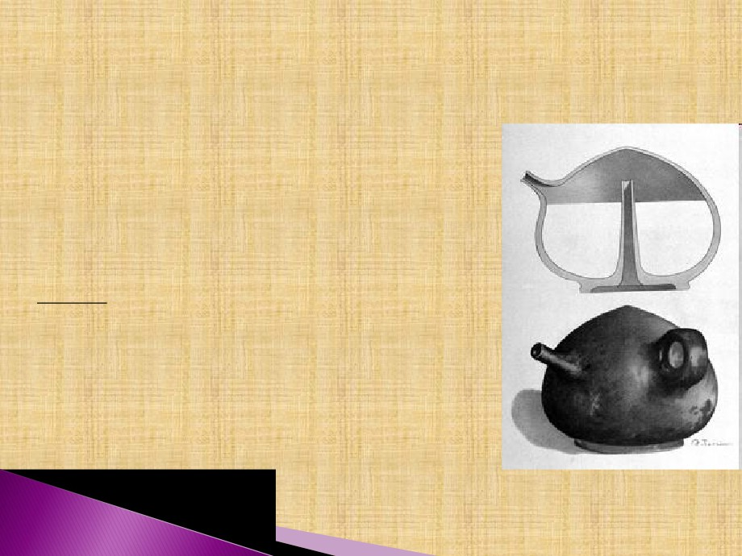

Romans invent ingenious baby's bottle.
This bottle, shaped like a female breast, was
constructed so that no flies or dust could reach its
contents. The milk was introduced by inverting the

bottle, and pouring it through an open tube ascending
within from the centre of the base almost to the apex
(see cross section). This same tube prevented the
escape of milk when the bottle was placed on its base.
The child sucked through the spout, on the opposite
side of which is a small round handle. Bottles like
this from the 1st to 5th centuries CE.

Soranus taught that breast-feeding should not begin
until 3 weeks after birth so that the mother might
regain her health and produce wholesome milk.

Substitutes for human milk included honey diluted
with water or goat's milk although neither would
have provided the correct balance of nutrients and fat
content. If a wet-nurse was not available for this
important period in a new-born's life, its survival
prospects on artificial feeding would have been
grim.Votive offering excavated from Forum of
Augustus, Rome.

Slide 10

 Leonardo da Vinci(1452-1519) made
anatomical drawings of pregnant
uterus.
 In 1513 Rösslin publishes first textbook
for midwives
 This is an illustration from the first
printed textbook for midwives, written
by a German physician, Eucharius
Rösslin. The text was largely compiled
from the writings of Soranus although
Rösslin added his own woodcuts. The
book went through at least 40 editions
and, in 1540, was translated into
English as The byrthe of mankynde.
 It maintained its place as a textbook of
midwifery until the 18th century.

Slide 11
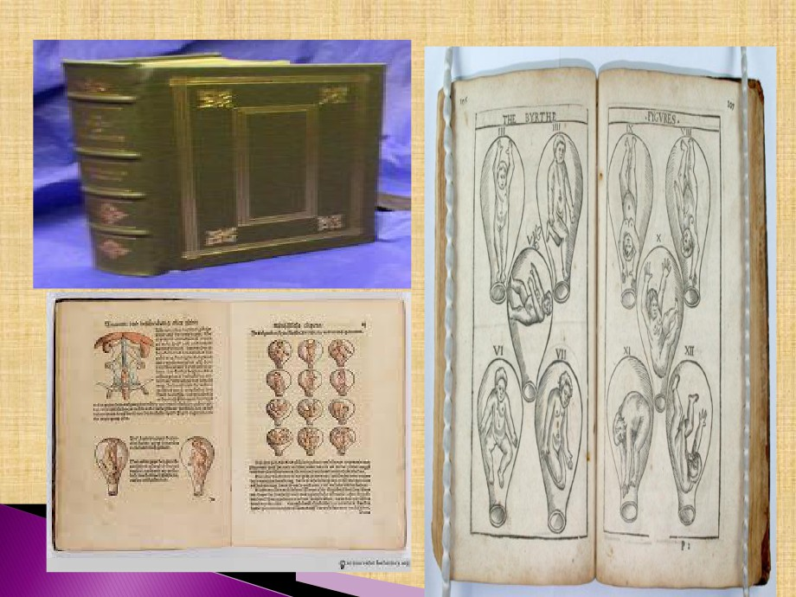

Slide 12
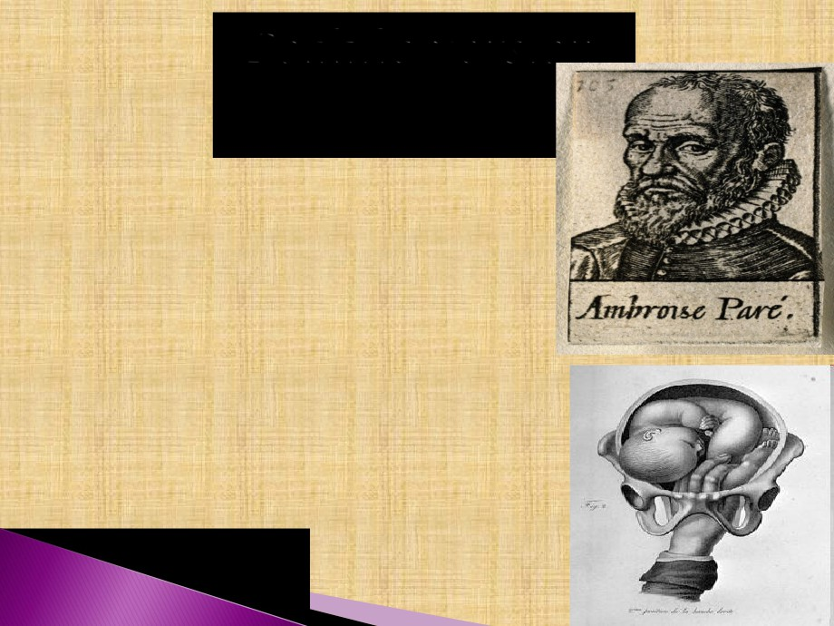
 Ambroise pare(1510-1590) laid the
foundations of modern obstetrics.
He performed internal podalic
version & skillfully delivered
women (In this manouevre, the
doctor introduces a hand into the
womb to turn a malpositioned
child so that it can be delivered
feet first).
 He was first to deliver a women
in bed instead of the birthing
stool.
 He founded the school for
midwife in Paris.

Slide 13
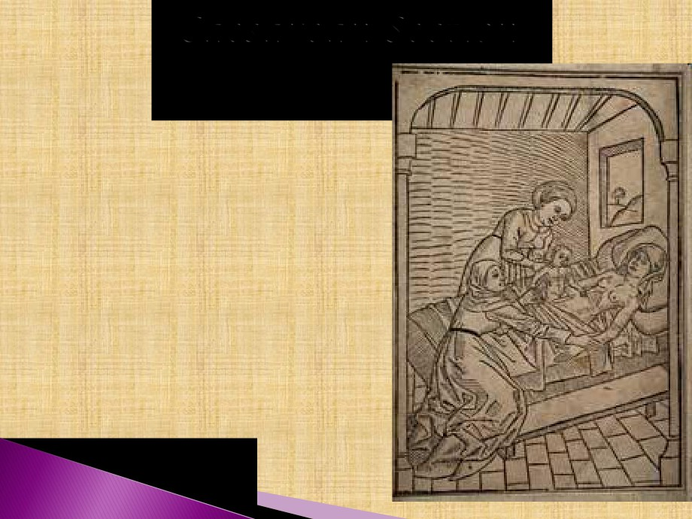
 Julius Ca
the Caesa
contracted pelvis.
 He wrote the first book for
Italian midwives which ran 17
edition.

1610 - First documented Caesarian
section in which mother survives.

Slide 14
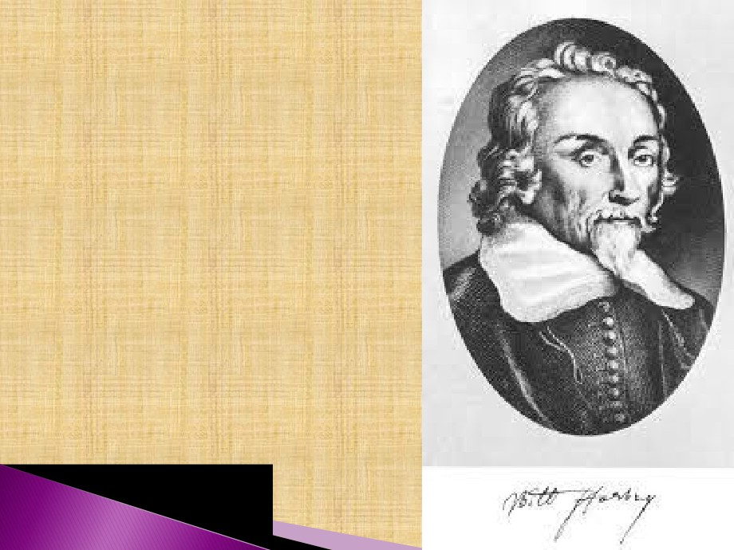
 William Harvey (1578- 1657),
the father of British of British
midwifery, wrote the first
English
textbook
on
midwifery.
 He describes the fetal
circulation & placenta, & Was
the first deliver the fetus by
massaging the uterus.

Slide 15
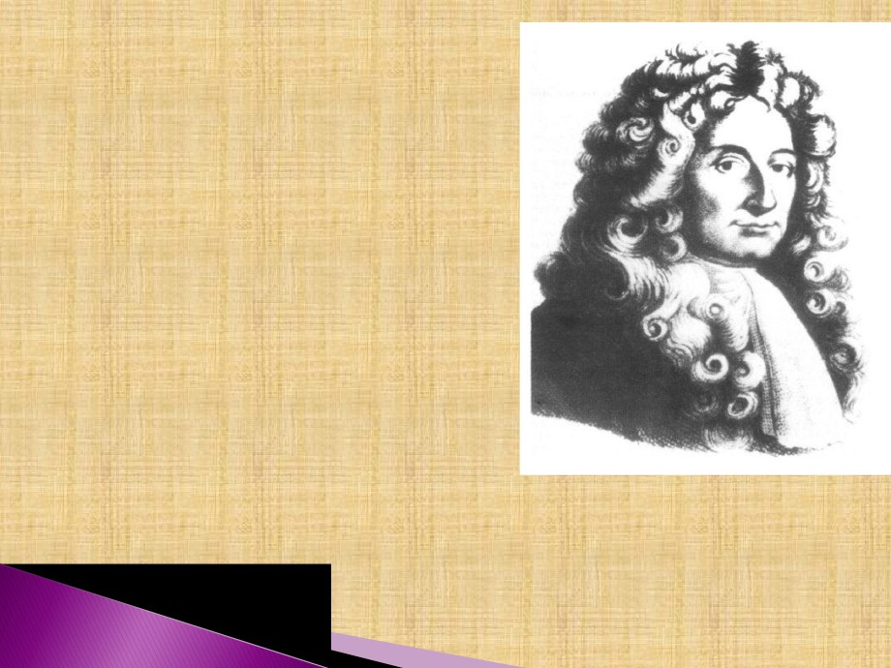
 Mauriceau was the
greatest physician of the
17th century. He
described the attitude of
the fetus in uterus.

Slide 16

 Chamberlen in 1675, designed obstetric
forceps.
 {The Chamberlens moved in the highest
circles although it is doubtful whether this
was due entirely to their forceps. They were
clearly accomplished men-midwives. In
1628, Hugh Chamberlen's son, Peter, was
called to attend Henrietta Maria, wife of
Charles I(reigned1625-1649), after the
midwife in charge swooned with fear' on
entering the queen's bedchamber. Whether
he used the forceps (always carried in a
box) is unrecorded. In 1818, several pairs of
forceps were found in a secret compartment
at Woodham Mortimer Hall near Maldon,
Essex, which had once been the home of
Peter Chamberlen's son, also called Peter
(1602-1683)}.

Slide 17
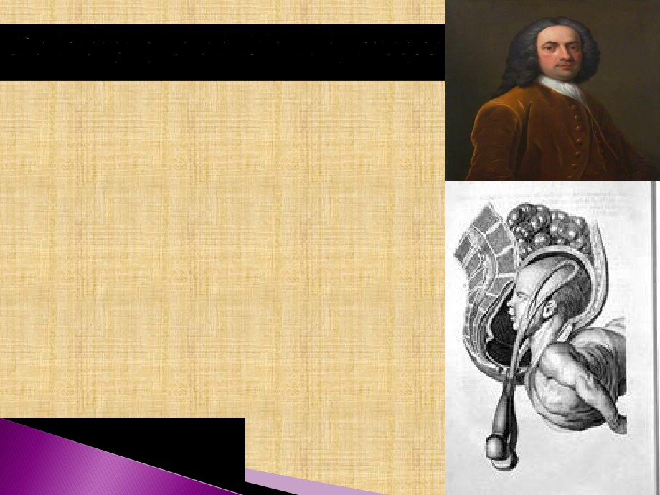
 WilliamSmellie at first employed
wooden forceps so as to avoid the
clinking noise of the metal blades. Later,
he modified the shape of metal forceps
by adding the long pelvic' curves and
bound the blades with strips of leather
(as in this illustration). He did suggest
that the leather should be renewed after
each case. He devised a lock for the
obstetric forceps, which is permitted
each blade to be introduced separately.
 He explained labor to be a mechanical
process & described pelvimetry,
cephalometry.

Slide 18
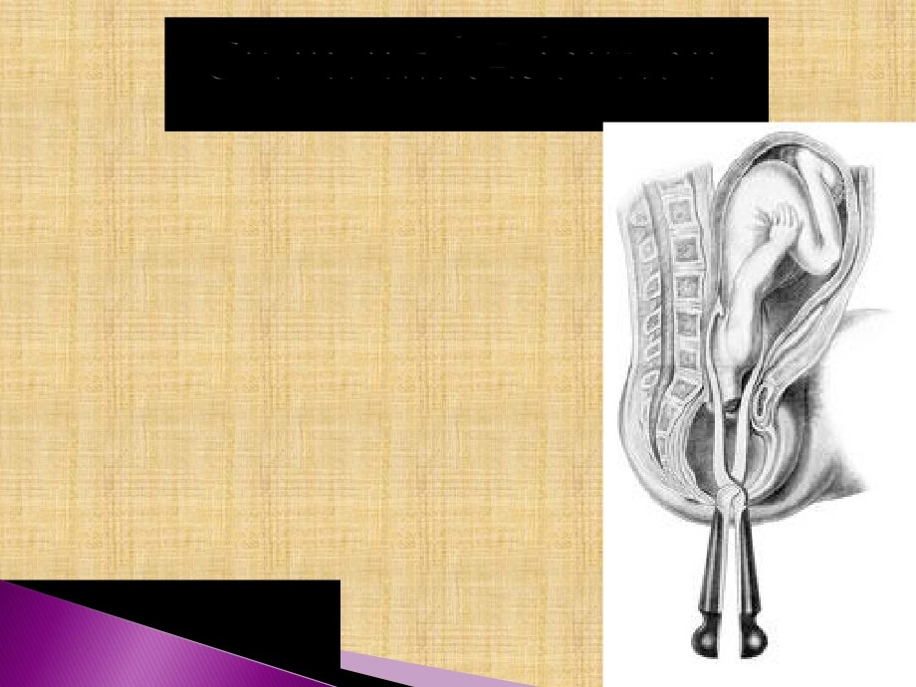
This illustration, from an early

19th
century
textbook
of
operative
midwifery', shows a procedure for
removing a child during obstructed
labour. The head of the child has been
broken up (craniotomy) and removed
via an instrument introduced into the
womb, after which the headless body is
delivered with obstetric forceps. This
unfortunate and crude delivery
technique, practiced since antiquity,
often endangered the life of the mother
by tearing the cervix and womb or
introducing potentially lethal germs
into the maternal passage. In the hands
of poorly trained doctors, craniotomy
was a very dangerous procedure.
Source: D Davis.Elements of operative
midwifery. London 1825.

Slide 19

 Charles white in 1773, stated that puerperal fever
was infectious. He used the lime as disinfectant
& clean linen, isolation, adequate ventilation &
sitting posture to facilitate drainage.
 Fielding Ould (1710-1789) described the
mechanism of labor. & performed the first
episiotomy.
 Gordon in 1795 described the puerperal sepsis.
 Laennec in 1816, invented the stethoscope.
 Francois in1818, first recognized fetal heart
sounds in the pregnant uterus.

Slide 20
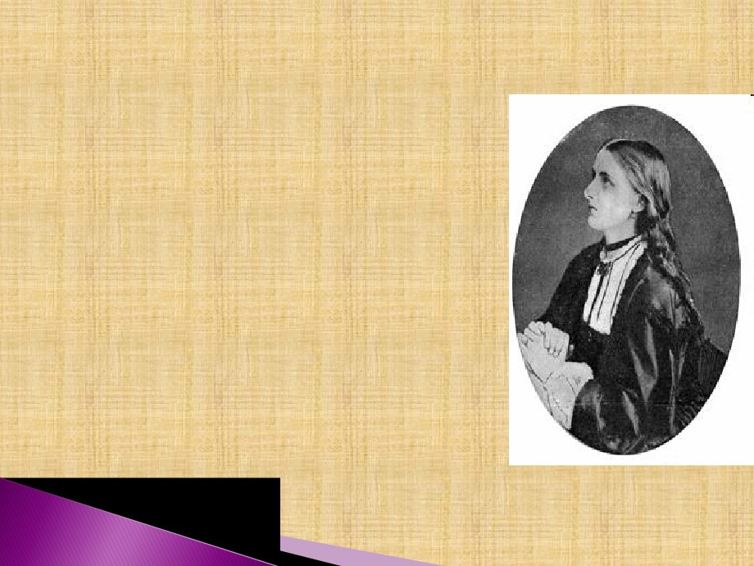
 1847 First child born under
anesthesia.
 James Young Simpson discovered
the anesthetic effects of chloroform
(by accident when he and his
assistants were experimenting with
chemicals and somebody upset a
bottle. When Simpson's wife
brought in dinner she found them all
asleep).
 Florence Nightingale in
1862
,
organised a small training school in
connections with the King’s College
Hospital, where she conducted the
training for midwives.

Slide 21
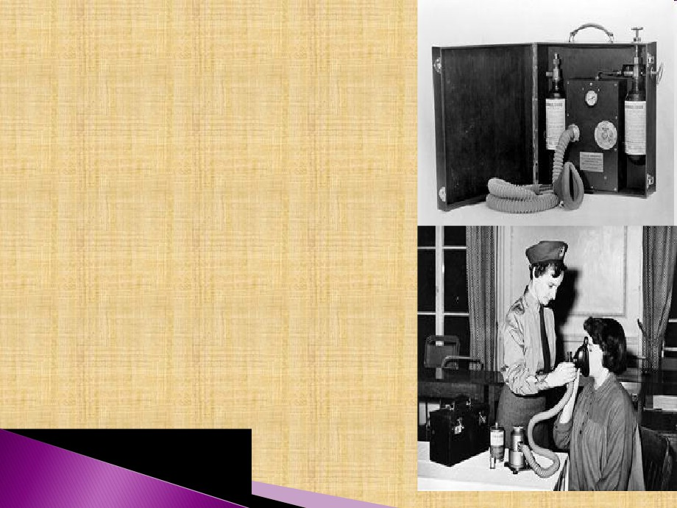
 1933 Robert James Minnit invents
gas and air apparatus for the relief
of labor pains.

The gas and air machines used by
midwives were portable and easy to
use. This photograph, showing a
midwife applying the mask, was
produced for promotional purposes
by the British Oxygen Company
who supplied the gases used with
the machines. Machines donated by
the National Birthday Fund carried
plaques indicating their provenance.

Slide 22


childbirth included education, correct breathing,
relaxation and exercises' which would help a
healthy woman achieve a natural birth'. In fact, the
techniques were based on his investigations of
childbirth practices amongst non-westernised
African communities.

Slide 23
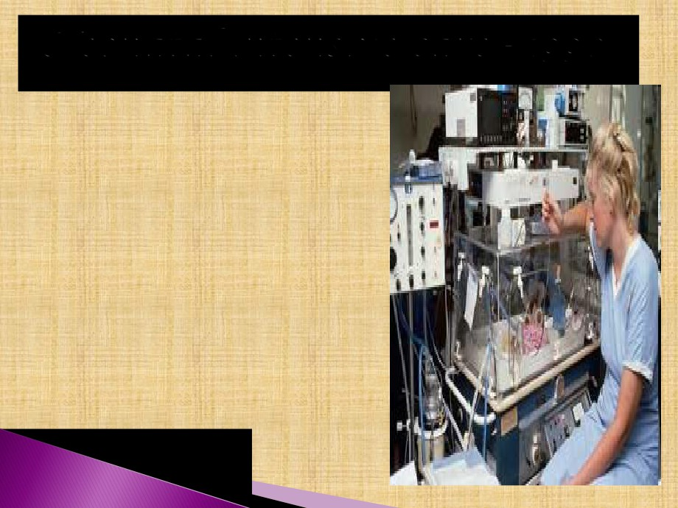
 By the 1990s, a child born at
22-23 weeks gestation(the
normal period is 40 weeks)
had about a 24% chance of
survival whilst one born at
25 weeks had a 50% chance.
Most infants born after 32
weeks
survived.
The
viability of fetuses at such
early stages of development
raised issues surrounding
the 1967 Abortion Act
which made termination of
pregnancy legal until28
weeks. Various campaigns
were mounted to limit the
time to 20 weeks.

Slide 24
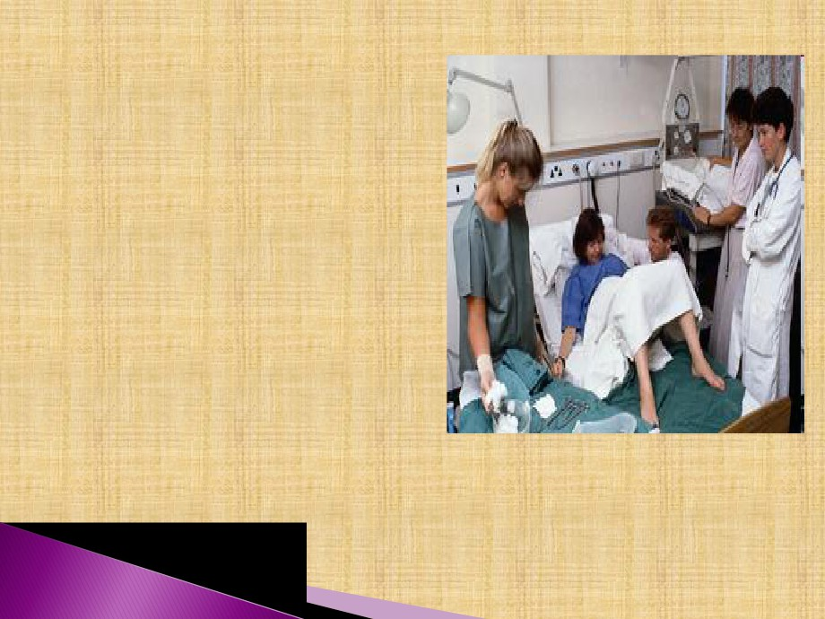

In this hospital labour
ward of the 1990s, the
mother is attended by a
midwife and doctor. The
father-to-be, no longer
forced to pace the floor
outside the delivery
room, is encouraged to
participate in the birth.

Slide 25

 In this colour-enhanced
scanning electron micrograph
(SEM), a human sperm
attempts to fertilise an egg.
Once the sperm has fused to
the egg cell membrane, the
zona reaction' takes place
which prevents other sperm
from entering the egg.

Slide 26


8-celled human embryos.
 Light microscope image of two8-celled
human embryos ready to be implanted
into their
mother's womb. Pre-
implantation embryos withstand freezing
for long periods of time allowing them to
be implanted at intervals coinciding with
normal
birth
spacing.

Slide 27
History of Midwifery

The history of midwifery is a long and interesting one.
Women of all countries have done noble work as midwives throughout
the countries.


Socrates mother was a midwife and he considered it “a most respected
profession”.

According to Aristotle, a midwife is a most necessary and honorable
office, being a helper of nature.

Midwife carries a huge responsibility in helping women during childbirth.

Biblical references to midwives have always been to their honor. There
are instances in the Old Testament to show that midwives play vital role.
Until the end of the sixteenth century, midwifery was practiced entirely
by women. Men could be severely punished for attending women in

childbirth.

In the seventeenth century male midwives began to take up midwifery.
By the middle of the eighteenth century the number of male midwives
had increased, though there was great opposition and competition from

the midwives and from the general public.

In English the word midwife means “With woman” (the person with the
woman who is in labor).

Midwives hold an important key to positive care at the time of childbirth
that will contribute to a good

