Slide 1
Lymphatic system

Slide 2
Introduction
The cells of body are bathed in interstitial fluid which leaks constantly out of the blood stream through the permeable walls of the blood capillaries.
Some tissue fluid returns to the capillaries at their venous end and the reminder diffuse through the more permeable walls of lymph capillaries, forming lymph.
Lymph passes through vessels of increasing size and a varying number of lymph nodes before returning to the blood.

Slide 3
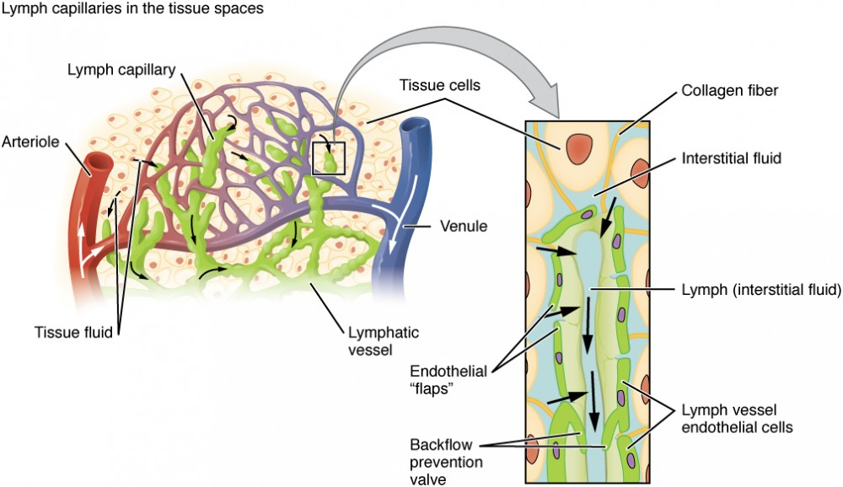

Slide 4
The lymphatic system consist of :
Lymph
Lymph vessels
Lymph nodes
Lymph organ, like spleen and thymus
Diffuse lymphoid tissue like tonsils
Bone marrow

Slide 5
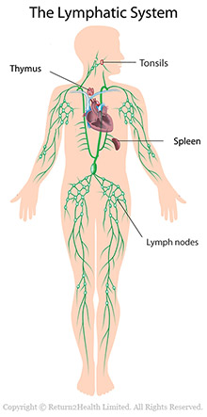

Slide 6
Function of lymphatic system:
1. Tissue drainage:
The interstitial fluid which leaks constantly out of the blood stream through the permeable walls of blood capillaries this will helps the tissue to drain waste products aorta to prevent tissues from water logging.
2. Absorption in the small intestine:
Fat & fat soluble materials are absorbed into lymph.
3. Immunity:
The lymphatic organs are concerned with the production and maturation of lymphocytes, the white blood cells responsible for immunity.

Slide 7
Lymph:
Lymph is clear fluid, watery fluid similar to plasma.
Lymph transports plasma proteins that coming out of the capillary beds back to the blood stream.
Lymph also carries, bacteria, cell debris from damaged tissues.
Lymph contains lymphocytes , which circulate in the lymphatic system.

Slide 8
Lymph capillaries:
Lymph capillaries are originates as blind end tubes in the interstitial spaces.
They have same structure as blood capillaries.
The tiny capillaries join up to form larger lymph vessels.

Slide 9
Lymph vessels:
Lymph vessels are often found running along side the arteries and veins.
Like vein, lymph vessels are having valves to prevent back flow of lymph.
Lymph vessels become larger as they join together eventually forming two large ducts.
1. the thoracic duct
2 .the right lymphatic duct
Both will empties into subclavian veins.

Slide 10
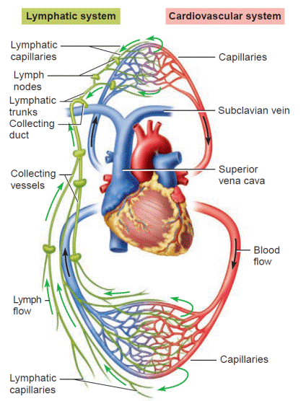

Slide 11
1. thoracic duct:
This duct begins at the cisterna chyli , which is dilated lymph vessel situated in front of the bodies of the two lumber vertebra.
Length: 40 cm long
And opens into left subclavian vein.
It drains from :
Both legs
Pelvic cavity
Abdominal cavity
Left half of thorax
Neck & left arm

Slide 12
2. right lymphatic duct:
This is dilated lymph vessel about 1 cm long.
It lies in the root of the neck & opens into the right subclavian veins.
It drains from:
Right half of the thorax
Head & neck
Right arm

Slide 13
Lymph node:
Lymph nodes are oval or bean shaped organs that lie, often in group, along the length of lymph vessels.
The lymph drains through the number of the nodes usually 8-10 before returning to venous circulation.

Slide 14
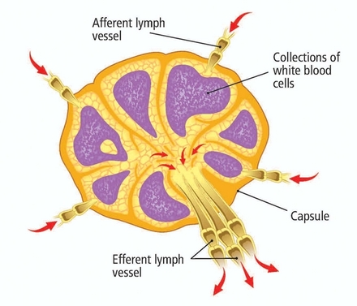

Slide 15
Structure:
Lymph nodes have outer fibrous capsule which dips down into the node substance forming partitions or tubercle.
There will be lymphatic tissue & reticular tissue containing many macrophages & lymphocytes.
A. Afferent lymph vessels: these are 4 or 5 lymph vessels which enters into the lymph node.
B. Efferent lymph vessels: these are single lymph vessel which leaves from the lymph node.

Slide 16
Location:
1. lymph from head, neck passes into cervical nodes.
2. lymph from upper limb passes into axillary nodes.
3. lymph from organs in thoracic cavity drains through group of nodes situated close to mediastinum, airways, oesophagus.
4. lymph from pelvic & abdominal cavities passes into cisterna chyli.
5. The lymph from the lower limbs drains through inguinal lymph nodes.

Slide 17
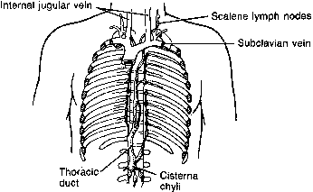

Slide 18
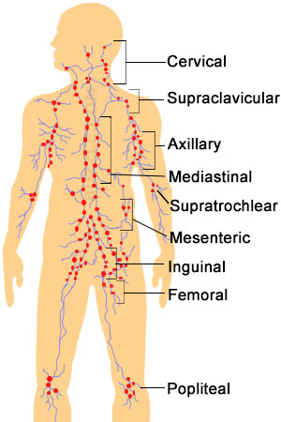

Slide 19
Functions of lymph:
1. filtering & phagocytosis:
Lymph is filtered by reticular tissue as it passes through lymph nodes.
Matters like microbes, dead and live phagocytes containing ingested microorganism worn out & damaged tissue cells will be filtered.
2. proliferation of lymphocytes:
Activated T & B lymphocytes multiply in lymph nodes.

Slide 20
Lymphoid organs: SPLEEN
Introduction:
The spleen is lymphoid organ formed by reticular & lymphatic tissue & it is the largest lymph node.
Location: left hypochondriac region of abdominal cavity between the fundus of the stomach & the diaphragm.
Size: 12cm long
7 cm wide
25 cm thick
200 gm weight

Slide 21
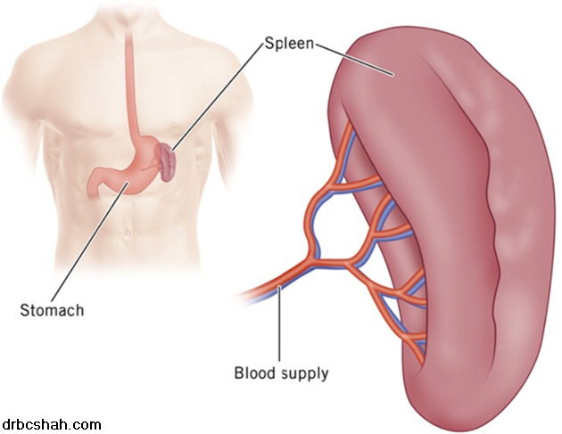

Slide 22
Structure of spleen
Slightly oval in shape, with hilum on the lower medial border.
It is enclosed by fibroblastic capsule.
Splenic pulp: it is the cellular material consist of lymphocytes & macrophages.
There will be :
Red pulp: consist of blood
White pulp: consist of lymphocytes

Slide 23
Hilum is the area where organs are entering & leaving into the spleen.
Those are
Splenic artery
Splenic vein
Lymph vessels
nerves

Slide 24
Function of spleen:
1. phagocytosis: engulfing of microbes
2. Storage of blood: it contains up to 350 ml of blood.
3. Immune response: spleen contains T & B lymphocytes for immunity response.
4. erythropoiesis

Slide 25
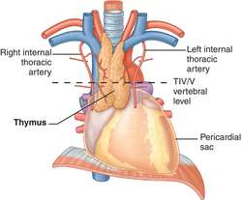
Thymus gland

Slide 26
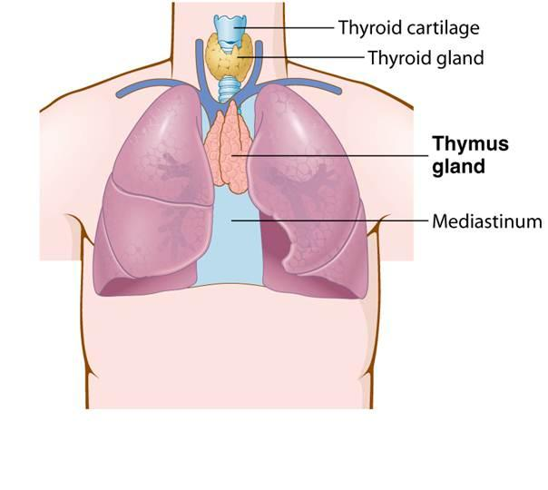

Slide 27
Location: upper part of the mediastinum behind the sternum & extends up to the root of the neck.
Weight: 10-15 gm at birth, after puberty it begins to atrophy.
Organs associated:
Anteriorly: sternum
Posteriorly: aortic arch & branches
Laterally: lungs
Superiorly: structure in the root of the neck

Slide 28
Structure:
It consist of two lobes joined by alveolar tissue.
Each lobes are enclosed by the fibrous capsule, which dips into their subcutaneous & dividing into lobes that consists of epithelial cells & lymphocytes.
Functions:
Development of Lymphocytes
Production of hormone thymosin.

Slide 29
Mucosa Associated lymphoid tissue( MALT)
MALT is present through out GI tract , respiratory tract, GI tract, where mucosal tissue are present.
The main group of MALT are:
Tonsils: these are located in the mouth & throat & therefore destroy swallowed and inhaled antigens.
Peyer’s patches: these are large collections of lymphoid tissue are found in small intestine.

Slide 30
Immunity:
Definition : it is the state of having sufficient biological defence to avoid infection disease or other unwanted biological invasion.
Immunity possess two key attributes not seen with non specific defence specificity & memory:
Two types of immunity:
1. active immunity
2. passive immunity

Slide 31
1. Active immunity
This is a kind of immunity which is obtained by body by birth itself.
It is of two types.
A. active natural acquired immunity
B. active artificial acquired immunity

Slide 32
T -lymphocytes:
These are processed by thymus gland , which lies between the heart & the sternum.
The hormone thymosine is responsible for promoting formation of fully specialised , mature functional T lymphocytes.
It will provide cell mediated immunity.

Slide 33
Cell mediated immunity:
When body is exposed to antigen the macrophages will engulf & digest antigens.
Macrophages will show antigens on their cell membrane & stimulate t cell.
Activation of T cell
Production & multiplication of T lymphocytes
Production of 4 main types of T lymphocytes
A. suppressor –T lymphocytes: turn off immune response
b. helper t lymphocytes: release cytokines to support t lymphocytes
C. memory t lymphocytes: long lived & provide immunity to antigen
D. cytotoxic T lymphocytes: destroy antigen

Slide 34
B- LYMPHOCTYES
This is produced in bone marrow . It will produced antibodies( immunoglobulin)
It will provide antibodies mediated immunity.

Slide 35
Antibody mediated immunity
On exposure to antigenic determinants in lymphatic organs , B lymphocytes are activated and differentiated from plasma.
Plasma cells are specialized differentiated cells that synthesize and secret antibodies specific for an antigen.

