Slide 1
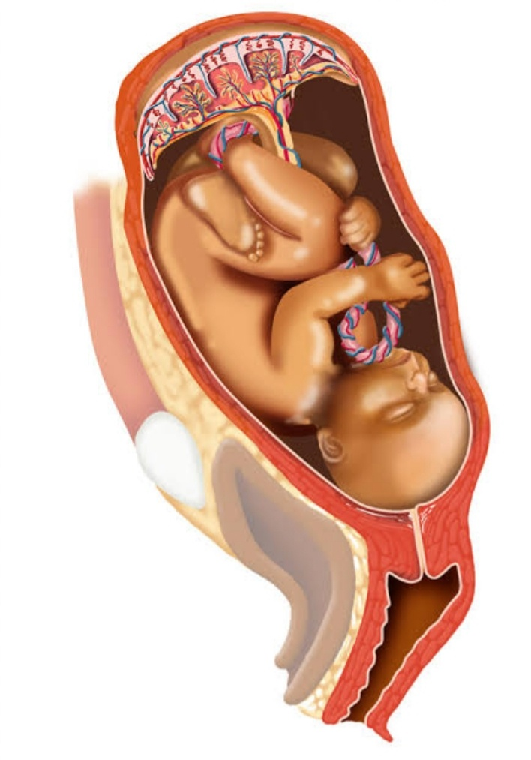
PLACENTA

Slide 2
The placenta is partly fetal and partly maternal in origin.
It connects closely with the mother circulation to carry out function which the fetus is unable to perform for itself during intrauterine life.
The survival of the fetus depends on the integrity and efficiency of the placenta.

Slide 3
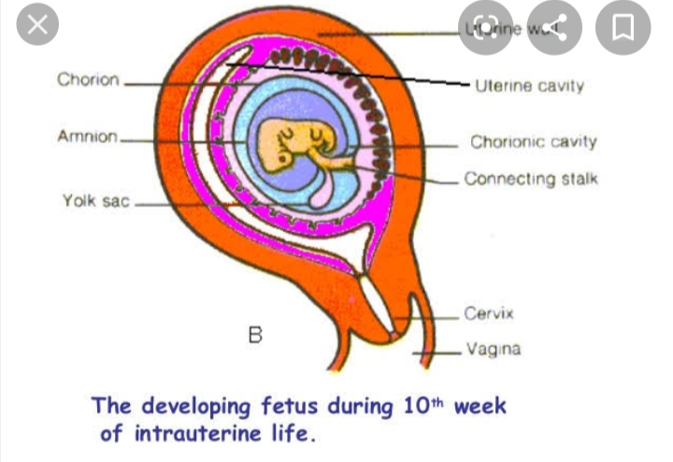
DEVLOPMENT OF PLACENTA

Slide 4
THE PLACENTA DEVLOPMENT
The small projections that appear on the trophoblastic layer of the blastocytes proliferates and branch from about 3 weeks after fertilization, forming the chorionic villi.
The villi become most profuse in the area where the blood supply is richest,i.e. in the basal decidua.
This part of the trophoblast is know as the chorion frodosum.

Slide 5
It villi eventually devlop into the placenta.
The villi under the capsular decidua get less nourishment and gradually atrophy and form the chorion leave or bald chorion, which is the origin of the chorionic membrane.
The villi erode the wall of maternal blood vessals as they penetrate the decidua, opening them up to form a lake of maternal blood in which they float.

Slide 6
Placenta circulation are establishing by 17th day.
Each chorionic viilus is a branching structure.
Its center consist of mesoderm and branches of umbilical vein and artery.
Four layers of tissue separates the maternal blood from the fetus blood making it impossible for the two circulation (maternal and fetus) it mix unless the villi are damaged.

Slide 7
The placenta are fully developed and functioning from the 10th week after gestation.
In its early stages, it is a relatively loose structure, but become more compact as it matures.
Between the 12 and 20 week of gestation the placenta weight more than the fetus.
At this stage the fetus organs are insufficiently developed to cope with the metabolic processes of nutrition.

Slide 8
Later in pregnancy as the fetus mature some of the fetal organs, such as the liver, begin to function resulting in easier exchanging of oxygen and carbon dioxide.
Each main stem viilus and its branches form a cotyledon.
The total number of cotyledons remains constant, but the individual cotyledones continue to grow untile term.

Slide 9
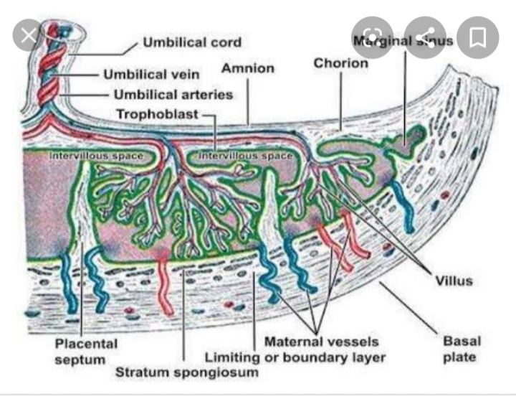
CONT……

Slide 10
CIRCULATION THROUGH THE PLACENTA
Foetal blood that is low in oxygen is pumped by the foetal heart towards the placenta along their branches to the capillaries of the villi.
The blood returns to the fetus via umbelical vein after giving up carbon dioxide and absorbing oxygen.
Maternal blood is delivered to the placental bed in the decidua by the spiral artery that flow into the blood spaces surrounding the villi.
The blood enters the sinuses in a funnel shaped stream similar to a fountain and it passes upwards, bathes the villus and drains back into a branch of uterine vein.

Slide 11
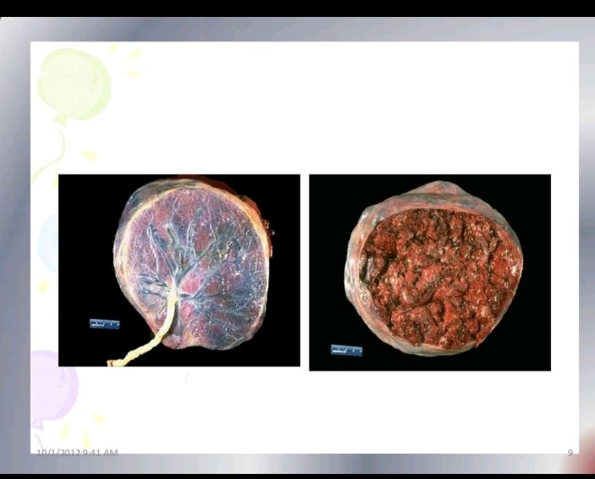
PLACENTAS

Slide 12
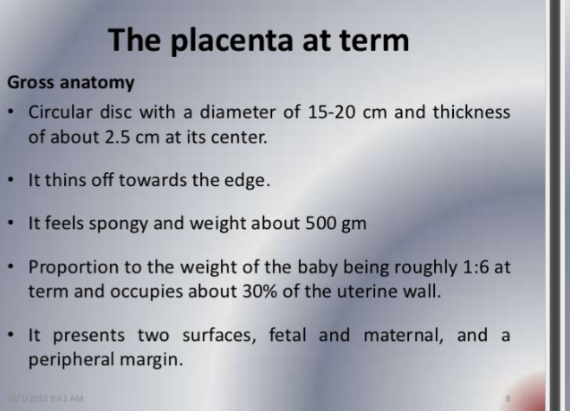

Slide 13
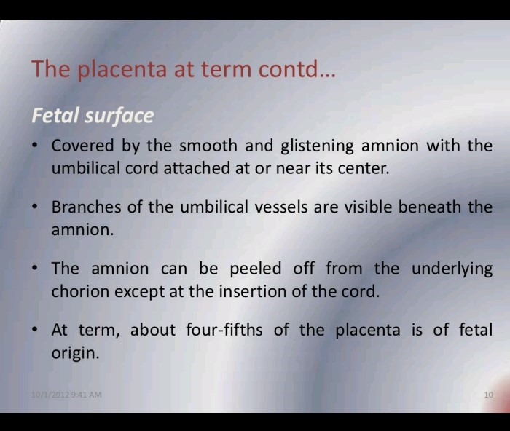

Slide 14
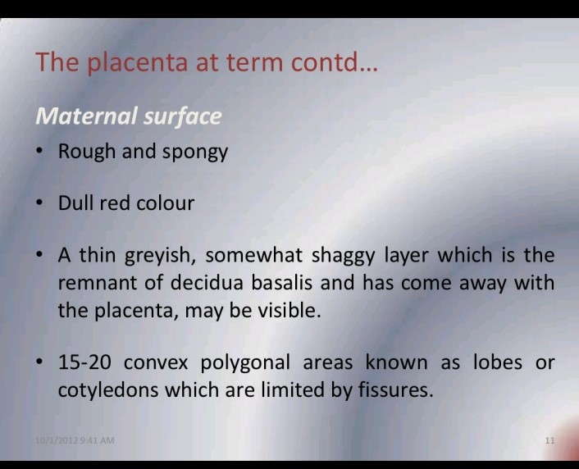

Slide 15
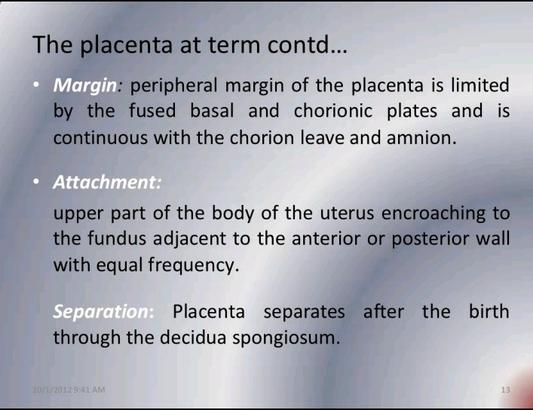

Slide 16
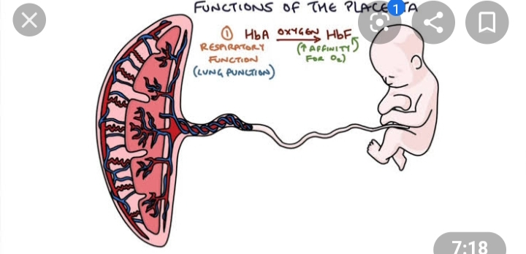
FUNCTION OF PLACENTA

Slide 17
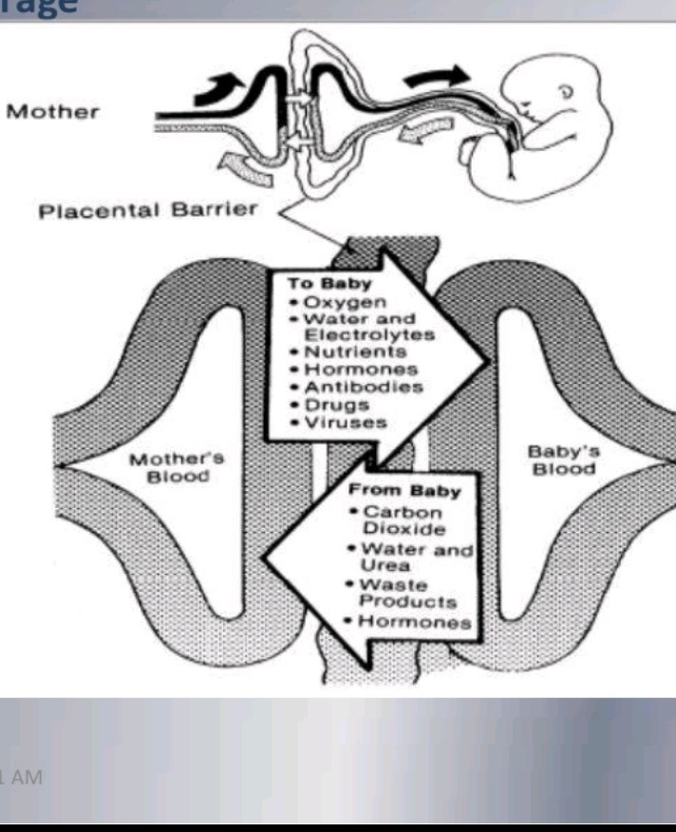

Slide 18
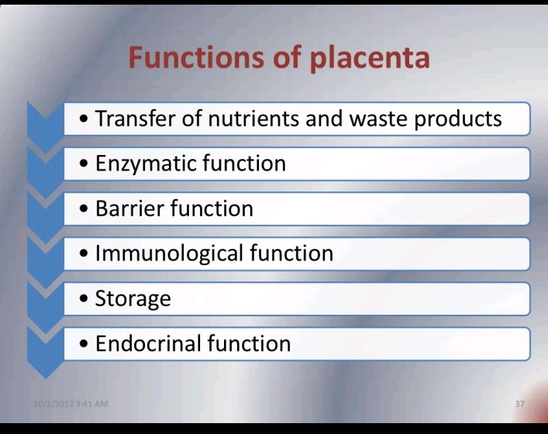

Slide 19
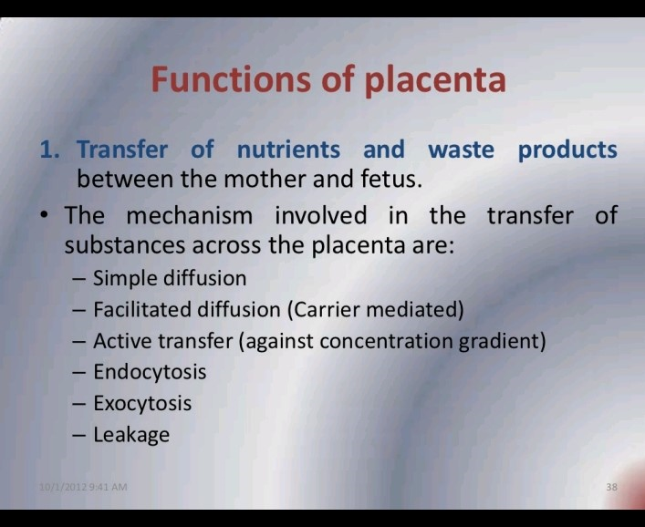

Slide 20
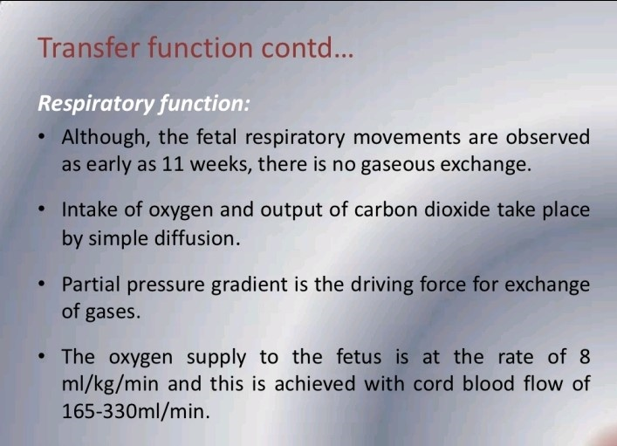

Slide 21
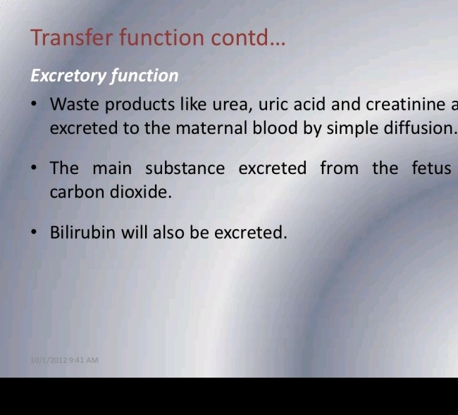

Slide 22
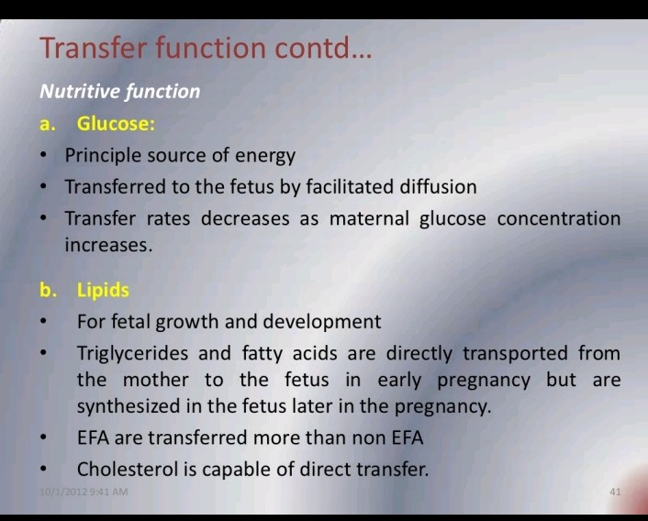

Slide 23
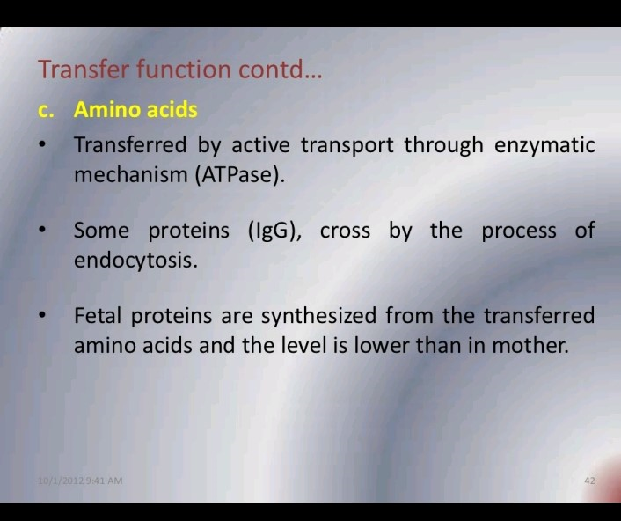

Slide 24
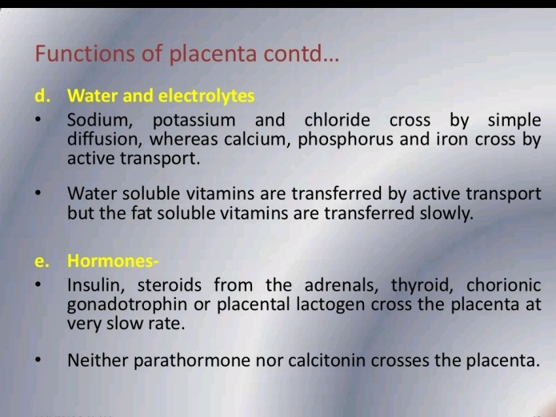

Slide 25
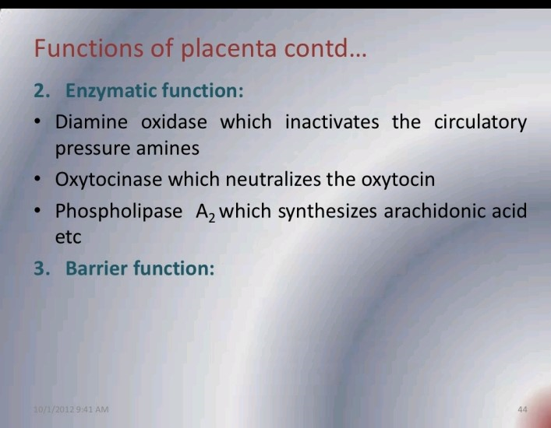

Slide 26
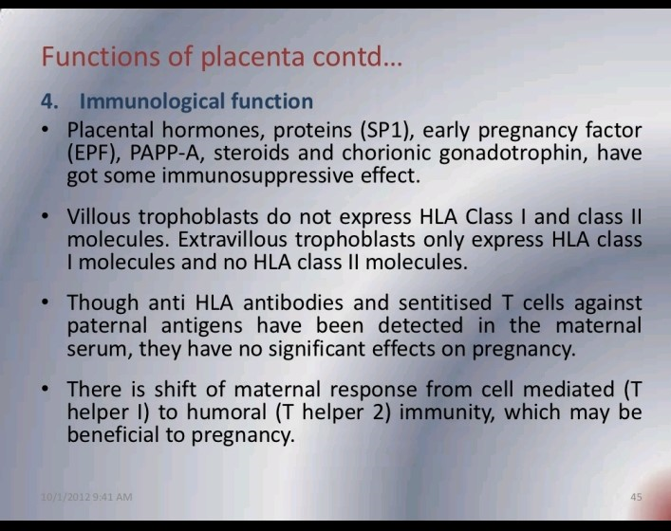

Slide 27
STORAGE FUNCTION
During early pregnancy the placenta synthesizes glycogen, cholesterol and fatty acid ,which serve as a source of nutrients and early embryo and fetus.
Placenta store glucose in the form of glycogen, and reconverts it into glucose, when required .
Iron and vitamins can also stored in the placenta.

Slide 28
ENDOCRINE FUNCTION
THE HORMONAL FUNCTION OF PLACENTA IS LIST BELOW
Human chorionic gonadotropin (HCG)
Estrogen and progesterone
Human placental lactose (HPL) or human chorionic somatomammotropin
Human chorionic thyrotrophic
Insulin like growth factor
relaxing
HCG: synthesis of HCG begging before implantation, and is responsible for maintaining corpus luteum that secretes progesterone and estrogens.
The trophoblastic layer of the chorionic villi produced this hormone.
HCG is basic for early pregnancy test.

Slide 29
2) Estrogen and progesterone:
the placenta can produce progesterone and estrogen.
These hormone are synthesized by trophoblast.
3) Human placental lactogen:
This hormone is similar to growth hormone and influence growth.
4)Human chorionic thyrotrophin:
Small amount produced, functions similar to pituitary hormone.
5) relaxin: produce by decidua cell, softens the cervix and pelvis ligament in preparation for child birth.

Slide 30
VARIATION,ANOMALIES AND ABNORMALITIES OF PLACENTA
Larger and heavier than normal placenta are seen with excessively large fetuses, fetal symphisis.
Smaller and lighter than normal placenta may occur with general systemic diseases or local uterine condition which causes undernourishment of the placenta and resulting intrauterine growth retardation.
Color of placenta tissue markedly lighter: this condition cause may be caused by fetal anemia.
Edema of placenta: edematous placenta is mushy, thick and pale, and fluid can be also form. This may be caused severe maternal fetus diseases, diabetes or nephritic syndrome. The fetus usually die in uterine life.

Slide 31
5.) excessive infarct formation.
Infarction of cotyledone happen due to disease processes, such as sever maternal hypertension, sever preeclampsia or eclempcia.
Which may be result intrauterine growth retardation and may be in fetal death.
6.) Tumors are found in association with prematurity and polyhydroamnions.
perinatal mortality and hemorrhage both are increased

Slide 32
7.) syphilitic placenta:
It is abnormally large , large ,pale yellow placenta.

Slide 33
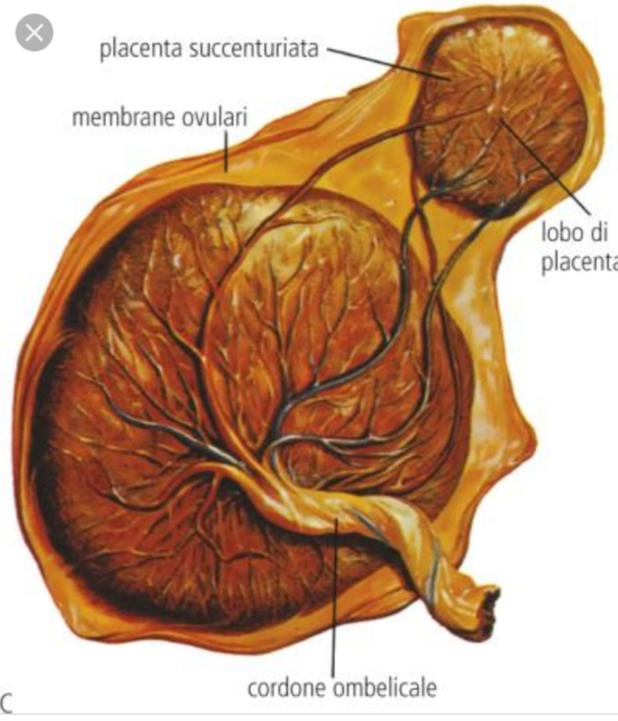
8) Succenturiate or succenturita placenta:.
One or more separate accessory lobe in the membranes, a variable distance away from the main placental mass..
These accessory lobe are usually connected to the main placental mass

Slide 34
the primary significance of this placenta anomalies in the possibility that the will be retained in the uterus after expulsion of the main placental mass.
This lobe may cause sever postpartum hemorrhage.
This condition can be detected during inspection of the placenta.

Slide 35
9) extrachorial placenta:
A placental anomalies can be observe on the fetal surface, as a thick white ring, which give the impression that the central portion is somewhat depressed.
There are two varieties, which are determined by the location of ring.
Both may be complete or incomplete as detected by ring.
Placenta circumvallates or circumvallates.
The ring situation of the variable distance between the margin and center of the placenta.

Slide 36
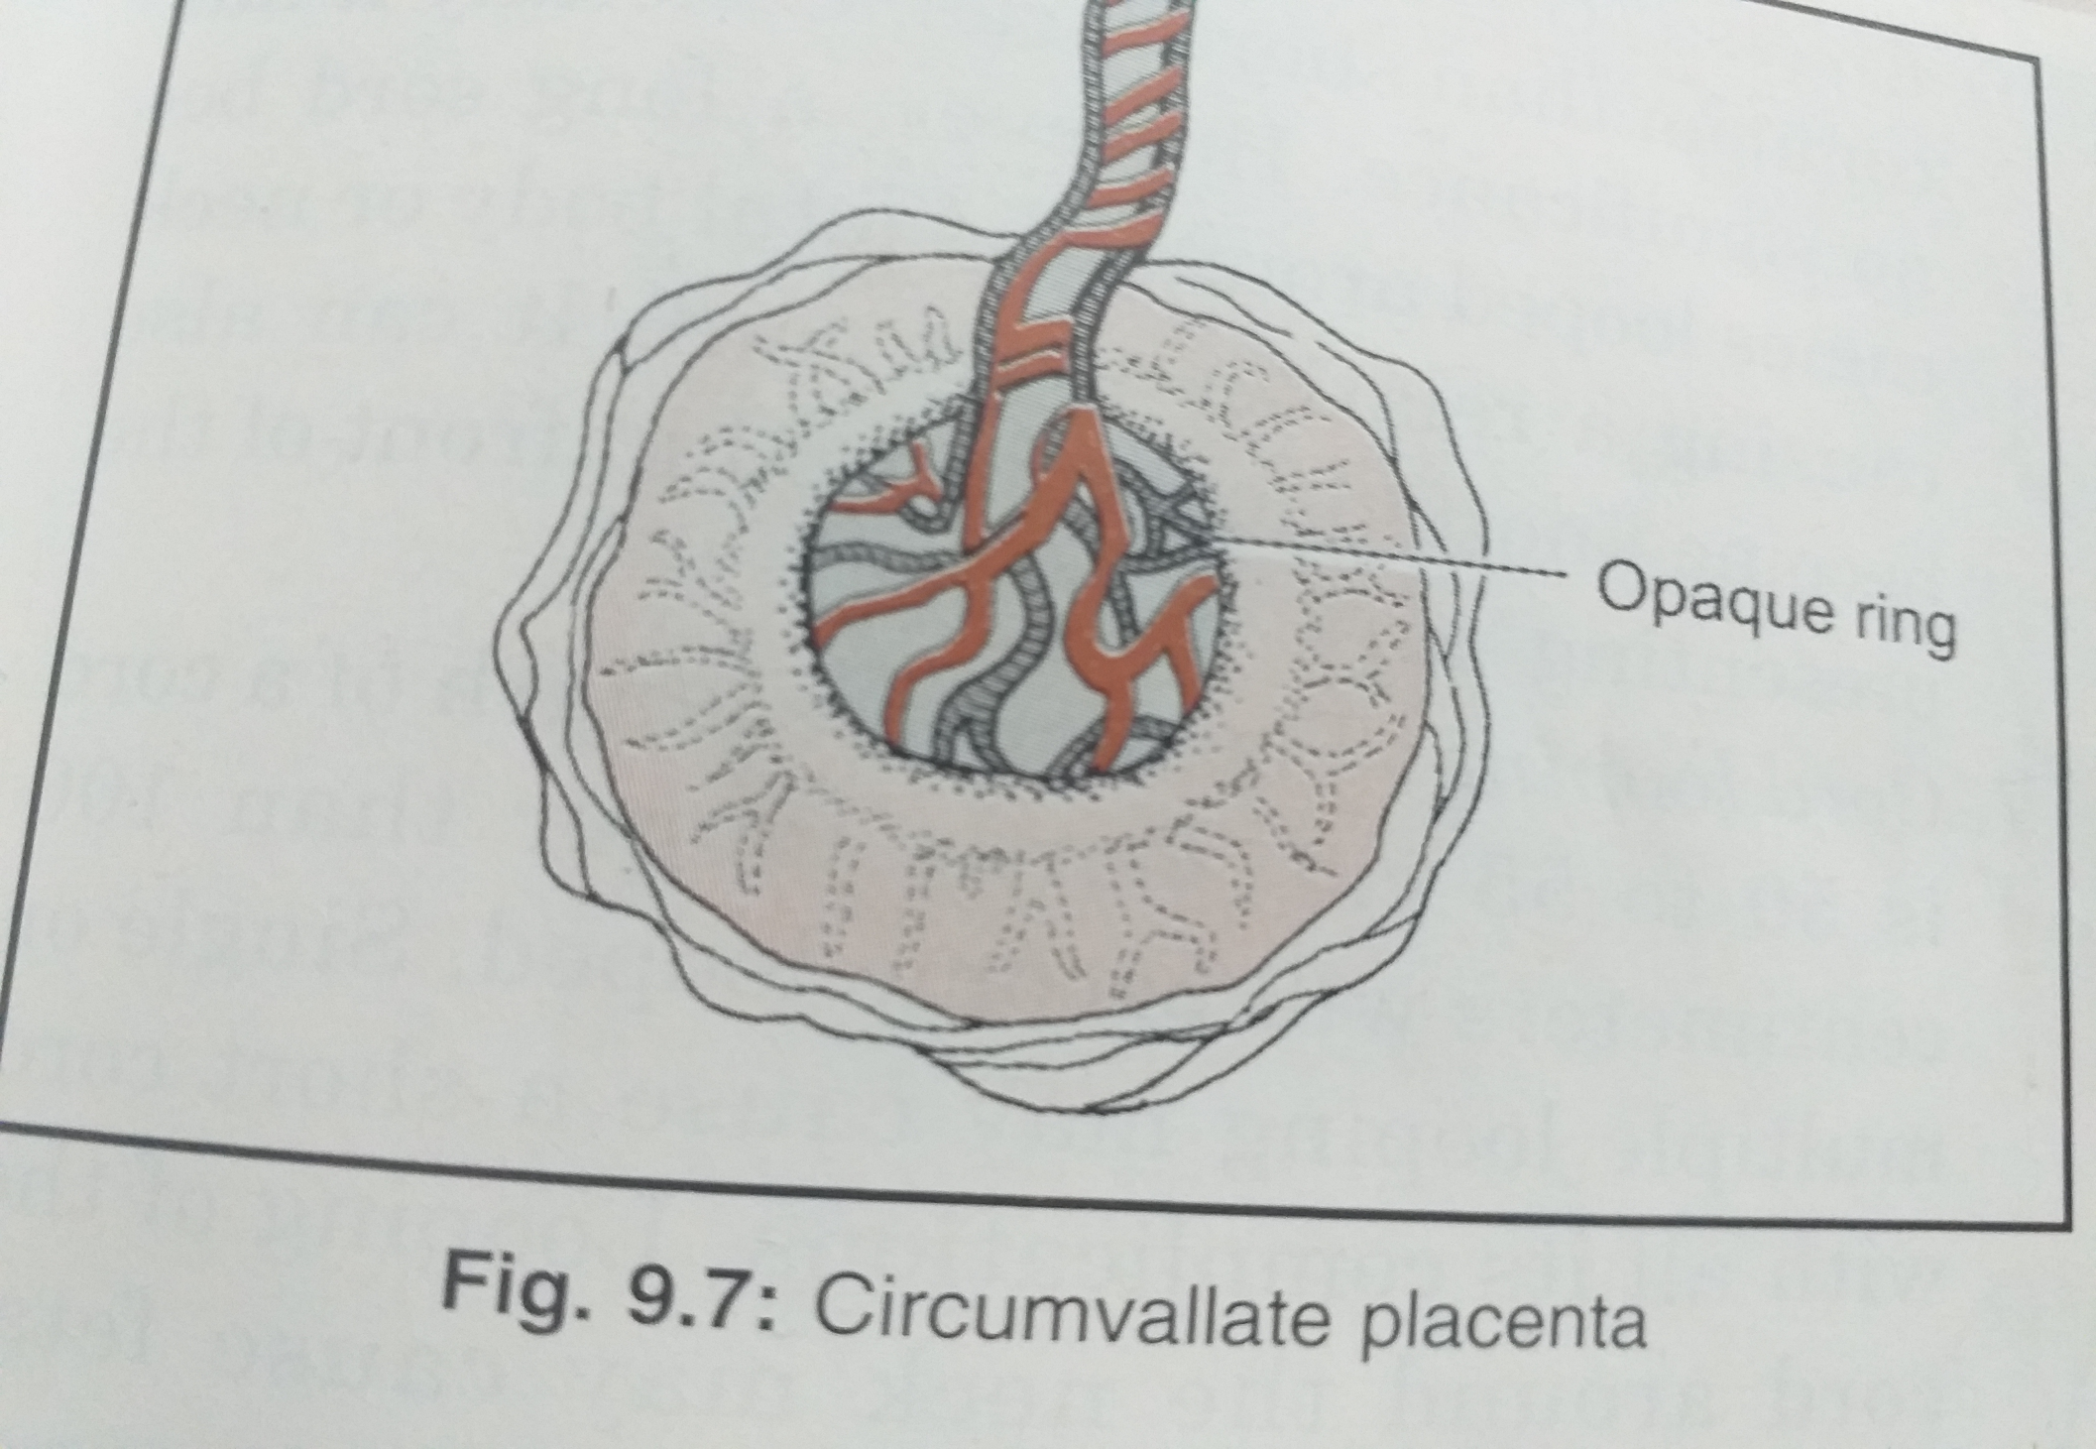

Slide 37
B) Placenta marginta.
The ring is located at the edge or margin of the placenta

Slide 38
10. Lobulated placenta:
There appearances be multiple placenta for a singal baby.
In fact it is divided into two or more part.

Slide 39
